Slide 1
Berkshire Heatwave and Summer preparedness during COVID-19
Actions to prevent harm
For local authorities and partners
June 2020
Content from the Heatwave Plan for England resources: https://www.gov.uk/government/publications/heatwave-plan-for-england

Slide 2
Contents
Key contacts for advice
Heatwave Plan for England
Why is heatwave planning important?
Heat-Health Watch alert service
Heat and COVID-19
Action tables from Heatwave Plan for England
Key public health messages
Links to guidance and resources

Slide 3
Key contacts for advice
Organisation | Email address
Bracknell Forest Council Public Health | Katherine.Davies@bracknell-forest.gov.uk Cynthia.Folarin@bracknell-forest.gov.uk
Royal Borough of Windsor and Maidenhead Council Public Health | holli.dalgliesh@rbwm.gov.uk
Slough Borough Council Public Health | timothy.howells@slough.gov.uk
Reading Borough Council Public Health | Yasmine.illsley@reading.gov.uk
West Berkshire Council Public Health | catherine.greaves@westberks.gov.uk april.peberdy@westberks.gov.uk
Wokingham Borough Council Public Health | mustafa.kamara@wokingham.gov.uk
Shared Public Health Team for Berkshire | Jonas.Thompson-McCormick@bracknell-forest.gov.uk Chris.Barrett@bracknell-forest.gov.uk

Slide 4
Heatwave Plan for England
The Heatwave Plan for England becomes operational between 1st June and 15th September to raise both public and professional awareness of the health impacts of hot weather, including severe heat.
The Heatwave Plan for England provides guidance to NHS, social care and local authorities on how to prepare for and respond to a heatwave which can affect everybody’s health, but particularly the most vulnerable people in society.

Slide 5
Why is heatwave planning important?
There are around 2,000 heat-related deaths per year in the UK
Death rates rise soon after temperature increases, with many deaths occurring in the first two days
The impact of heat on mortality is not reflected in admissions, supporting the idea that many heat-related deaths occur before people come to medical attention
This emphasises the importance of long-term year round planning actions by LA and Health sector
1 in 5 homes in England are prone to overheating; few (~ 1-3%) have air conditioning
A range of mild to severe health impacts can result from exposure to high temperatures
The main causes of illness and death during a heatwave are exacerbation of respiratory and cardiovascular illness

Slide 7
Heat-Health Watch alert service
Heat-Health Watch alerts are cascaded to a wide range of partners. There are five levels:
The triggering threshold temperatures for South East England are 31⁰C by day and 16⁰C by night.
The distribution list for the Heat-Health Watch alerts is managed by the Met Office. For new registrations contact enquiries@metoffice.gov.uk Existing users need not re-register.
Level 0 | Long-term planning All year
Level 1 | Heatwave and Summer Preparedness programme - 1st June – 15th September
Level 2 | Heatwave is forecast – Alert and readiness 60% risk of heatwave in the next 2–3 days
Level 3 | Heatwave Action - Temperature reached in one or more Met Office National Severe Weather Warning Service regions
Level 4 | Major incident – Emergency response Central Government will declare a Level 4 alert in the event of severe or prolonged heatwave affecting sectors other than health

Slide 8
Heat and COVID-19

Slide 9
Headlines
COVID-19 amplifies the risks of hot weather
Fear of COVID-19 should not prevent action to tackle the risks from hot weather and heatwaves
It is critical that actions to prevent health harms from high temperatures continue, with necessary adaptations in line with coronavirus guidance to keep everyone safe (i.e. shielding and self-isolation advice)
Fans:
  In home: do not use a fan if anyone in the home is unwell with symptoms of coronavirus (COVID-19)
  Care homes: fans should only be used in single rooms for residents who do not have COVID-19 and have not been a close contact of a confirmed case
Our care homes and domiciliary care are particularly stretched due to COVID-19, and workforce planning is essential in order to continue to protect those who are dependent on others during a potential heatwave.

Slide 10
Potential risks
Potential increase in adverse outcomes amongst the same population groups affected by both high temperatures and COVID-19. For example, older people and those with comorbidities such as cardio-respiratory diseases
Increase in exposure to indoor overheating due to COVID-19 restrictions. For example, people who have been advised to stay at home
Reduced access to cool public spaces for respite due to COVID-19 restrictions
System-level risks related to concurrency of impacts. For example, increased demand on social care services to prevent both heat and COVID19 related harms

Slide 11
Individual vulnerability (1)
EVERYBODY can be affected by high temperatures, but there are certain factors that increase an individual’s risk during a heatwave. These include:
Older age: especially those over 75 years old, or those living on their own and who are socially isolated, or those living in a care home
Chronic and severe illness: including heart or lung conditions, diabetes, renal insufficiency, Parkinson’s disease or severe mental illness
Inability to adapt behaviour to keep cool: babies and the very young, having a disability, being bed bound, consuming too much alcohol, having Alzheimer’s disease
Environmental factors and overexposure: living in a top floor flat, being homeless, activities or jobs that are in hot places or outdoors and include high levels of physical exertion
Other risk groups: older carers; tourists; people attending large events; people fasting over Ramadan
N.B. Although BAME people are not at increased risk per se, significant numbers of people from BAME communities live in urban areas and so may be adversely affected by the urban heat island effect

Slide 12
Individual vulnerability (2)
We still have much to learn about how coronavirus (COVID-19) affects the body, but both heat and COVID-19 infections put a strain on the heart and lungs, the kidneys and are linked with inflammation in the body.
Clinical vulnerabilities that have been linked with worse outcomes from COVID-19 that are also risks for heat related harms are:
• High blood pressure
• Chronic obstructive pulmonary disease
• Heart and lung conditions (cardiovascular disease)
• Conditions that affect the flow of blood in the brain (cerebrovascular disease)
• Kidney disease

Slide 13
Environmental risks
Environmental risk factors for increased exposure to heat include:
Living in urban areas
This is due to the urban heat island effect and is important for those with limited green space nearby
Dwelling types prone to overheating
Such as south-facing top-floor flats
Local air pollution (i.e. particulate matter) may exacerbate the health impacts of heat

Slide 14
Indoor overheating
Many more people will be at home this summer
To reduce the transmission of coronavirus (COVID-19) many people be will be working from home
Anyone with symptoms of COVID-19 will need to stay at home for at least 7 days, others may be advised to stay at home if they have been in close contact with someone who has COVID-19 or they are living in the same household as someone with COVID-19
People who are extremely clinically vulnerable have been advised to limit their contact with others and to stay at home to limit their risk
Latest Government advice can be found here: https://www.gov.uk/coronavirus

Slide 15
Higher risk groups
Specific populations at increased risk of exposure to heat due to the context in which they live include:
Homeless people (whether sleeping rough or in shelters)
People resident in specific institutional settings (e.g. prisons, barracks, inpatient psychiatric units)
Some occupations, workplaces and schools - particularly those involving significant manual exertional, heat generation (e.g. cooking, some manufacturing roles) and in buildings prone to overheating and without air conditioning.
Many of these settings have restrictions in place to reduce COVID-19 transmission – additional considerations will be needed to ensure that plans are in place should a heatwave occur

Slide 16
Action tables from Heatwave plan for England
Public Health England states the following action tables in the Heatwave Plan for England should continue to be followed with some additional considerations to mitigate and manage the concurrent COVID-19 risks

Slide 17
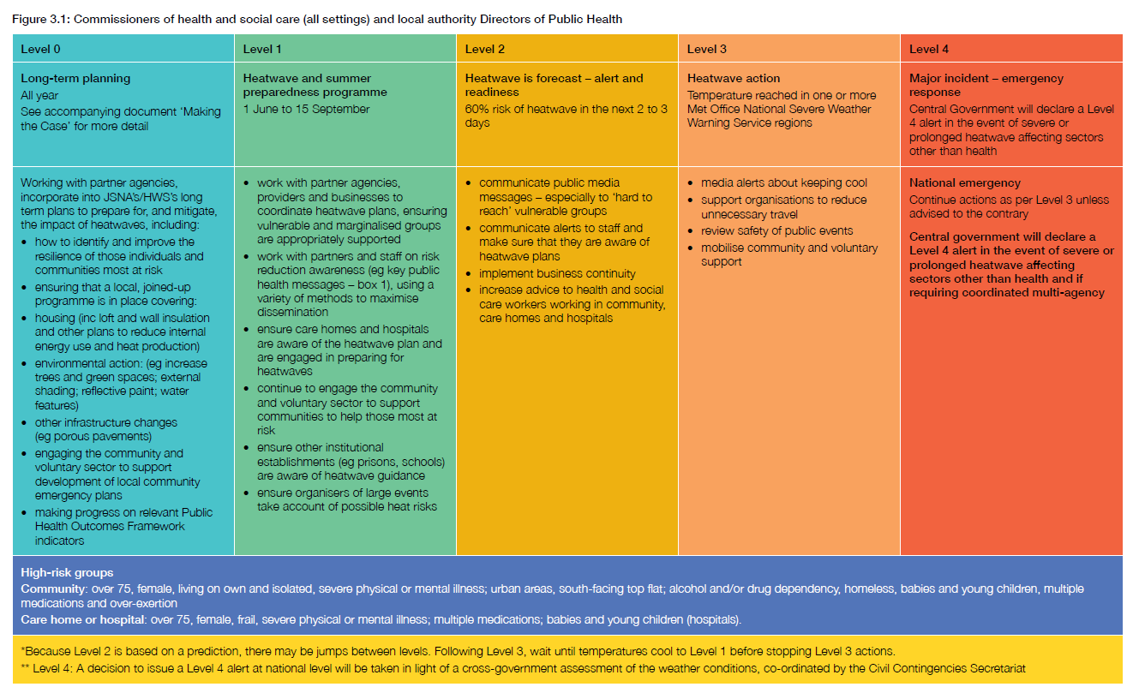
Action table for commissioners of health and social care (all settings) and Public Health

Slide 18
COVID-19: additional actions for commissioners of health and social care (all settings) and Public Health
Work with partner agencies, providers and businesses to raise awareness about the concurrent risk of hot weather and COVID-19
Encourage partners to sign up to the heat-health alert system
Ensure care homes and hospitals are aware of the heatwave plan and are preparing for heatwave as a concurrent risk with COVID-19
Engage the community and voluntary sector to support communities to help those most at risk, especially those who are socially isolated
Ensure other institutional establishments (i.e. prisons, schools) are aware of heatwave guidance
Work with local partners to facilitate equitable and flexible access to green public spaces during hot weather

Slide 19
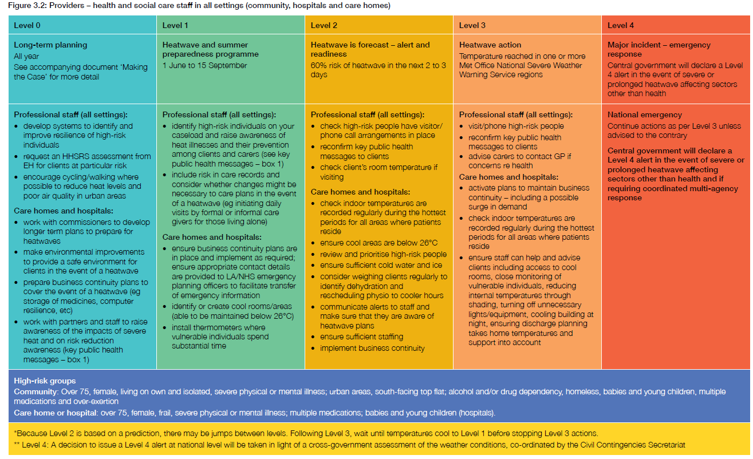
Action table for providers

Slide 20
COVID-19: additional actions for providers of health and social care staff in all settings (community, hospitals and care homes)
More residents of care homes and people receiving personal care than usual may be at risk from heat due to COVID ill-health and COVID restrictions. Review who may be at high risk
People receiving care may need additional support to cope with the hot weather. Review your usual plans for surge capacity in hot weather in light of possible COVID-19 related staff absence and to ensure staff welfare
Communicate alerts to staff and ensure they know what to do when the weather gets hot – use the PHE COVID-19 ‘Beat the Heat’ leaflet and checklist for Care Homes (page 2)
Care home managers may wish to remind staff that face masks should be changed when they get damp, staff may need to change their masks more often in hot weather
Fans should only be used in single rooms for residents who do not have COVID-19 and have not been a close contact of a confirmed case

Slide 21
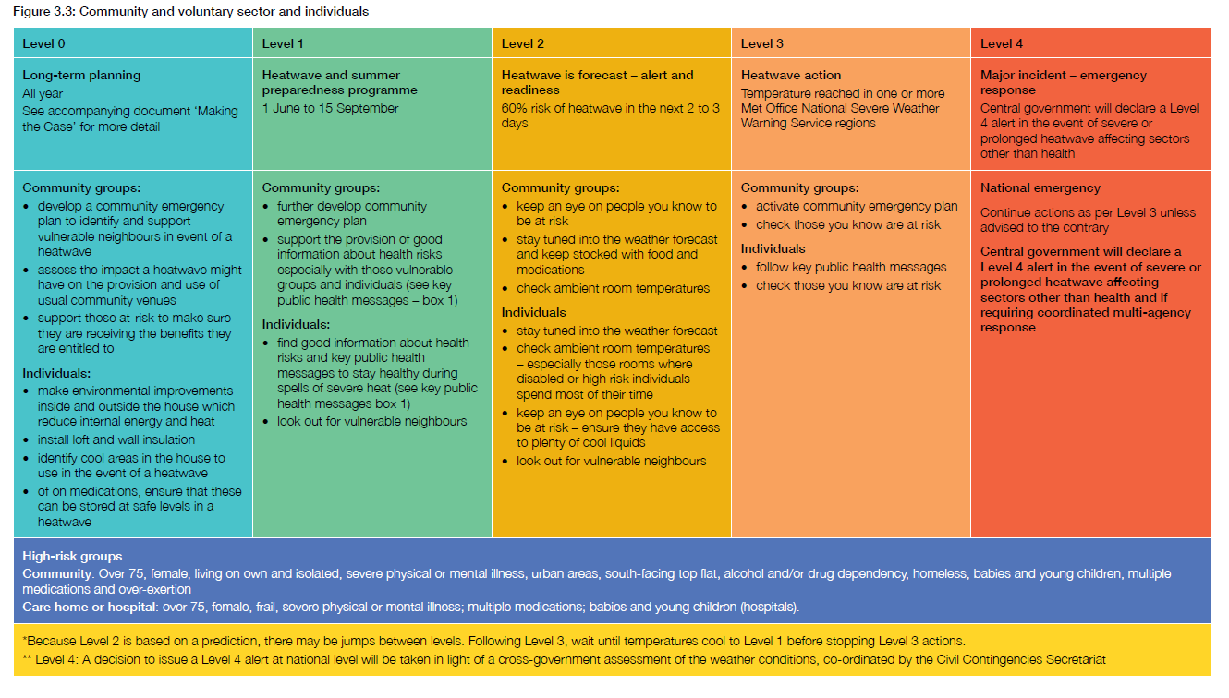
Action table for community and voluntary sector and individuals

Slide 22
COVID-19: additional actions for community and voluntary sector and individuals
Have plans in place to be able to check on others safely in advance of the hot weather (i.e. over the phone)
Follow the advice on the PHE resource ‘Coping with heat and COVID-19’
Encourage those who may find it more difficult to cope in hot weather to request help through the volunteer networks, for example, https://www.goodsamapp.org/home
Advise those at risk that they should continue to seek medical help if they are feeling unwell and that plans are in place to deliver services safely despite COVID-19

Slide 23
Key public health messages

Slide 24
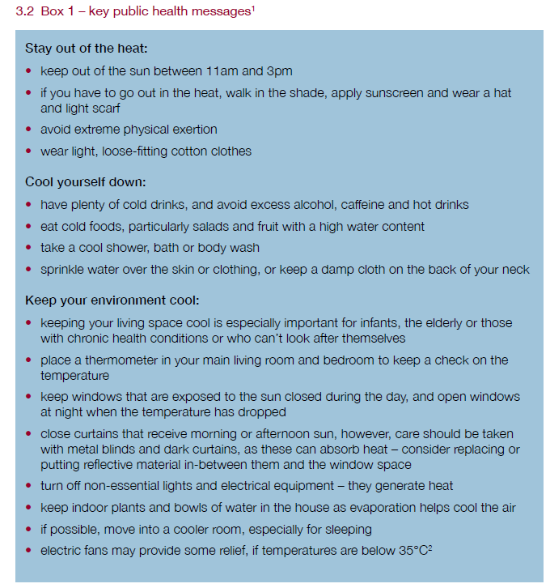

Slide 25
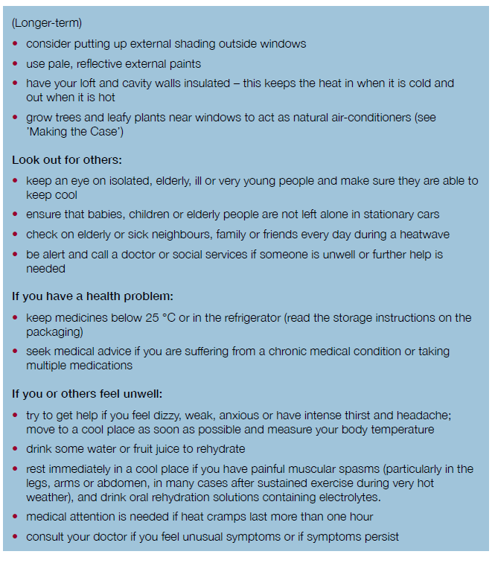

Slide 26
Guidance and resources
For everyone:
Beat the Heat: Coping with heat and COVID-19 (poster)
Beat the heat: Coping with heat and COVID-19 (leaflet)
Beat the heat: keep cool at home (checklist)
Heatwave Plan for England: easy read version
Specific advice and guidance on coronavirus (COVID-19)
For care homes and domiciliary care:
Beat the Heat Keep residents safe and well during COVID-19 – including a checklist for staff in on page 2
Advice for care home managers and staff: supporting vulnerable people before and during a heatwave

Slide 27
Guidance and resources
For health and social care professionals:
Advice for health and social care professionals: supporting vulnerable people before and during a heatwave
For schools, early years settings and professionals (school nurse, community health practitioner, family health visitor):
Looking after children and those in early years settings during heatwaves: guidance for teachers and professionals

Slide 28
NHS summer health advice
Heatwave: how to cope in hot weather
Hydration leaflet and poster
How to get vitamin D from sunlight
Sunscreen and sun safety
Stay gas safe this summer
Water safety for children and young people
Window safety for children

