Slide 1
Berkshire cold weather preparedness and response during COVID-19: actions to prevent harm
For local authorities and partners
November 2020
Content from the Cold weather plan for England and Health Matters resources: https://www.gov.uk/government/collections/cold-weather-plan-for-england https://www.gov.uk/government/publications/health-matters-cold-weather-and-covid-19/health-matters-cold-weather-and-covid-19

Slide 2
Summary of key headlines and actions
This short video from Public Health England provides an overview of cold weather and COVID-19

Slide 3
Key headlines (1)
COVID-19 amplifies the risks of cold weather
Fear of COVID-19 should not prevent action to tackle the risks from cold temperatures and winter weather
On average, there are approximately 35,000 excess winter deaths each year in England and Wales
Most of these deaths occur at what we would probably view as normal seasonal temperatures (4 to 8°C) rather than extremes
Lung and heart conditions are the primary causes of excess winter deaths
There is emerging evidence of poorer outcomes in those who are co-infected with COVID-19 and flu

Slide 4
Key headlines (2)
People are anxious regarding accessing healthcare. Confidence was found to be lower among people from BAME backgrounds, people living with a disability and older people. Older people may also not be able to connect with services or healthcare appointments online (effect of digital exclusion).
Increased numbers of people are spending more time at home than usual (more than 90% of our time being spent indoors), which may lead to:
  A higher demand for energy and an increase in associated costs of heating bills. This winter, new groups of people and households may also be drawn into fuel poverty for the first time and be unaware of the funds and resources available to help with keeping warm
  Increased transmission of viruses within the home (such as flu and COVID-19) – advice later within this slide deck
For the homeless, there may be reduced access to shelters and other public warm spaces, which increases risk of exposure to the cold for this group.

Slide 5
Key actions
Identify those at greatest risk this winter, for example those on the shielded patients list, and plug them into local services. This includes people who end up getting COVID-19. NHS Volunteer Responders can help with shopping, picking up prescriptions and Check In and Chat phone calls. Extra support is available for the clinically extremely vulnerable to coronavirus.
Provide a single point of contact (such as community hubs)
Work with NHS colleagues on safe discharges and discharge support
Ensure adequate provision of COVID-safe accommodation for homeless people
Ask people whether their home is warm in the winter (3 suggested questions later in this slide deck – older people may not be aware their home is cold) and signpost them to benefits and grants available to them – we know that not everyone accesses the payments they are entitled to
Encourage staff and residents to get the flu vaccine if they are eligible. Routine vaccines should also continue, such as the MMR, pneumococcal (pneumonia) vaccine and shingles vaccine. More info here.
Communicate that people can still access healthcare if they need it – services are open
Use different channels for communication, e.g. older people’s forums; include lung health leaflets with prescriptions

Slide 6
Contents
Key contacts for public health advice
Why is cold weather planning important?
Cold weather plan for England
Cold weather and COVID-19
Action tables from the Cold weather plan for England (split out by sector)
Key public health messages (including info on recommended minimum indoor temperatures)
Links to guidance and resources (including info on benefits and payments)

Slide 7
Key contacts for public health advice in councils
Organisation | Email address
Bracknell Forest Council Public Health | Public.Health@bracknell-forest.gov.uk
Royal Borough of Windsor and Maidenhead Council Public Health | holli.dalgliesh@rbwm.gov.uk Sian.Smith@RBWM.gov.uk
Slough Borough Council Public Health | timothy.howells@slough.gov.uk
Reading Borough Council Public Health | wellbeing.service@reading.gov.uk
West Berkshire Council Public Health | publichealthandwellbeing@westberks.gov.uk
Wokingham Borough Council Public Health | public.health@wokingham.gov.uk
Shared Public Health Team for Berkshire | Jonas.Thompson-McCormick@bracknell-forest.gov.uk BerkshirePublicHealth@bracknell-forest.gov.uk

Slide 8
Why is cold weather planning important?

Slide 9
How does cold weather affect the body?
Exposure to cold temperatures has a range of physiological effects including:
  Increased blood pressure
  Increased risk of clotting
  Suppression of the immune system
  Diminished capacity of the lungs to fight off infection
  Increased airway constriction and mucus production in the lungs

Slide 10
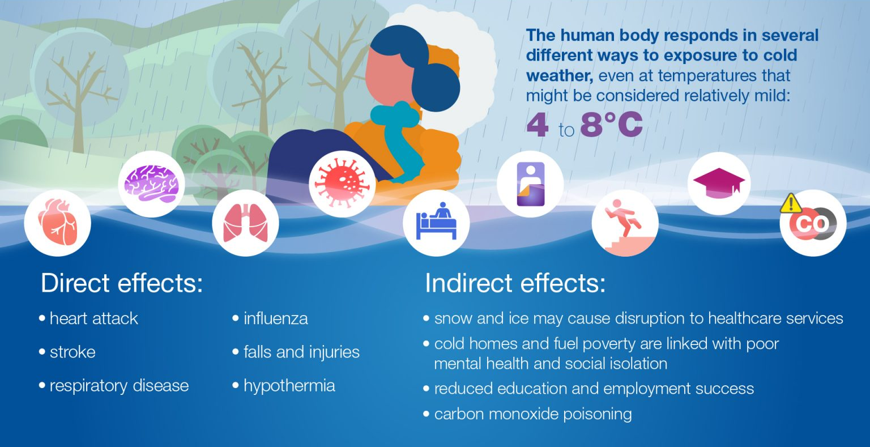
The direct and indirect health effects of cold weather
Notes:
Indirect effects include:
poor mental health – this can be due to the impacts of living in a cold home, reduced contact with loved ones, staying at home to keep warm, getting into debt due to fuel bills and/or becoming socially isolated
reduced education and employment success, as a cold home affects a child’s ability to study or do homework
carbon monoxide poisoning, which can result from a faulty heating system and poorly ventilated home
poor hygiene, from a lack of hot water for showers and washing
poor diet and nutrition, from a lack of energy for home cooking and/or financial pressure due to higher energy bills

Slide 11
Excess winter deaths
Excess winter deaths are the difference between average daily deaths in winter months (December to March) versus other months
Most excess deaths due to cold weather occur at what we would probably view as normal seasonal temperatures (4 to 8°C) rather than extremes
On average, there are approximately 35,000 excess winter deaths each year in England and Wales, but large fluctuations in excess winter deaths between years are common
In the recent past, the rate of winter deaths in England was twice the rate observed in some northern European countries, such as Finland
Excess deaths are not just deaths of those who would have died anyway in the next few weeks or months due to illness or old age – these deaths are extra
Excess winter deaths also represent a significant health inequality, with people experiencing greater socioeconomic deprivation being more likely to be affected
Whilst the greatest impact is seen in older age groups, excess winter deaths occur across all age groups

Slide 12
What causes excess winter deaths? (1)
We may assume that hypothermia is the primary cause of cold-related death, however respiratory and circulatory (lung and heart) conditions, as well as dementia and Alzheimer’s are the leading causes of the observed excess winter deaths
Respiratory disease is the leading cause of excess winter deaths – it’s estimated that it’s 85% higher than at other times of the year
A fall of about a degree in temperature leads to a 5% increase in respiratory disease and a 3% increase in respiratory deaths
After a cold snap, initially we see increases in heart disease and stroke within the first week. Respiratory illness takes longer to rise and that peaks around 12 days later. Impacts are seen for a significant period and in fact excess deaths after a cold snap only return to baseline levels after 40 days.

Slide 13
What causes excess winter deaths? (2)
Up to 30% of excess winter deaths are due to people living in cold homes in fuel poverty
Other interlinked factors that contribute to excess winter deaths:
  Seasonal factors – e.g. weather and rise in circulating infectious diseases, particularly flu and norovirus
  Individual vulnerability to health effects of cold
  Attitudes to cold and associated behaviours

Slide 14
Cold weather plan for England
The Cold weather plan for England is operational between 1st November and 1st March.
It aims to prevent the major avoidable effects on health during periods of cold weather in England by alerting people to the negative health effects of cold weather, and enabling them to prepare and respond appropriately.
It recommends a series of steps to reduce the risks to health from cold weather for:
  NHS, local authorities, social care, and other public agencies
  Professionals working with people at risk
  Individuals, local communities and voluntary groups

Slide 15
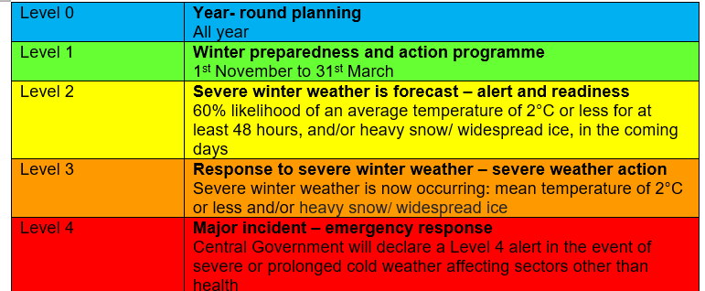
Cold weather alert service
The Cold weather health watch comprises five levels of response based on cold weather thresholds (see table below). The thresholds have been developed to trigger an alert when severe cold weather is likely to significantly affect people's health. The alerts take account of temperature along with other winter weather threats such as ice and snow.
The distribution list for the Cold weather alerts is managed by the Met Office. All previous users need to re-register here. New users can use the same link.
The Met Office uses hashtags #winterready for winter preparedness and #weatheraware for levels 2-4, which will be supported by PHE, DHSC and other government departments when appropriate in social media communication

Slide 16
Cold weather and COVID-19

Slide 17
Cold weather and COVID-19
COVID-19 is likely to amplify the risks of cold weather
It is possible that clinical outcomes may be more severe where exposure to cold and COVID-19 co-occurs for a given individual, for example through increased stress on the cardiovascular and respiratory systems
There is emerging evidence of poorer outcomes in those who are co-infected with COVID-19 and flu

Slide 18
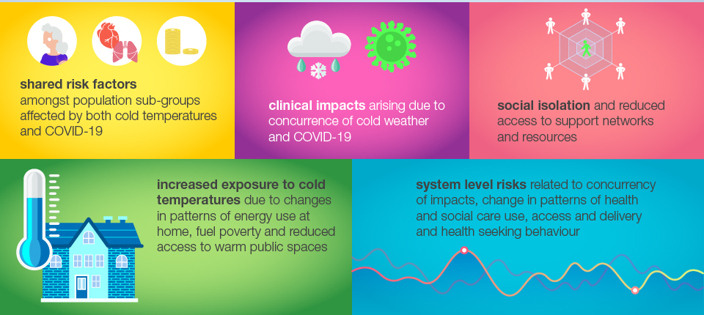
Potential interactions between cold weather and COVID-19 include:

Slide 19
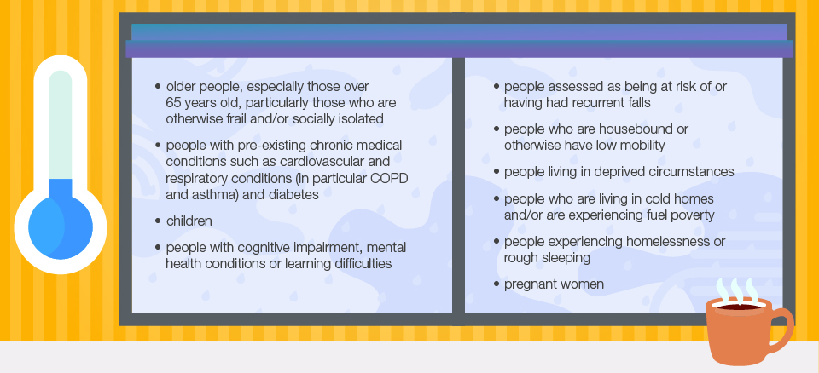
Certain groups of people are particularly vulnerable to cold weather. Many of these groups are also at greater risk of severe illness from COVID-19, as well as other winter illnesses such as flu

Slide 20
Attitudes to accessing healthcare
Perceptions of risk from COVID-19 negatively impacted on attitudes to accessing care during lockdown, including anxiety about being at risk from COVID-19.
Polling found that 76% of UK people surveyed in May were anxious about the risk of exposure to COVID-19 and 47% were uncomfortable accessing a hospital.
Confidence was found to be lower among people from BAME backgrounds and people living with a disability.
There was a significant reduction in presentations to emergency care for both minor and urgent conditions from March to May.
There is also evidence suggesting the pandemic resulted in an inflation in acute cardiovascular deaths, nearly half of which occurred in the community and most did not relate to COVID-19. This suggests there were delays to seeking help or that the deaths were likely the result of undiagnosed COVID-19.
Such changes in patterns of health seeking behaviour may impact on cold-related health harms such as heart attacks and strokes.

Slide 21
Cold homes and fuel poverty
During the COVID-19 pandemic, increased numbers of people are spending more time at home than usual (more than 90% of our time being spent indoors), which may lead to a higher demand for energy and an increase in associated costs of heating bills
This winter, new groups of people and households may also be drawn into fuel poverty for the first time and be unaware of the funds and resources available to help with keeping warm
Fuel poverty is determined by the interaction of 3 main drivers:
  Energy efficiency of the household
  Energy prices
  Income
Being unable to heat the home, in particular common living spaces, is associated with an increased risk of common mental health disorders, social isolation and increased stigma (see more detail in presentation notes below)
The Fuel Poverty Strategy for England published in 2015 is underpinned by the fuel poverty target for as many fuel poor homes as reasonably practicable to achieve an energy efficiency standard of Band C by 2030, which became law in December 2014. This is an important target which involves year-round planning.
Notes:
A questionnaire linking proxies for fuel poverty to common mental disorders (CMD) – including depression and anxiety – showed that 10% of those with CMD reported not being able to keep their home warm enough in winter, compared with just 3% without CMD. Of those with CMD, 15% said they had mould in their home, compared with 8% with no CMD

Slide 22
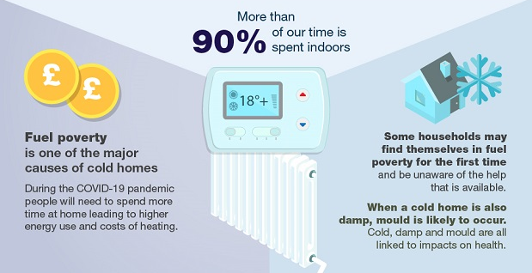
Cold homes and fuel poverty

Slide 23
3 questions to assess fuel poverty
3 key questions at contact assessment stages to identify those who are at risk of living in fuel poverty and in cold homes:
  Is your whole house warm in winter? (This question helps to identify how people are heating their home and whether they are limiting heating to certain rooms)
  Can you afford to heat your home to a comfortable level? (This question helps to identify whether occupants are meeting ‘minimum’ recommended temperatures all the time)
  Can you afford to pay your fuel bills? (This question will flag whether someone has sufficient income to spend on the fuel they need for warmth and comfort)

Slide 24
Transmission of viruses within the home
Another health harm related to cold weather and housing is transmission of viruses (not just COVID-19). As people spend significantly more time indoors during the winter, the risk of transmission can increase due to housing factors such as:
  Overcrowding, including multiple occupancy and intergenerational households
  Poor ventilation, which increases the density of virus particles accumulating in a room
  Barriers to ventilation include fuel poverty and living in an area with noise, pollution and security concerns
Stay at home guidance for households with possible coronavirus (COVID-19) infection is available here. This includes guidance on reducing the spread of COVID-19 in households (next slide)

Slide 25
Reducing spread of COVID-19 in households
Everyone in your household should take the following steps to reduce the risk of catching COVID-19 or passing it on to others.
Wash your hands regularly for at least 20 seconds with soap and water or use hand sanitiser. Cover your mouth and nose with a disposable tissue when you cough or sneeze, bin it promptly and wash your hands. If you don’t have a tissue, cough or sneeze into the crook of your elbow. Avoid touching your face.
Regularly clean frequently touched surfaces and shared areas such as kitchens and bathrooms and keep indoor areas well-ventilated by opening windows where possible.
Do not shake dirty laundry. Do not share towels, including hand towels and tea towels.
If you have symptoms of COVID-19 or a positive test result, use a face covering when spending time in shared areas inside your home.
Further guidance is available here

Slide 26
Homelessness and rough sleeping
People experiencing homelessness, whether sleeping rough or in temporary accommodation, are at increased risk from cold weather. As well as being more exposed to cold weather, they are also more likely to have pre-existing health conditions and may be more likely to experience social isolation, cognitive impairment, living alone and/or experiencing fuel poverty.
This year, due to COVID-19 measures, there may be reduced access to shelters and other public warm spaces, which increases risk of exposure to the cold for this vulnerable group. They may also be at increased risk of exposure to COVID-19 due to overcrowding and barriers to practising regular hand and respiratory hygiene, as well as facing a high burden of pre-existing problems such as smoking and chronic obstructive pulmonary disease (COPD).
The extent of interacting risks from cold and COVID-19 faced by this vulnerable group will be influenced by decisions about future arrangements, such as the safe provision of shelters, alternative accommodation and the activation of local Severe Weather Emergency Protocols (SWEP).
A Cold Weather Package was recently launched by the government to keep people experiencing rough sleeping safe during winter. In addition to further funding for local authorities and the faith and voluntary sector, the Ministry of Housing, Communities and Local Government (MHCLG) has published night shelter operating principles, with advice and input from PHE, and in consultation with Homeless Link, Housing Justice, councils and representatives from the shelter sector.

Slide 27
Vulnerable people at home
Reduced in person contact with health and social care staff, key workers, friends and family may lead to:
  Reduced opportunities to identify cold, damp and mould, unless specifically asked about on the phone – older people may also be unaware they live in a cold home
  Social isolation
  Difficulties in accessing food and medications
Concerns about COVID-19 risks have also influenced older peoples’ decisions to access care. During the first wave, 14% of older people living with long-term conditions who needed community health and social care services did not try to access them
Digital exclusion may also be more relevant as a driver of inequitable access during COVID-19, for example online healthcare appointments and treatments, e.g. lung rehab
During extended periods at home, older people may have become deconditioned (a reduction muscle mass). Regular exercise is therefore important, as well as a way to stay warm and reduce risk of falls. If exercise is difficult, these tips may be helpful from Age UK. For example, if someone sits down a lot during the day, encourage them to get up once an hour. If that's not possible, moving their arms and legs for a few minutes will help.
See links at the end of this slide set for sources of support. There is also national guidance on shielding and protecting people who are clinically extremely vulnerable from COVID-19.

Slide 28
Action tables from the
Cold Weather Plan for England
Public Health England states the following action tables in the Cold Weather Plan for England should continue to be followed with some additional considerations to mitigate and manage the concurrent COVID-19 risks

Slide 29
Key recommendations for all
Fear of COVID-19 should not prevent action to tackle the risks from cold temperatures and winter weather
It is critical that actions to prevent health harms from cold temperatures and winter weather continue – including identifying and supporting those at risk – with necessary adaptations in line with coronavirus guidance to keep everyone safe
Identify those at greatest risk this winter, taking into account intersecting risks. Ask about living in a cold home, and support vulnerable individuals to access existing resources to keep warm

Slide 30
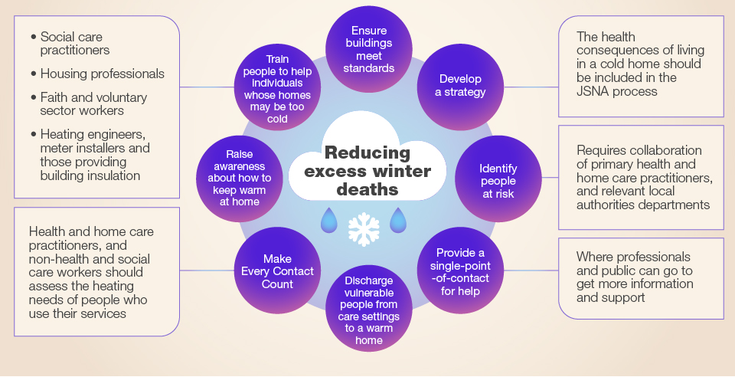
How local authorities can prevent cold-related harm

Slide 31
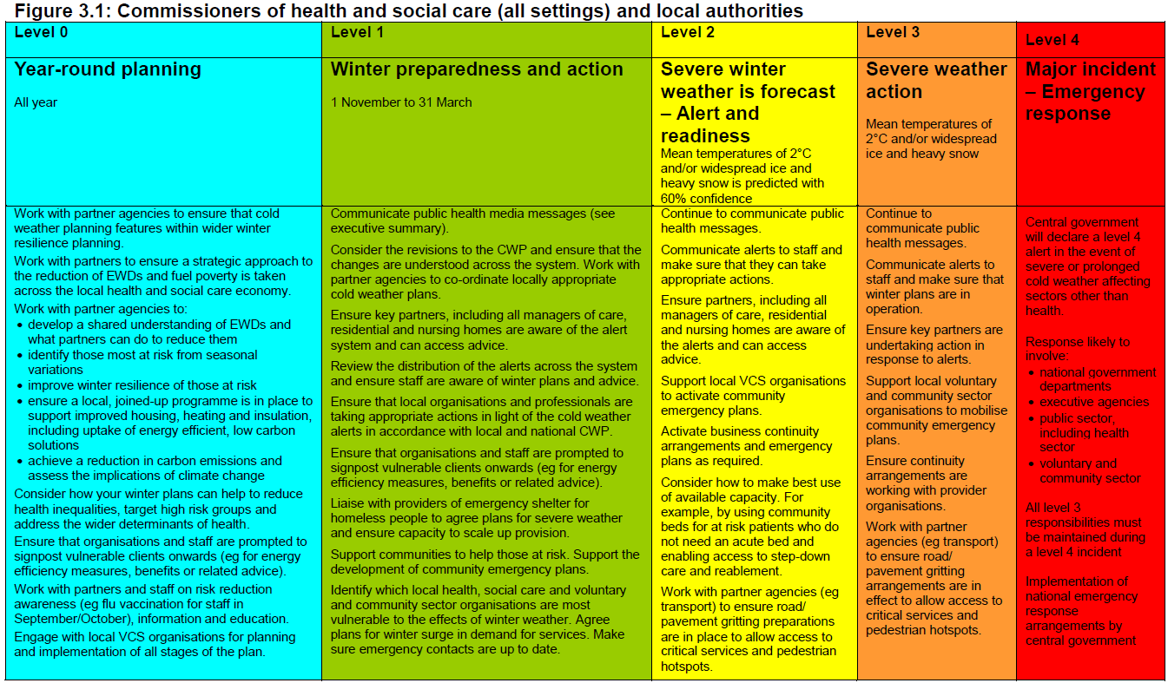
Action table for commissioners of health and social care (all settings) and local authorities

Slide 32
COVID-19: additional actions for commissioners of health and social care (all settings) and Public Health
Ensure there is a single point of contact to provide tailored advice for people living in cold homes
Train social care, housing and other professionals who may make home visits to identify those most at risk, taking into account the intersection of cold and COVID-19, and integrate these risk assessments to target information and support to vulnerable households
Engage the community and voluntary sector to identify and support those most at risk, especially those who are socially isolated
Work across STPs/ ICSs to utilise existing structures such as primary care networks; social prescribing networks; community pharmacists; local authority social care and crisis support teams to identify and support vulnerable individuals to access resources to keep warm
Consider potential measures which could be implemented to reduce the cold-related risks faced by individuals who are clinically vulnerable, clinically extremely vulnerable or self-isolating

Slide 33
Continued
Increase the resilience of partners to the concurrent risks of cold and COVID-19:
Work with partner agencies, providers and businesses to raise awareness about the concurrent risk of cold weather and COVID-19
Support local health and social care organisations in protecting vulnerable residents and ensuring staff welfare (e.g. mutual aid, PPE supply, mental health)
Local Health Resilience Partnerships may wish to satisfy themselves that there is adequate review across local health and social care systems of usual plans for surge capacity in cold weather in light of possible COVID-19 related staff absence and to ensure staff welfare
Local Resilience Fora should consider the impact of cold weather on the existing operational response to COVID-19 and vice versa
Ensure care homes and hospitals are aware of the cold weather plan and are preparing for cold weather as a concurrent risk with COVID-19
Ensure other institutional establishments (for example, prisons, schools) are aware of cold weather guidance
Ensure adequate provision of COVID-safe accommodation for homeless people and other vulnerable groups and ensure capacity to scale up provision

Slide 34
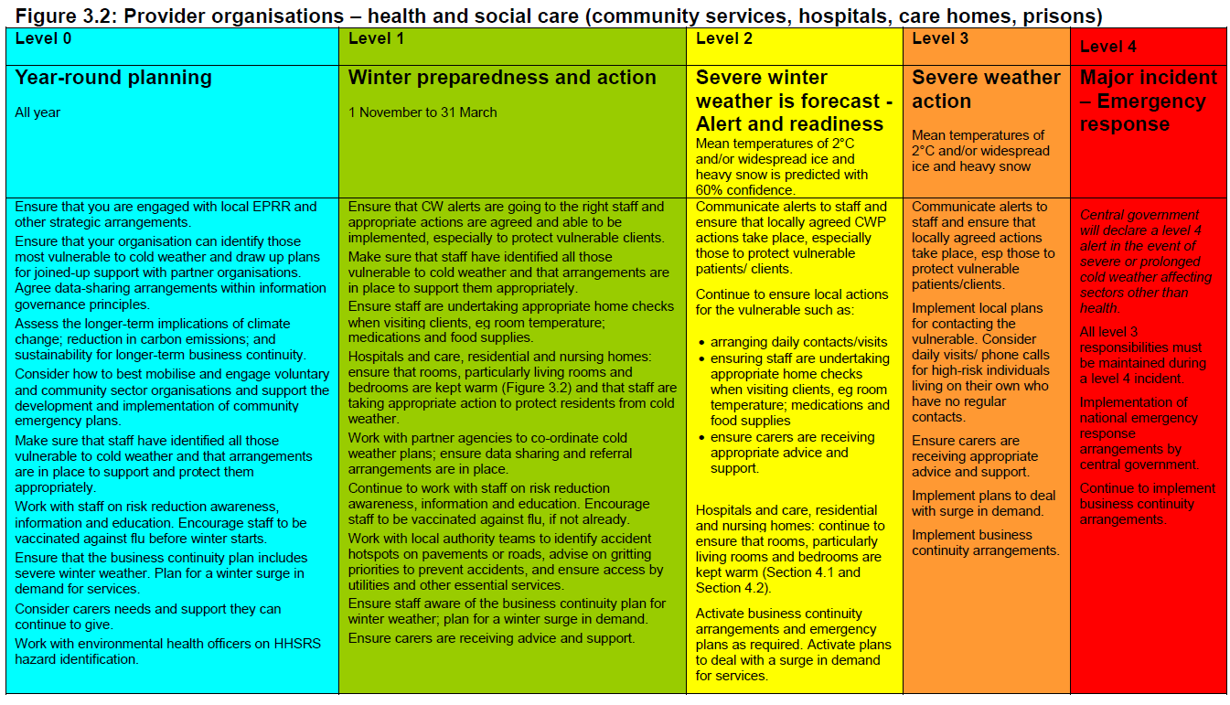
Action table for provider organisations – health and social care (community services, hospitals, care homes, prisons)

Slide 35
COVID-19: additional actions for provider organisations – health and social care staff in all settings (primary and community care, hospitals and care homes)
Review who may be at high risk –identify those at greatest risk this winter, taking into account intersecting risks. Ask about living in a cold home.
Provision of care and support during winter will be particularly important in the context of additional risks and vulnerabilities related to COVID-19 (such as protecting BAME staff) and cold weather. There may be additional need over above ‘usual’ winter pressures on this sector. Review your usual plans for surge capacity in cold weather in light of possible additional need and COVID-19 related staff absence.
Encourage staff to sign up to cold weather alerts, communicate alerts to staff, ensure staff know what to do when the weather gets cold, and get their flu vaccinations.

Slide 36
Continued
More people receiving personal care, particularly in domiciliary settings, may be at higher risk than usual from cold due to potential for concurrent COVID-19 related ill-health and COVID-19 restrictions.
Ensure a minimum temperature of 18C is kept and patients are comfortably warm whilst following COVID-19 guidance on ventilation.
Ensure safe discharge (for example, patients are not discharged to cold homes) including regular post-discharge support (which may need to be increased) and use of multi-disciplinary approaches such as hospital-at-home and reablement services.

Slide 37
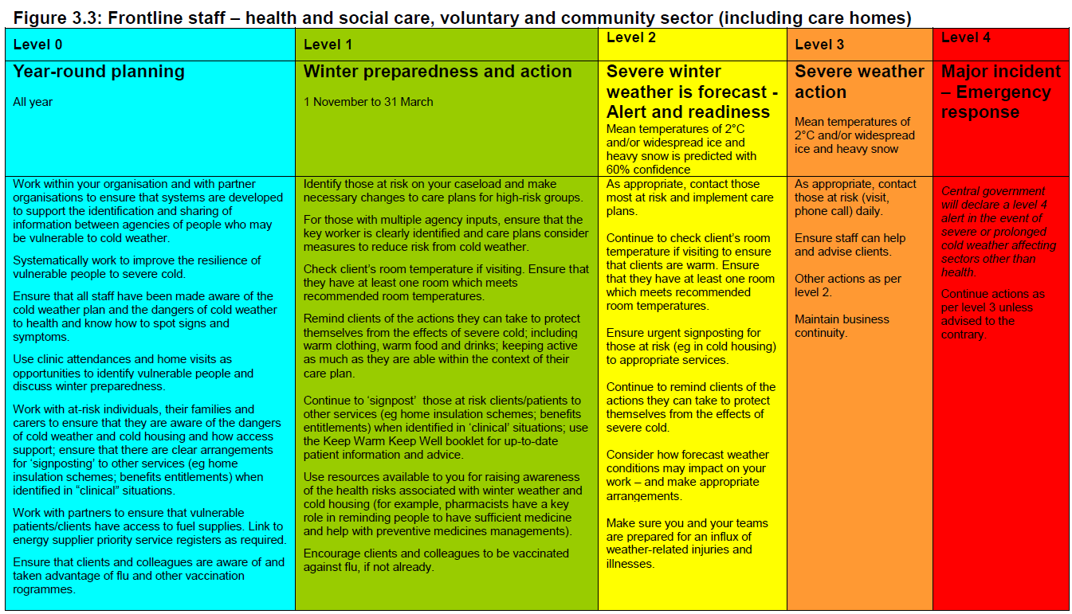
Action table for frontline staff – health and social care, voluntary and community sector (including care homes)

Slide 38
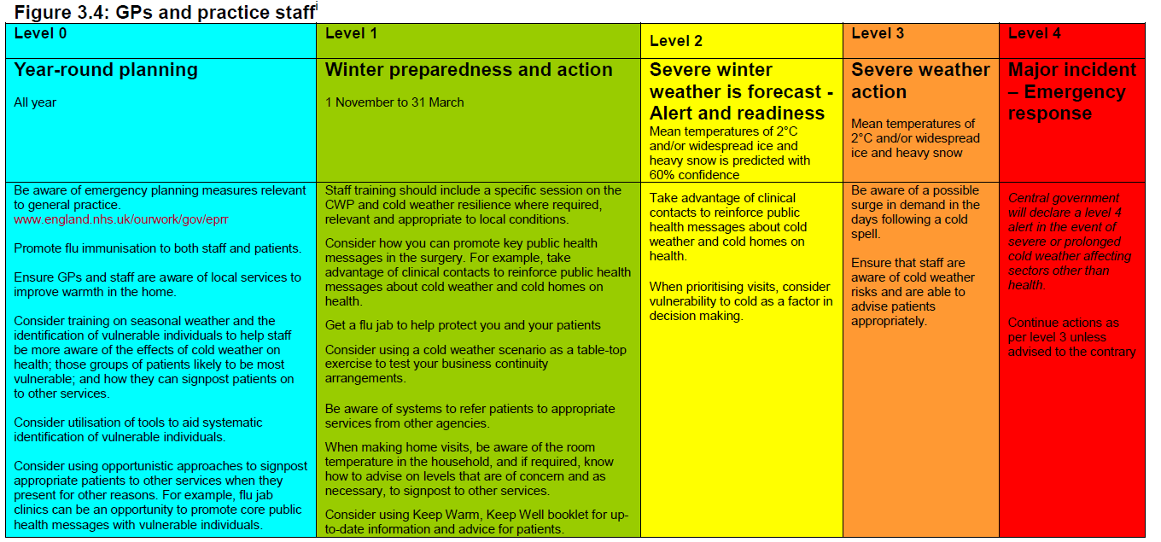
Action table for GPs and practice staff
Good practice examples: include lung health leaflets with prescriptions; develop comms to encourage people to attend to their own health and still seek advice if needed

Slide 39
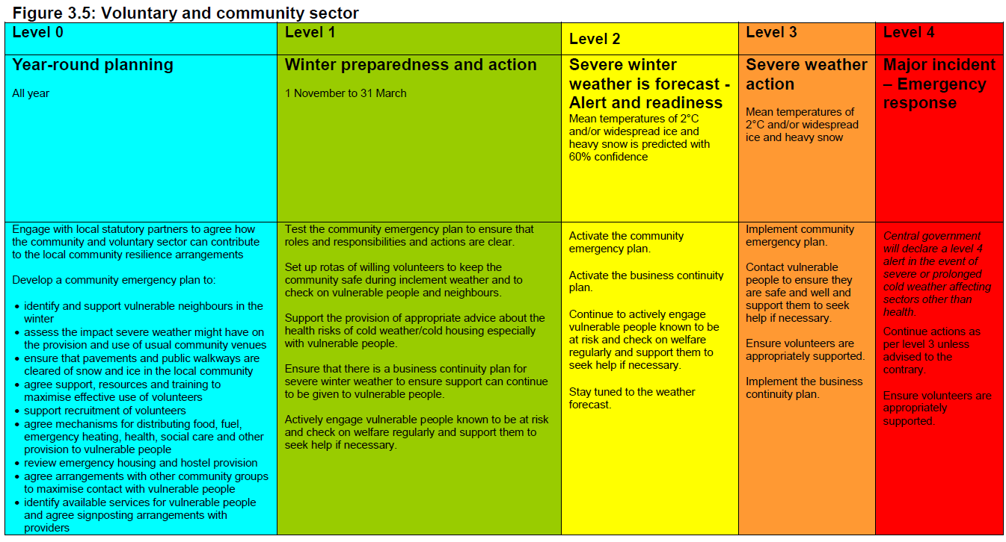
Action table for voluntary and community sector (VCS)
The wider VCS can also be involved as a provider of resources. This could be equipment (blankets, sleeping bags, stoves), facilities (emergency accommodation) or people (volunteers, signposting).

Slide 40
COVID-19: additional actions for voluntary and community sector
Have plans in place to be able to check on others safely in advance of the cold weather (for example, over the phone)
Develop clear messaging to the public to encourage them to begin winter preparedness, for example, checking eligibility for assistance with heating costs, checking heating appliances, and checking on vulnerable neighbours and relatives
Encourage those who may find it more difficult to cope in cold weather to request help through volunteer networks, for example, the NHS Volunteer Responders website
Advise those at risk that they should continue to seek medical help if they are feeling unwell and that plans are in place to deliver services safely despite COVID-19

Slide 41
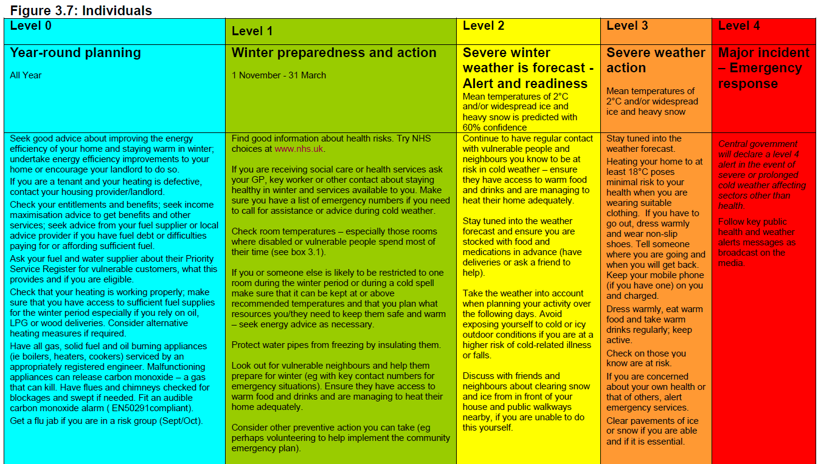
Action table for individuals

Slide 42
Key public health messages

Slide 43
Free Flu Jab Contact your GP or pharmacist if you think you, or someone you care for, might qualify for a free flu jab. If you are pregnant, you can have the NHS flu vaccine via your midwifery service. There are four flu leaflets: one general, one for pregnancy and, an easy read version, and one about children. They are available in different languages. For 2020/21 free flu vaccinations are available for those who: are aged 65 or older (including those who'll be 65 by 31 March 2021) are aged two to twelve years old are aged two to seventeen years with long-term health conditions aged between 6 months and 2 years and is in a high-risk group for flu have certain health conditions, see link here are pregnant are living in a long-stay residential care home or other long-stay care facility (not prison or university halls) receive a carer's allowance, or are the main carer for an older or disabled person who may be at risk if you get sick live with someone who's at high risk from coronavirus (on the NHS shielded patient list) are aged 50-64 years, link here to guidance frontline health or social care workers, including those employed by a registered residential care or nursing home; registered homecare organisation; hospice
Get financial support: There are grants, benefits and sources of advice to make your home more energy efficient, improve your heating or help with bills. It’s worthwhile claiming all the benefits you are entitled to before winter sets in

Slide 44
Keep your home warm, efficiently and safely by: Heating your home to at least 18°C in winter poses minimal risk to your health when you are wearing suitable clothing Get your heating system and cooking appliances checked and keep your home well ventilated Use your electric blanket as instructed and get it tested every three years. Never use a hot water bottle with an electric blanket Do not use a gas cooker or oven to heat your home; it is inefficient and there is a risk of carbon monoxide poisoning and this can kill Make sure you have a supply of heating oil or Liquefied Petroleum Gas (LPG) or sold fuel if you are not on mains gas or electricity – to make sure you do not run out in winter
Keep in the warmth by: Fitting draught proofing to seal any gaps around windows and doors Making sure you have loft insulation. And if you have cavity walls, make sure they are insulated too Insulate your hot water cylinder and pipes Draw your curtains at dusk to help keep heat generated inside your rooms Make sure your radiators are not obstructed by furniture or curtains

Slide 45
Look after yourself: Food is a vital source of energy and helps to keep your body warm so have plenty of hot food and drinks Aim to include five daily portions of fruit and vegetables. Tinned and frozen vegetables count toward your five a day Stock up on tinned and frozen foods so you don’t have to go out too much when it’s cold or icy Exercise is good for you all year round and it can keep you warm in winter If possible, try to move around at least once an hour. But remember to speak to your GP before starting any exercise plans Wear lots of thin layers – clothes made from cotton, wool or fleecy fibres are particularly good and maintain body heat Wear good-fitting slippers with a good grip indoors and shoes with a good grip outside to prevent trips, slips and falls Make sure you have spare medication in case you are unable to go out Check if you are eligible for inclusion on the priority services register operated by your water and power supplier – more details may be found here Make sure you get your prescription medicines before pharmacies close on Christmas Eve Always take your prescribed medicines as directed If you start to feel unwell, even if it’s just a cough or a cold, then get help from your pharmacist quickly before it gets more serious.
Look after others: Check on older neighbours or relatives, especially those living alone or who have serious illnesses to make sure they are safe, warm and well

Slide 46
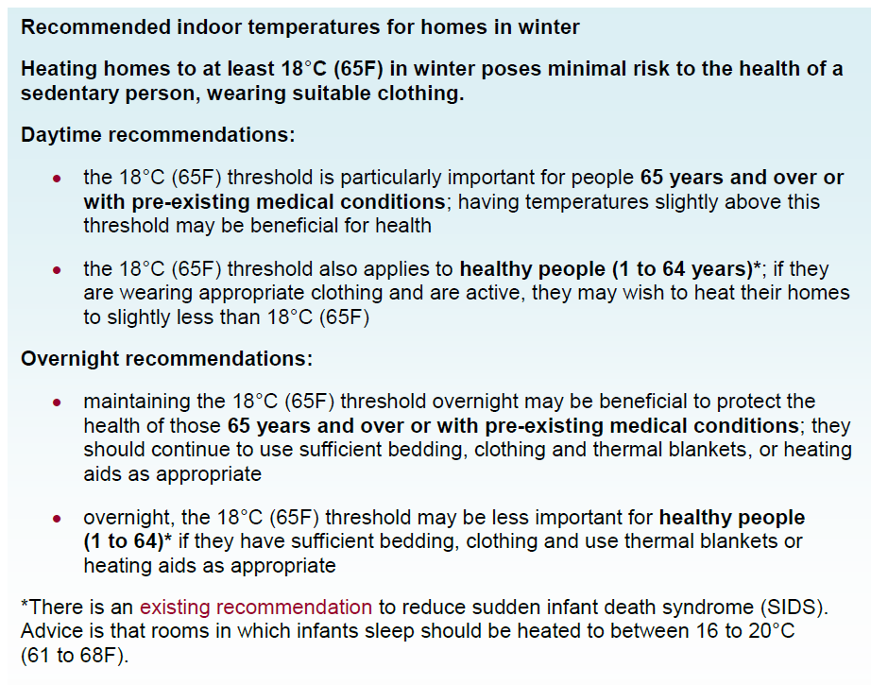
Recommended minimum indoor temperatures for homes in winter

Slide 47
Guidance and resources
For everyone:
‘Keep Warm Keep Well’ leaflet
Top tips for keeping warm and well
NHS Stay Well This Winter campaign pages – includes information on flu vaccination
NHS vaccinations and when to have them, such as the pneumococcal (pneumonia) vaccine and shingles vaccine
Latest NHS information and advice about COVID-19. Information is also available in British Sign Language via the SignHealth website
Cold Weather Plan for England – easy read guide
Support and advice for vulnerable people:
Help from NHS Volunteer Responders with shopping, picking up prescriptions and Check In and Chat phone calls. To arrange support for yourself or someone you know, register online or call: 0808 196 3646 (8am to 8pm, 7 days a week)
Extra support if you’re clinically extremely vulnerable to coronavirus
Winter Wrapped Up – from Age UK
Age UK Keep well this winter pages

Slide 48
Guidance and resources
For care homes and domiciliary care:
A quick guide for home care managers: a NICE resource to aid the implementation of NICE guideline 6 (Excess winter deaths and illness and the health risks associated with cold homes)
Influenza-like illness (ILI): managing outbreaks in care homes: guidance for managing seasonal influenza, identifying pathogens and transmission routes for acute respiratory disease in care homes.
List of infectious diseases guidance including norovirus
For health and social care professionals:
Download the NHS Stay Well This Winter campaign leaflet or order a printed copy from the PHE Campaigns Resource Centre
NICE guideline NG6: Excess winter deaths and illness and the health risks associated with cold homes
Quality standard QS 117: Preventing excess winter deaths and illnesses associated with cold homes
Take the Helping People Living in Cold Homes e-learning module
Use the Cold Homes Toolkits
Adult social care: coronavirus (COVID-19) winter plan 2020 to 2021

Slide 49
Guidance and resources
For schools, early years settings and professionals (school nurse, community health practitioner, family health visitor):
Children's flu vaccine
A practical guide for staff on managing cases of infectious diseases in schools and other childcare settings (including advice on flu, diarrhoea and vomiting, meningitis, measles and vaccines)
List of infectious diseases guidance

Slide 50
Energy advice
Simple Energy Advice (tel: 0800 444202) provides free advice on:
  Reducing energy bills
  Energy efficiency, including insultation
  Local and national grants
    Covering bills
    Making your home more energy efficient
    Fixing or replacing your boiler
Citizens Advice offers free and confidential advice online, over the phone and in person, including advice welfare benefits, debt and money, housing
Gas safety and carbon monoxide advice
Preventing frozen pipes
For additional support, check if you're eligible to register on your energy company’s Priority Service Register. For more information visit the Ofgem website

Slide 51
Benefits and payments related to cold homes and cold weather
Cold Weather Payment for those who receive:
  Pension Credit
  Income Support
  Income-based Jobseeker’s Allowance
  Income-related Employment and Support Allowance
  Universal Credit
  Support for Mortgage Interest
Winter Fuel Payment for those:
  Born on or before 5 October 1954
  AND lived in the UK for at least one day during the week of 21 to 27 September 2020 - this is called the ‘qualifying week’
Warm Home Discount Scheme for those:
  Who receive Guarantee Credit element of Pension Credit - known as the ‘core group’
  On a low income and meet your energy supplier’s criteria for the scheme - known as the ‘broader group’

