Slide 1
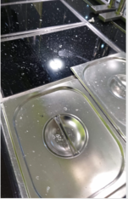
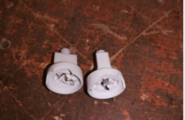
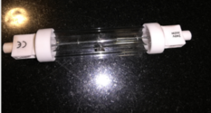
Air Sector
SHE Alert
Heat lamp under Catering Servery Counter
Insert Photo
Insert Photo
An incident occurred when a heat lamp under the catering servery counter exploded over the food below.
The damaged lamp was confirmed to be the correct type which are designed not to explode scattering debris. Supplier advised this can happen if there is a flaw/fault with the quartz casing. The lamp concerned although the correct type did not have visible CE markings on the ends (see photo above).
All lamp fittings in the servery were checked for cracks and CE markings and were replaced where necessary (one with a crack was found on inspection).
Lamps in store were also checked for faults/CE Markings, the lamp supplier was contacted regarding those supplied with No CE marking. Faulty stock was returned/replacement sent.
Authorised by: Jon Yeoman, Head of SHE
CROSS CHECK LIST
1 | Check all servery heat lights have correct lamp type installed with visible CE markings.
2 | Check all lamp stock have correct CE markings and no visible faults eg cracks in the casing
3
4
Issue Date: 10/12/2020
Reference Number KMRUVN-3TV7-JAA-OB Air Sector Red SHE Alert

