Slide 1
Role of Schools
Receipt & distribution of kits
Test kits will be delivered by either the DHSC or the council direct to schools
Deliveries will be staggered over the next week and a half (prioritised on advice of PHE)
Kits to be distributed to students and staff to take home and carry out test that evening
Tests to be returned to school and not put in the post
Data collection
All kits to be returned to school the following day
You will be asked to complete a data return sheet – total number of tests returned, broken down by year group and role (e.g. staff or student)
We do not need identifiable information, e.g. names
Collection of kits
Completed kits must be boxed into “clean pack” boxes (same as they arrived in if possible)
Marked up in red: Operation Eagle, ready for collection (please let us know asap if you need volunteer support with this)
Please take the boxes to the Montem Testing Site (TBC)
Couriers will collect all completed tests from the Local Testing Site each day at 8pm and take directly to the labs for sequencing

Slide 2
Role of Schools
HEADS UP Letter- send first if not already done
2nd letter to parents: explaining school will now start surge testing on X date til X date, expect kit to be taken home by pupil
IF: Secondary School going to really struggle due to language barriers, understanding of parents to have “take home” system for kits work then an MTU can be used
RESOURCE: May be able to get volunteers to help (RBFS?) with packing test kits if required plus transport to Montem
POTENTIAL ISSUE: Montem going to walk through only on 19th July- may need to be taken to MTUs

Slide 3
Education Contingency Framework
Sets out the local preventative measures affecting education settings
Including standing up onsite asymptomatic testing, advice to retain face coverings in communal areas or classrooms, and restricting attendance
Ensures consistency between areas
Provides assurance that the educational drawbacks of interventions are fully considered
East Berkshire Health Protection Board have reviewed a number of enhanced measures for schools and agreed the following in areas of surge testing, where school populations are targeted (Bracknell Forest and Slough)

Slide 4
Education Contingency Framework
Issue | Current guidance | East Berks Health Protection Board recommendation
Face coverings in communal areas and classrooms | Step 3 of road map does not require face coverings in communal areas or classrooms Contingency framework specifically notes face coverings as a measure that can be locally reviewed | Reintroduce face coverings in all schools with an outbreak (defined as two or more linked cases)
Transition days (Rec, Year 6, Year 11) or mass gatherings of multiple schools | Transition days not prohibited Risk assessment should be undertaken Should be conducted in line with step 3 of roadmap | Movement between schools should be restricted, therefore transition days to be cancelled and alternative / virtual arrangements made Events that bring together individuals outside of current bubble arrangements should not go ahead (either within or between schools)
Meetings (including workplace meetings, governors meetings, parents evenings) | National restrictions currently advise work from home where possible (to be reviewed today) No specific guidance Risk assessments and alignment with roadmap restrictions | All workplace meetings should remain virtual, as per the current guidance and restrictions, and this should be extended to parents evenings
These arrangements to stay in place until the end of term, with a review in 3 weeks

Slide 5
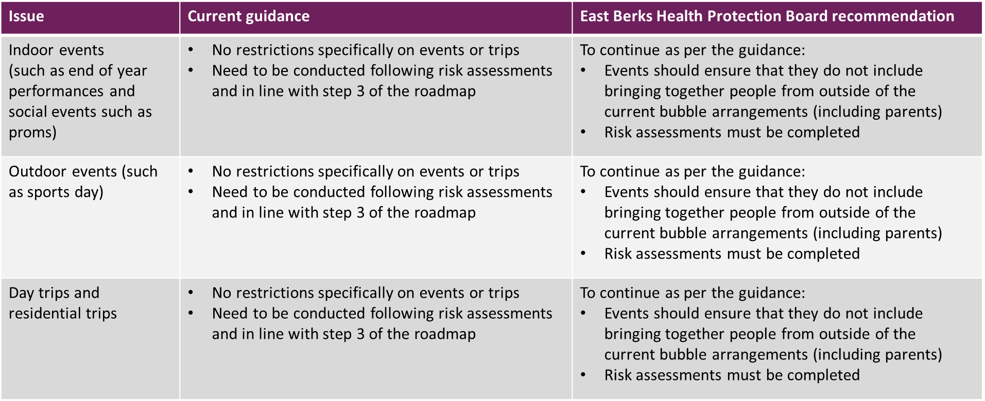
Education Contingency Framework

Slide 6
Education Contingency Framework
Issue | Current guidance | East Berks Health Protection Board recommendation
Bubble sizes | Assess circumstances and implement ‘bubbles’ of an appropriate size to achieve the greatest reduction in contact. Bubbles should be kept apart from each other and encourage social distancing Limit interaction and sharing spaces between bubbles | Bubble sizes to be reduced as far as possible, for recreational periods (e.g. breaks and lunch) as well as during lessons

