Slide 1
Education Contingency Framework
Issue | East Berks Health Protection Board recommendation
Face coverings in communal areas and classrooms | Reintroduce face coverings in all schools with an outbreak (defined as two or more linked cases)
Transition days (Rec, Year 6, Year 11) or mass gatherings of multiple schools | Movement between schools should be restricted, therefore transition days to be cancelled and alternative / virtual arrangements made Events that bring together individuals outside of current bubble arrangements should not go ahead (either within or between schools)
Meetings (including workplace meetings, governors meetings, parents evenings) | All workplace meetings should remain virtual, as per the current guidance and restrictions, and this should be extended to parents evenings
These arrangements to stay in place until the end of term

Slide 2
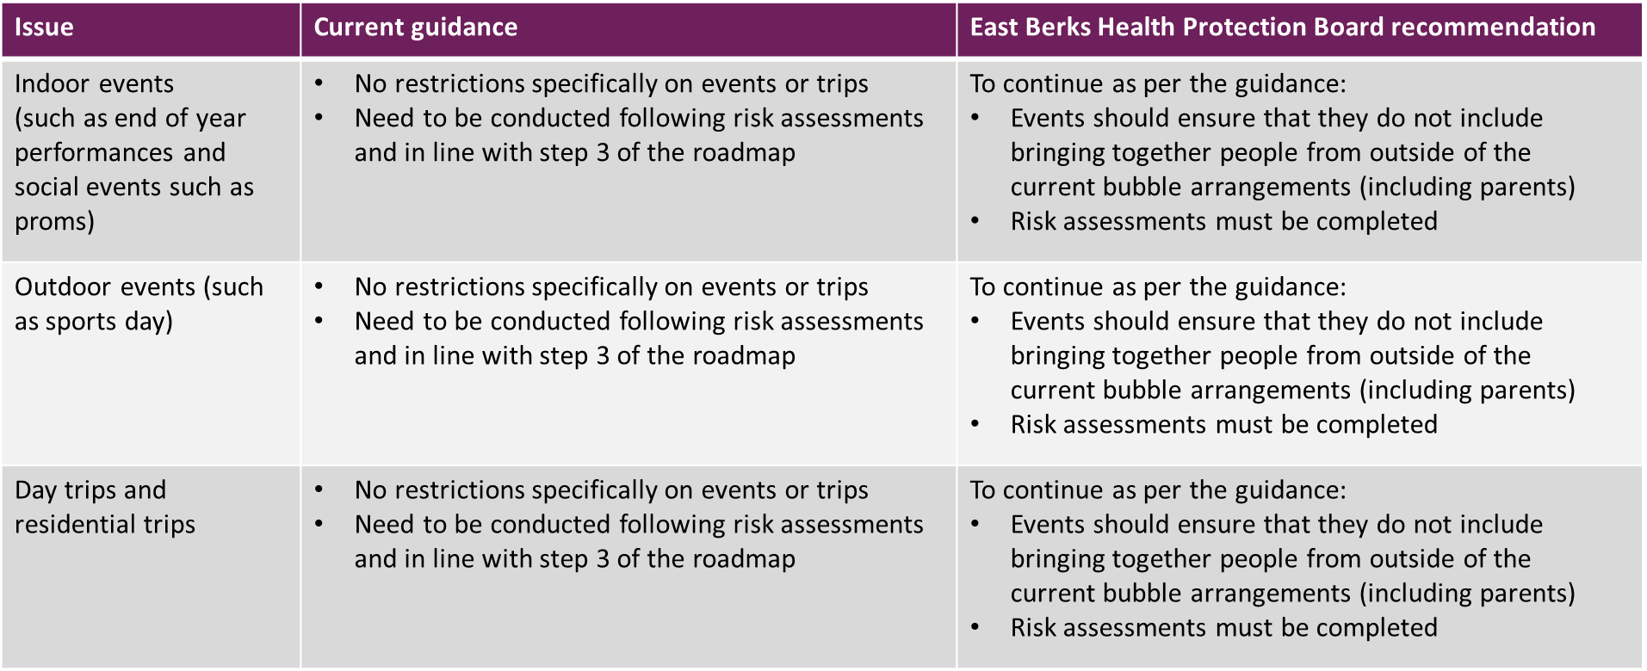
Education Contingency Framework

Slide 3
Education Contingency Framework
Issue | East Berks Health Protection Board recommendation
Indoor events (such as end of year performances and social events such as proms | To continue as per the guidance: Events should ensure they do not bring people together from outside of the current bubble arrangements (including parents) Risk assessments must be completed
Outdoor events such as sports day | To continue as per the guidance: Events should ensure they do not bring people together from outside of the current bubble arrangements (including parents) Risk assessments must be completed
Day trips and residential trips | To continue as per the guidance: Events should ensure they do not bring people together from outside of the current bubble arrangements (including parents) Risk assessments must be completed

Slide 4
Education Contingency Framework
Issue | East Berks Health Protection Board recommendation
Bubble sizes | Bubble sizes to be reduced as far as possible, for recreational periods (e.g. breaks and lunch) as well as during lessons

