Slide 1
EYFS Profile 2022

Slide 2
EYFS Profile 2022
Aims:
EYFS Profile handbook; working through the sections
Understand your role in making a judgement against the revised ELGs
Identify the responsibilities of the school and headteacher for accurate and timely completion of the EYFSP cohort data
Recognise how this statutory assessment process supports its primary focus of effective transition into year one
Notes:
The EYFSP handbook sets out the statutory requirements for the EYFSP assessment in the 2021/22 academic year.

Slide 3
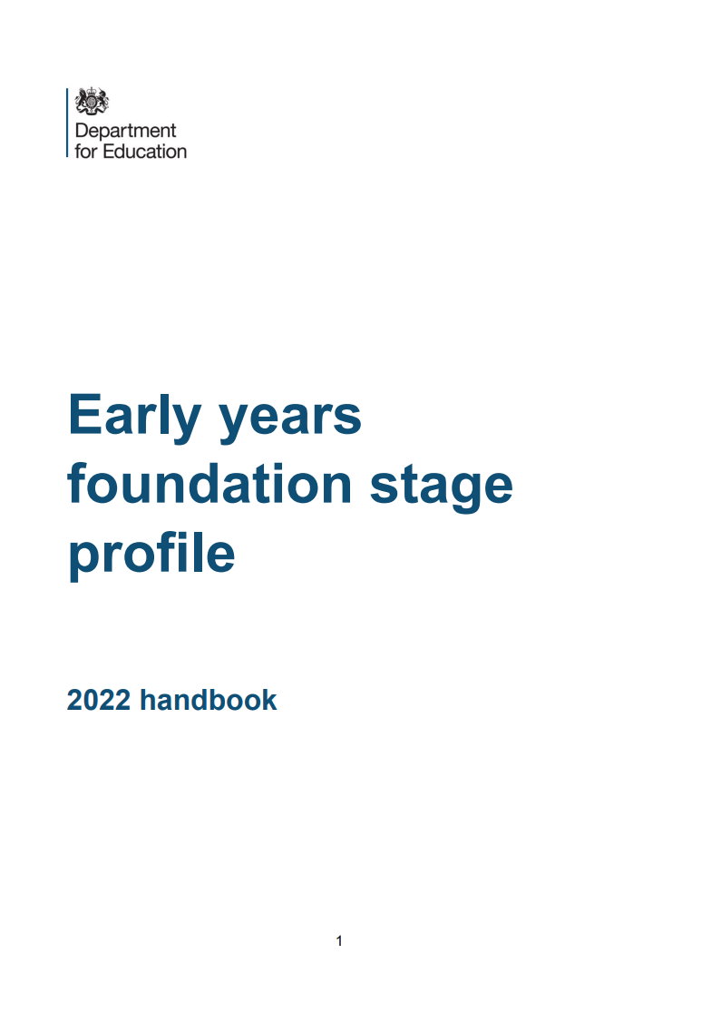
EYFS Profile 2022
Early years foundation stage profile handbook - GOV.UK (www.gov.uk)
Early years foundation stage (EYFS) statutory framework - GOV.UK (www.gov.uk)
Early years foundation stage: exemplification materials - GOV.UK (www.gov.uk)
EYFS supporting information for case study videos (publishing.service.gov.uk)
SEND gateway
series of short guides
Essential guidance
Notes:
EYFS stat framework – must be used in conjunction with the EYFSP handbook when undertaking completing the profile and ensuring that these are completed in line with stat expectations.
ARA included in EYFSP handbook ​ - no separate document for EY as in previous years.
Exemplification materials​ - new format this year – further explanation later in session
NASEN link for SEND​
You will find it essential to familiarise yourself with the key guidance and support materials to ensure that you and colleagues can complete the EYFSP requirements.

Slide 4
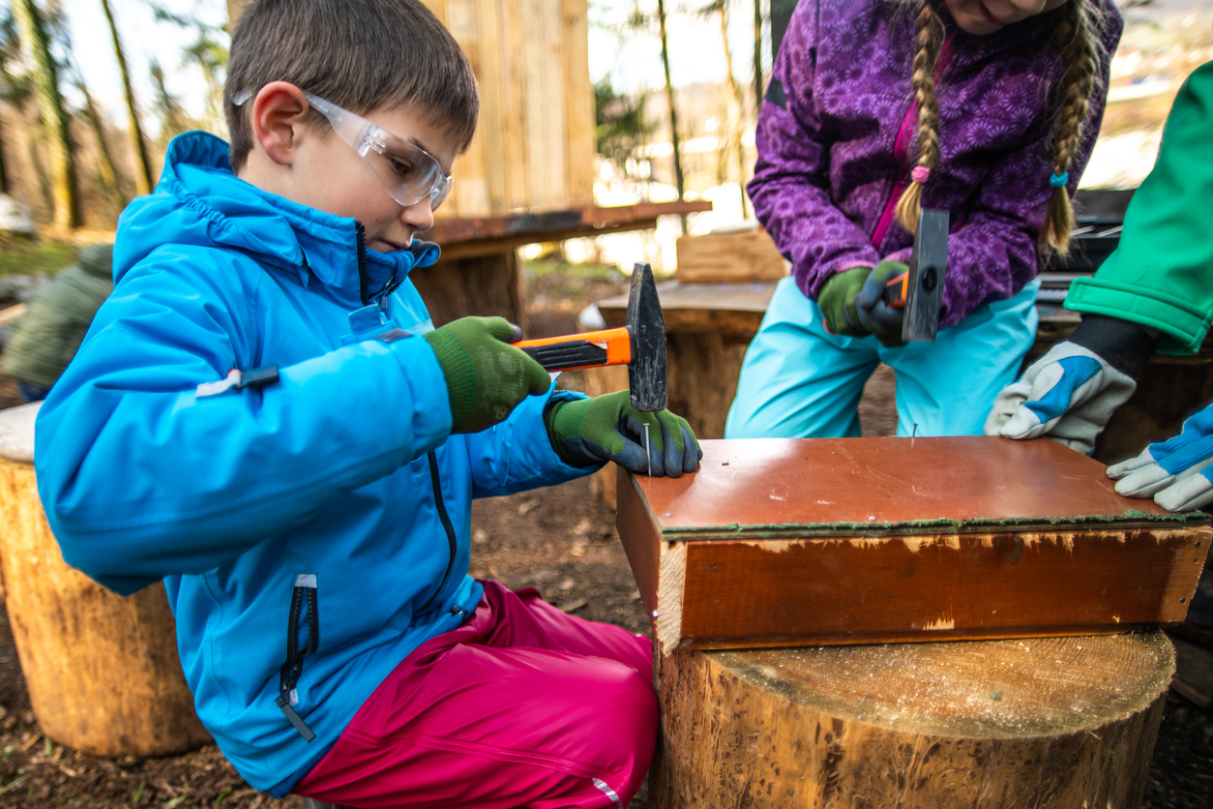
EYFS Profile 2022
Clearer and more specific ELGs better aligned with KS1 to support greater school readiness and smooth transitions
EYFSP should remain as a statutory assessment to provide support for child development and effective transition and teaching into year 1; ensuring year 1 teachers have the key information to continue with teaching from what the children already know and can do
EYFSP assessment and moderation should be streamlined, have a less time-consuming approach and place greater value on teachers’ professional judgement
EYFSP results should not used as an accountability measure
Removal of LA statutory external moderation
Removal of exceeding criteria
Overview of the EYFS reforms
Notes:
Following comprehensive consultation with the EY sector the revised EYFS came into force for all EY registered settings in Sept 2021. As part of this process the EYFS profile was also reviewed, piloted in a number of schools and changes made to reflect the key messages from the sector.
Revised ELGs – clearer to take away the ambiguity when making assessment, specific - reflect new information about child development – self regulation, and mirror the educational programmes especially all have key elements for vocabulary development, as in the EYFS curriculum. Some ELGs have been removed (Technology)
Not accountable data - reflects the changes in focus by Ofsted away from tracking of data, ensure a wide and varied curriculum is taught (not narrow focus of ELGs) and ensuring less burden on teachers to have to produce evidence.
Schools own assessment and moderation policies should follow these expectations, especially in regards to reducing teacher workload./paperwork
No exceeding criteria, this is partly to support teachers with less burden when making EYFSP assessment judgements, however some children will still be working beyond the ELGs and they should be supported through effective teaching and provision and also this information shared with Yr 1 teachers.

Slide 5
EYFS Profile 2022
2.1 Overview of the profile
carried out in the final term of the year in which a child reaches age 5, and no later than 30 June in that term
EYFS Profile is intended to provide a reliable, valid and accurate assessment of each child’s development at the end of the EYFS
is an assessment of the child’s outcomes in relation to the 17 early learning goal (ELG) descriptors
practitioner’s professional judgement should be used to make these assessments, based on their knowledge and understanding of what the child knows, understands, and can do
the early learning goals (ELGs) are what is assessed at the end of the reception year and should not be used as a curriculum
EYFS Profile is not intended to be used for ongoing assessment or for entry-level assessment for early years settings or reception classes
Overview of the profile
Notes:
The EYFSP is subject to legal enforcement by the Childcare Act 2006 Section 40(2) and the statutory EYFS 2021, as outlined in the EYFSP handbook 2022 1.3. This is why EYFS statutory framework MUST be used alongside the EYFSP handbook to ensure that all requirements are met.
EYFS Stat framework Section 2 – Assessment (p18-20) clearly sets out what is expected, including information about the ongoing, formative assessment being an integral process of learning and development, ensuring that what teachers know about children supports the curriculum planning, provision and teaching. Day-to-day informal checking of what children have learnt will inform teaching and learning on an ongoing basis throughout the final year of the EYFS. This will include identifying areas where children may be at risk of falling behind, so that practitioners can provide rapid, effective support.
Assessment should not need prolonged breaks from interactions with children or require excessive paperwork. These last two points have been carried through into the EYFSP processes, following lengthy consultation with the EY sector and these are reflected in the EYFSP handbook and profile process.
The EYFSP is an assessment of the child’s outcomes in relation to the 17 Early Learning Goal (ELG) descriptors. Practitioners must use their professional judgement to make these assessments, based on their knowledge and understanding of what the child knows, understands, and can do. Under the revised EYFS There is no expectation or requirement for practitioners to collect or use documented or photographic evidence in order to make judgements for assessment. Practitioners may however choose to refer to any documented observations, assessments or notes made in the course of their teaching across the year to inform their professional judgement. EYFSP is not intended to be used as an accountability measure for schools or teachers

Slide 6
EYFS Profile 2022
2.2 Principles of EYFS profile assessments
Reliable and accurate assessment at the end of the EYFS is:
Practitioners using knowledge of children
Summative
Informed by a range of perspectives
Inclusive
Underpinned by a broad curriculum and effective pedagogy
Principles of assessment
Notes:
Principles of EYFS profile assessments have always been integral part of ensuring reliable and accurate assessment at the end of the EYFS. Streamlined to key points, some very familiar and other reflect the changes made in the new EYFSP 2022.
Practitioners using knowledge of children is key and assessment is based primarily on the practitioner’s professional knowledge of what the child knows, remembers and can do day to day. It is a means of checking whether a child has learnt what has been taught (for example letter/sound correspondence) or can take place during routine interactions with children and does not need to be planned or documented. The practitioner may simply reflect on the knowledge, skills and understanding that the child demonstrates in the course of everyday learning to plan what to teach next. Where something has been well taught a child’s learning is embedded and secured. The child is likely to demonstrate what they know and can do consistently in a range of situations. Should not involve excessive time away from the children or collection of evidence
Summative: assessment is based on a holistic view of what the child can demonstrate against each ELG at the end of the reception year. This will be based on the ongoing formative assessments that you have made throughout the year, taking this information about what you know about each child, their achievements, interests and how they demonstrate to you what they know, understand and can do. This will have also supported you in identifying what the gaps were and where they needed further teaching and opportunities to learn.
Informed by a range of perspectives: assessment is predominantly based on the teacher’s professional judgement but should also take account of contributions from a range of perspectives, including the child, their parents and other relevant adults.
Inclusive: practitioners need to be alert to the general diversity of children’s interests, needs and backgrounds, in order to accurately assess their development and outcomes against the ELGs. This includes children with a special educational need or disability (SEND), who may demonstrate their attainment in different ways. Children whose home language is not English should have opportunities to engage in activities in the security of their home language. Children from different cultural backgrounds will demonstrate their attainment not only through what they have been taught but also when activities such as role play, cookery, celebrations, visits or events are linked to their cultural experience.
Underpinned by a broad curriculum and effective pedagogy: teaching should enable each child to demonstrate their learning and development fully. Effective assessment takes place when children are taught well and can talk about what they know, demonstrating their learning and development in a range of contexts. The ELGs represent a narrow measure of what is assessed at the end of reception year and should not restrict the breadth of what is taught in the final year of the EYFS. It is for schools to determine their pedagogical approach and curriculum (having regard for the ‘Educational Programmes’ set out in the EYFS framework) to support children’s learning and development

Slide 7
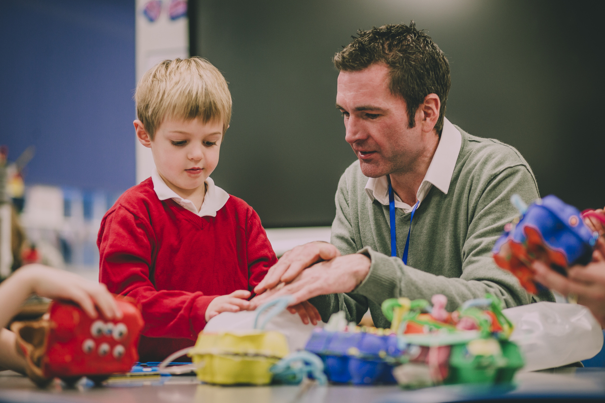
EYFS Profile 2022
based on a holistic view of what the child can demonstrate against each ELG at the end of the reception year
Use the whole description for each ELG and determine whether this best-fits your professional knowledge of the child as the most accurate picture of the child’s overall embedded learning
‘Best fit’ does not mean that the child has equal mastery of all aspects of the ELG
The ELGs are interconnected with children often demonstrating attainment in more than one area of learning when engaged in activities. Consider the child’s development across the areas of learning, and whether the levels of development in relation to each of the goals make sense when taken together
For each ELG, teachers must judge whether a child is:
Expected: meeting the level of development expected at the end of the EYFS
Emerging: not yet reaching this level
Good level of development GLD; is when a child has achieved the expected level in the ELGs in the prime areas of the learning and the specific areas of literacy and maths (pg 6)
Making judgements against the ELGs
Notes:
Assessing children 3.3 and ELGs 3.4 page 10-14 17 ELGs.
Each ELG descriptor is written in bullet point form, but this is for presentational purposes only to aid clarity; teachers should not ‘tick off’ these bullet points one by one but should use their professional judgement to determine whether each ELG in its totality best fits the child’s learning and development.
The ELGs are based on typical child development at the age of 5, so most children are likely to meet the ‘expected’ level of development
Summary of changes to the ELGs:
Communication and Language – provides more focus on vocabulary.
Personal, Social and Emotional Development – includes self-regulation and self-care has been moved here.
Physical Development – separation of fine motor and gross motor skills.
Literacy – comprehension is now included here.
Mathematics – greater focus on a deep understanding of numbers to 10 and a new ELG on number patterns. Shape, space and measure are not assessed but are still in the statutory Educational Programmes in the EYFS.
Understanding the World – includes more information about the different areas of learning: science, geography and history. A greater emphasis on vocabulary.
Expressive Arts and Design – more clarity here and a focus on developing language throughout.

Slide 8
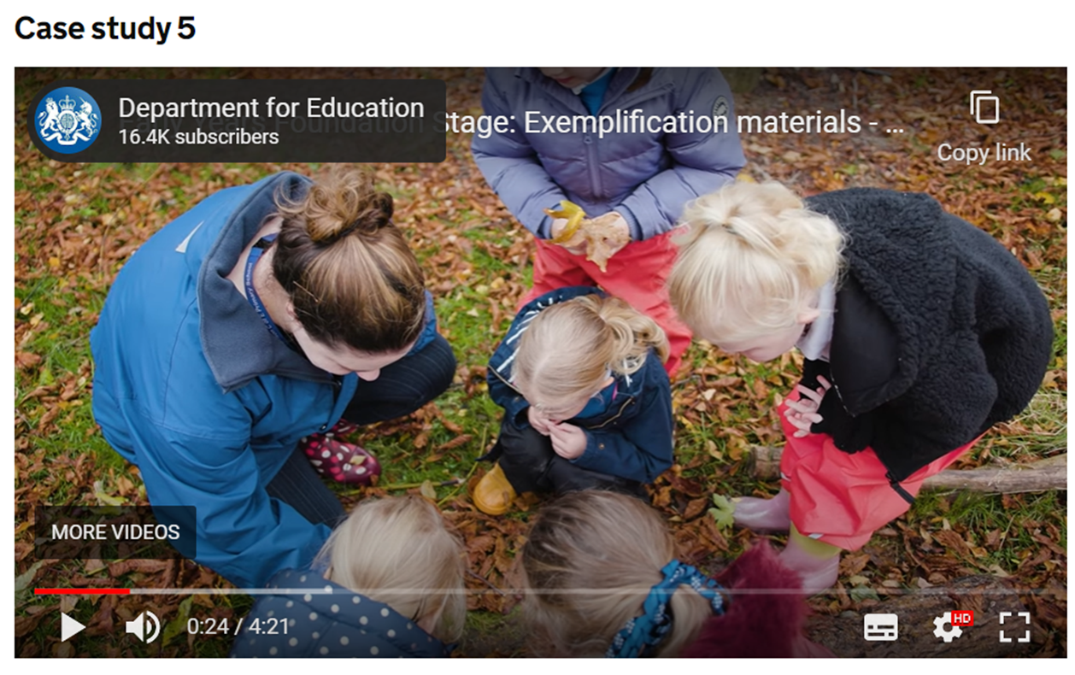
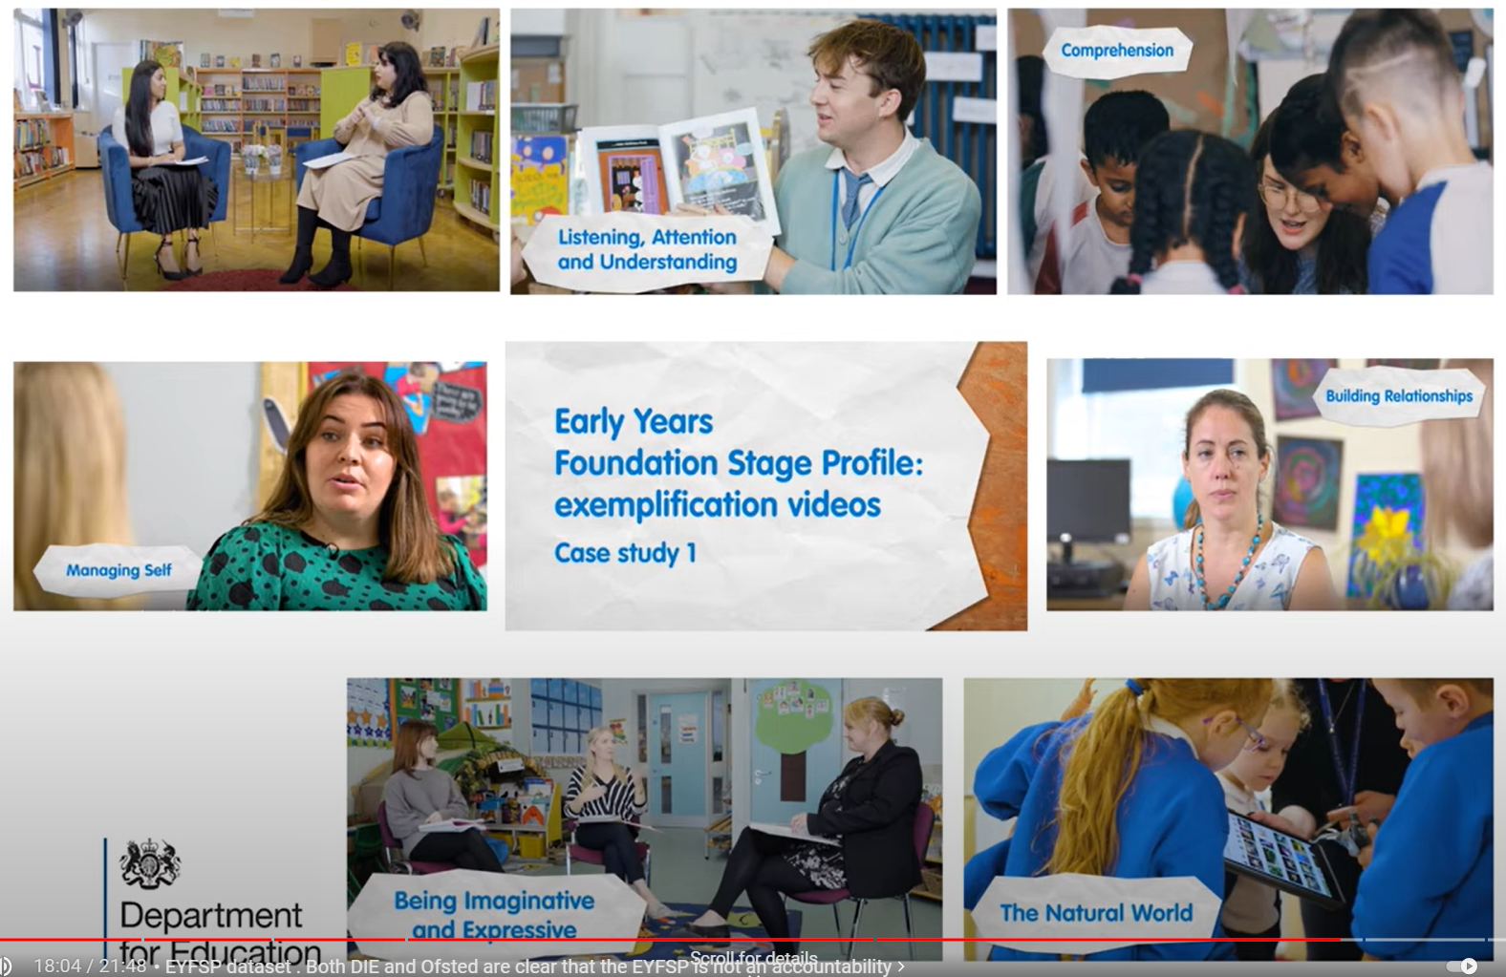
EYFS Profile 2022
Exemplification materials
Notes:
Linked video on slide
The DfE has published exemplification materials to provide support for schools when completing the Early Years Foundation Stage Profile (EYFSP) assessment for children at the end of reception year. These are a collection of case study videos that demonstrate teachers and leaders having professional discussions about individual children’s development and their EYFSP judgements.
DfE have deliberately taken a different approach to these exemplification materials to be clear that teachers, schools and settings should move away from excessive tracking and evidence collection and to avoid giving schools additional criteria to consider when completing the EYFSP, beyond what is set out in the new goals themselves.
The exemplification materials demonstrate how, over the course of the reception year, practitioners build their knowledge and understanding of what children know, understand and can do.
Practitioners show how they can draw on this knowledge and their own expert professional judgement to make an accurate summative assessment at the end of the year. This is sufficient to assess a child’s individual level of development in relation to each of the ELGs.
Teachers are not expected to record evidence for each of the ELGs or provide proof of the child’s level of development for the purposes of completing the EYFSP.
What matters most is providing information to parents/carers and Key Stage 1 teachers in order to support each child’s development and next steps.
Suite of 7 videos; teachers, leaders and support staff engaged in professional discussions about a child’s holistic development; based on knowledge of the child over the year, to make a judgement on whether they have reached expected level in ELG

Slide 9
EYFS Profile 2022
3.6 Completing the profile for children with a special educational need or disability (SEND) (page 15)
Teachers must have regard to the SEND Code of Practice when supporting children with SEND. This outlines the four-stage process of ‘assess, plan, do, review’ to identify and support children with SEND.
Further resources for teachers working with children with SEND are available on the SEND gateway. On behalf of the Department for Education, Nasen has produced a series of short guides on identifying and supporting children with SEND in the early years, including a guide focused on reception classes.
SEND
Notes:
Note; refer to Inclusive……
Assessment of a child’s development should include any scaffolding, strategies or support that a child may need in order to demonstrate what they know, remember and can do.; children who on a day to day basis use mobility aids, IT, magnification, etc
Children may show this using AAC - Makaton, signing, visuals, PECs and any other non-verbal communication, except for the ELGs in Speaking.
An Education Health Care Plan (EHCP), or an ongoing identification of need, is not a reason for exemption of a child from the EYFSP assessment, or to assume that the child cannot meet the ELGs. For example, when assessing children in the ELG for ‘Managing Self’ it is important to take in to account the ways a child with profound and/or multiple learning disabilities, or medical needs might demonstrate that they recognise their own self-care needs and comply with toileting, dressing or feeding routines.

Slide 10
EYFS Profile 2022
The profile recognises and values linguistic diversity and is inclusive of children whose home language is not English.
The ELGs for communication and language, and for literacy, must be assessed in relation to the child’s competency in English. However, the remaining ELGs may be assessed in the context of any language.
In such cases teachers will need to observe the child over time and seek input from the parents, and/or bilingual support assistants, to be confident about what the child knows and understands. Teachers should use their professional judgement to consider whether the accounts provided are consistent with their professional knowledge of the child. Other teachers as well as parents/carers should be consulted to aid with this.
EAL
Notes:
It is important to provide children with experiences and opportunities to demonstrate their learning in their home language
When assessing your EAL children, the ELGs for Communication and Language and Literacy must be assessed in English.
The EYFSP handbook asks practitioners to acknowledge the importance of parental partnerships and that learning and development for children with EAL and different cultural back grounds is enhanced when Children whose home language is not English should have opportunities to engage in activities in the security of their home language. Children from different cultural backgrounds will demonstrate their attainment not only through what they have been taught but also when activities such as role play, cookery, celebrations, visits or events are linked to their cultural experience
Children with EAL, including those who are recently new to English, are not exempt from the EYFS Profile, except in very exceptional circumstances, and every effort should be made to include the child’s family in assessment
Inclusive: practitioners need to be alert to the general diversity of children’s interests, needs and backgrounds, in order to accurately assess their development and outcomes against the ELGs. …..Children whose home language is not English should have opportunities to engage in activities in the security of their home language. Children from different cultural backgrounds will demonstrate their attainment not only through what they have been taught but also when activities such as role play, cookery, celebrations, visits or events are linked to their cultural experience.

Slide 11
EYFS Profile 2022
3.2 Exceptions and exemptions
The EYFS profile must be completed unless:
• The Secretary of State for Education has granted an exemption for the profile for the setting or an individual child
• the child is continuing in EYFS provision beyond the year in which they turn 5
• the child has not spent enough time in the setting for an accurate assessment to be made, for example due to illness or
medical treatment or not starting at the setting until a substantial part of the year has gone by. It is for the teacher to use
their professional judgment to decide whether an accurate assessment can be made in the time available.
The expectation is that children will move with their peers so they will be assessed once for the EYFS profile. In exceptional circumstances, after discussion and in agreement with parents, a child might remain in EYFS provision beyond the end of the academic year in which they reach the age of 5. Schools should take care to make sure this decision does not prejudice the child’s personal, social, and emotional development.
In these exceptional cases, the EYFS profile should be completed once only, at the end of the year before the child moves into KS1.
If an exemption is granted for an individual child, this must be recorded as ‘A’ (no assessment) for each ELG.
3.2 Exemptions
Notes:
If an exemption is granted for an individual child, this must be recorded as ‘A’ (no assessment) for each ELG. – this means no assessment is recorded for all ELGs for that child
Consider how do you gather information about a child joining your setting mid year?
If a child remains at their nursery setting during their reception year and joins at the spring/easter point what do you do during the year to share information with the setting?
To accurately assess a child how/who are you having conversations with – the previous setting, other professionals that have been working with that child?
Change in the guidance for completing EYFSProfile – used to be a date after which if a child joined your reception there was a duty on the previous setting to complete a profile for that child
NOW your professional judgement

Slide 12
EYFS Profile 2022
LA responsibilities
LAs must:
• ensure schools have a secure electronic system to submit EYFS profile data
• collect EYFS profile data, and quality assure and submit it to DfE
LA quality assurance of the data relates to ensuring that a full and complete set of data is submitted to the department for the schools in their area
LA should submit data to DfE using the COLLECT data collection system
4.3 Responsibilities
Notes:
Key stakeholders specific responsibilities – important that these are known and actions, timeframe etc created to ensure they are undertaken.
The data collection, entry and submission processes should be planned in advance. LA data team have sent information to your schools detailing how and when this should happen. Please check with your assessment leads for specific information and allowing time for internal processes to take place.
Key dates are on the next slide.
LA QA - following up on missing records either at school or child level, querying any clear errors or inconsistencies. No longer ensuring accuracy of teachers’ professional judgement. It is the HT responsibility to make internal checks and verifying the data is an accurate record of the cohort before submitting to the LA.
LA data must pass a range of validation checks in order to be accepted by DfE and must be submitted before the required date for it to be included in national data set.

Slide 13
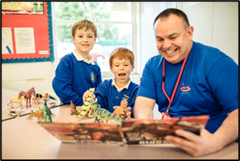
EYFS Profile 2022
Key responsibilities of Headteachers
• EYFS profile completed for all eligible children and data is quality assured
• provision is made to meet the requirements of all children with special educational needs
• EYFS profile outcomes and the data accurately reflects the level of development of the
current cohort of children
• return EYFSP data to their LA in accordance with the table in section 4.2
• provide to their school’s governing body EYFS with profile assessments, enabling it to
comply with national data submission requirements and report to parents
• ensure parents are provided with a written report of the child’s development against the
ELGs and have the opportunity to discuss the EYFS profile
4.3 Responsibilities
Notes:
Headteachers have a duty to implement the EYFS. They must ensure their school or provision complies with the learning and development requirements and are responsible for the reliability of their EYFS profile outcomes. They must check to ensure that the data accurately reflects the outcomes of the current cohort of children.
Assessment processes- should be proportionate and directly inform teaching and learning and should not involve excessive record keeping, collection of evidence or prolonged time away from the children
Moderation processes - EYFSP handbook makes it clear that it is for schools to decide on their approach to moderation – should be collaborative with colleagues, and not require the gathering of physical evidence. Professional discussions
Increasingly governing bodies are required and want to have a good understanding of the functions of a school and particularly the teaching and learning that is being provided for the children across all ages and key stages.
Do you know if there is an appointed EY governor in your school? Have they been to see the provision and meet the team. This can help them have a better understanding of EYs and how the ‘teaching’ can and should be different to meet the EYFS stat framework and needs of the children. Talking to them about the learning that is taking place is crucial.

Slide 14
EYFS Profile 2022
5.1 Reporting to the year 1 teacher
Reception teachers must give year 1 teachers a copy of each child’s EYFS profile, including:
a record of the child’s outcomes against the 17 ELGs, stating for each ELG whether the child is:
- meeting ‘expected’ levels or
- not yet reaching expected levels (‘emerging’)
may choose to provide a short commentary on how the child demonstrates the three characteristics of effective learning
EYFS teachers are not required or expected to produce any written reports for year 1 teachers beyond these basic requirements
where children have an outcome at the ‘emerging’ level, teachers should provide additional information, including any specific assessment or provision in place for children with SEND
5.1 Reporting to year 1 teachers
Notes:
inform year 1 teachers about each child’s stage of development and learning needs and help them to plan the year 1 curriculum to meet the needs of all children
EYFS teachers are .
It is, however, crucial that EYFS teachers and year 1 teachers are given sufficient time to discuss and expand on all the information presented in the EYFS profile, in order to give the year 1 teacher a fully rounded picture of the development of each child.

Slide 15
EYFS Profile 2022
Teachers must:
provide a written report to parents which summarises the results of the EYFS profile
make the results of the child’s profile available to parents
Schools must:
offer parents the opportunity to discuss the profile with the child’s teacher
if parents ask to see a copy of their child’s profile report, the provider must make this available
be aware of their responsibilities under the Data Protection Act 1998 and the General Data Protection Regulation
5.2 Reporting to parents
Notes:
Parents should be involved in the assessment process and encouraged to take part in their child’s learning and development.
These have some implications for internal processes to be organised and reviewed to ensure they meet with the new EYFSP handbook.

Slide 16
EYFS Profile 2022
High quality professional dialogue between EYFS and year one teachers should include:
information on each child’s stage of development and learning needs
discussing in depth of children with ‘emerging’ for one or more ELG providing additional information such as barriers to learning that have been identified and successful strategies to help the child overcome these
ongoing dialogue before the summer term allows processes to be built on a shared understanding and planned and implemented in good time
sharing any records from within or outside the setting with year 1 teachers and using these records to inform transition conversations and processes
other professionals working with the child so they can contribute to transition conversations
Supporting successful Transition to Year 1
Notes:
help them to plan the year 1 curriculum to meet the needs of all children. (pg 6)
Along with EYFS profile judgements, teachers should. Wherever possible, with the 15. Ongoing dialogue with parents is vital so that practitioners can get a clear picture of the child’s learning and development, and to ensure parents have a clear understanding of their child’s development and any additional support which will be offered. (pg 15)

Slide 17
EYFS Profile 2022
Does the EYFS Profile data reflect your knowledge and expectations of the cohort?
What are the strengths/ weaknesses in this year’s cohort?
across areas of learning?
across aspects of learning?
across individual outcomes?
achievement of GLD?
From the data, what aspects of breadth/depth of EYFS provision need further development in the school?
Are there any significant differences in outcomes for your boys and girls?
How does the attainment of different groups (SEN, ethnic minority groups, pupil premium) compare to the average attainment of the group?
How have the needs of individual children been addressed e.g. children with SEND or with EAL?
How are Y1 teachers using the EYFS Profile data as the starting point for curriculum planning? How are they using the EYFS to inform planning for children who have been assessed as emerging?
How does your profile data inform provision?

Slide 18
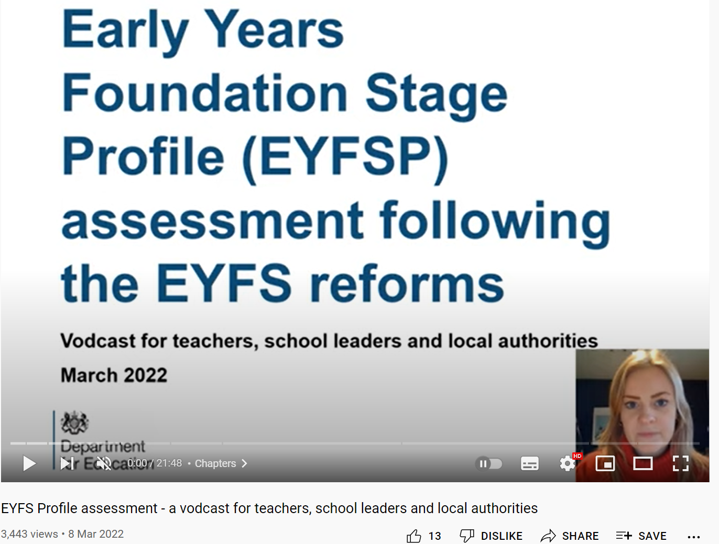
EYFS Profile 2022
EYFS Profile assessment - a vodcast for teachers, school leaders and local authorities – YouTube
DfE vodcast
Notes:
EYFS Profile assessment - a vodcast for teachers, school leaders and local authorities – YouTube
6.36 https://www.youtube.com/watch?v=7GaGGR3AzOc&t=396s new EYFSP assessment and requirements for schools
A vodcast for schools, multi-academy trusts and local authorities has also been published alongside the videos to explain the changes and what is different this year.

Slide 19
EYFS Profile 2022
Key actions | Dates
Schools’ internal moderation, professional discussions, QA & finalising EYFSP ELG judgements | Summer term 2022
Headteachers QA and sign off EYFS Profile cohort data | Early – mid June 2022
Submission of school EYFS Profile data to LA | by 22nd June 2022
Schools profile & transition discussion with year 1 teachers | Summer term 2022
Completion of EYFS profile | by 30th June 2022
LA EYFSP data verification period | 23rd June – 8th July 2022
LA EYFSP data submission to DfE | by 29th July 2022
Key dates

