Slide 1
MONUMENT AGAINST VIOLENCE AND AGGRESSION JANUARY 2023

Slide 2
Aims
To bring the community together to take a stand against Violence
Launch 30-days of intensive anti-violence youth engagement, addressing anti-violence and anti-aggression
Complete a programme of events incorporating engagement, education and enforcement
Spread the message of the Angel and encourage people to see the Monument
WORKING TOGETHER IN PARTNERSHIP
Notes:
Remind children that they do not have to share any personal experiences and should talk to an adult after if any of the content affects them in any way.

Slide 3
Knife Angel Visit Arbour Park 9th January 2023-31st January 2023
The Monument, also known as the Knife Angel, will see Police, Community Groups and clubs completing the following:
School Visits and educational program at Primary/Secondary Schools
Licensing Operations
Music Competition by Love Music Hate Violence and Slough Music Services
Knife Surrender bins, to encourage the local community to prevent knife crime
Knife arch’s in schools, train and bus stations.
WORKING TOGETHER IN PARTNERSHIP

Slide 4
WHY NOW
Whilst serious violence in Slough has reduced over the last three years, we know that violence, particularly knife crime in recent months has become a particular concern for our community.
There is a clear desire in our town to work together to stamp out violence and a multi-agency and community response is required.
There is never a right or wrong time to talk about violence and aggression however, the New Year can act as a catalyst for encouraging conversation about violence and aggression
WORKING TOGETHER IN PARTNERSHIP

Slide 5
What do you think Knife crime means?
Knife crime is any crime that involves a knife or sharp instrument. Offences with a knife can include threatening people, a robbery or burglary, a murder or assault. Simply carrying a knife – even if a young person hasn’t used it – is also considered a crime and can get them in trouble.
WORKING TOGETHER IN PARTNERSHIP
Notes:
Ask children to come up with ideas of what this means to them – it can be anything from whether they think this is illegal to if they have heard anything in the media. Explain that unfortunately some people do carry knives. Do u think knife arch tackle knife crime?

Slide 6
What can happen if you carry a knife?
Someone could get hurt. This could be you or someone else!
Even if you don’t use the knife, you can still be stopped, searched, and arrested for committing an offence.
This could lead to you having a criminal record for the rest of your life, affecting university offers, job opportunities and preventing entering certain countries when travelling.
WORKING TOGETHER IN PARTNERSHIP

Slide 7
The Law
It is illegal to carry a knife in public
It is illegal to threaten someone with a knife in public
It is illegal to have a knife at school
It is illegal to use someone else to look after/hide/transport a knife for you
WORKING TOGETHER IN PARTNERSHIP

Slide 8
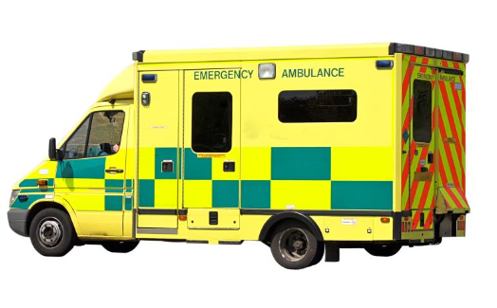
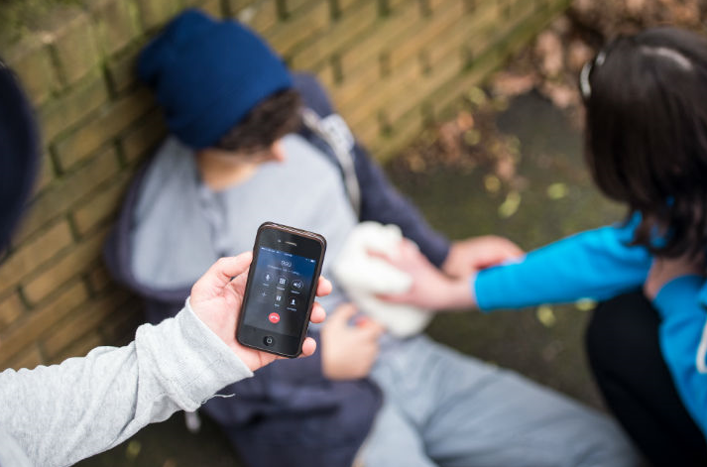
What should you do if someone gets hurt?
Call 999
Put pressure on the wound
Keep pressure on the wound until an ambulance arrives
WORKING TOGETHER IN PARTNERSHIP

Slide 9
WHAT WE NEED FROM YOU?
NOTHING! BUT….We encourage you all to go and see the Angel during its visit to Slough if you are able to. So please take yourselves, ask your parents or friends and come and visit the Angel
If you would like to discuss Violence in any form we signpost you to the following organisations or alternatively speak to a member of the teaching staff confidentially and independently
WORKING TOGETHER IN PARTNERSHIP

Slide 10
WORKING TOGETHER IN PARTNERSHIP

Slide 11
Any questions?
WORKING TOGETHER IN PARTNERSHIP

