Slide 1
Campaign kit
Brought to you by
Mental Health First Aid (MHFA) England

Slide 2
This campaign kit has been developed to support you to get involved with My Whole Self, both online and offline.
Whether you chose to run your activities on My Whole Self Day (14 March), or across the year, we hope you will join the campaign.
It is the campaign for workplace culture change and empowers employees to bring their whole selves to work.

Slide 3
Contents
About the My Whole Self campaign
Tools to help you join the conversation and spread the word
Plan your own virtual events
Join MHFA England's My Whole Self webinars
Social media posts and graphics
Share a My Whole ‘Selfie’ or a video story on social media
Web or newsletter copy

Slide 4
About My Whole Self
What?​
My Whole Self is the campaign for workplace culture change from Mental Health First Aid (MHFA) England
Now in its fourth year, it calls on organisations to empower employees to bring their whole self to work, and support their own and other’s wellbeing
Wherever you are working from, feeling supported to choose to bring your whole self to work is better for wellbeing and better for business
Why?​
As the way we work has changed over the last three years, it is vital that workplaces, whether virtual, in person, or hybrid support their staff to bring their whole selves to work
Workplaces are key to creating a society where everyone’s mental health matters
Bringing together diversity and inclusion with health and wellbeing will drive a positive transformation in workplace mental health and performance
The key points
By bringing together diversity and inclusion with health and wellbeing we can drive positive transformation in workplace mental health and performance
Our people and teams are at their most effective and creative when everybody feels psychologically safe and is seen, heard and valued. We understand the critical role that managers play in making this happen. Managers help build working environments that allow people to be authentic and share their whole self.
This year, MHFA England will be publishing a free Managers' Toolkit to help support themselves as a manager and therefore their teams
In the meantime, visit our website to find a suite of free tools and activities for to use to help support your involvement in My Whole Self

Slide 5
Support My Whole Self 2023

Slide 6
Plan your own virtual events
How will you celebrate My Whole Self Day on 14 March? Involve your colleagues and HR or Diversity & Inclusion team and start planning how you can mark the moment. Download more information including free resources from My Whole Self 2023 · MHFA England
My Whole Self Desert Island Favourites
My Whole Self book club
My Whole Self discussion panel

Slide 7
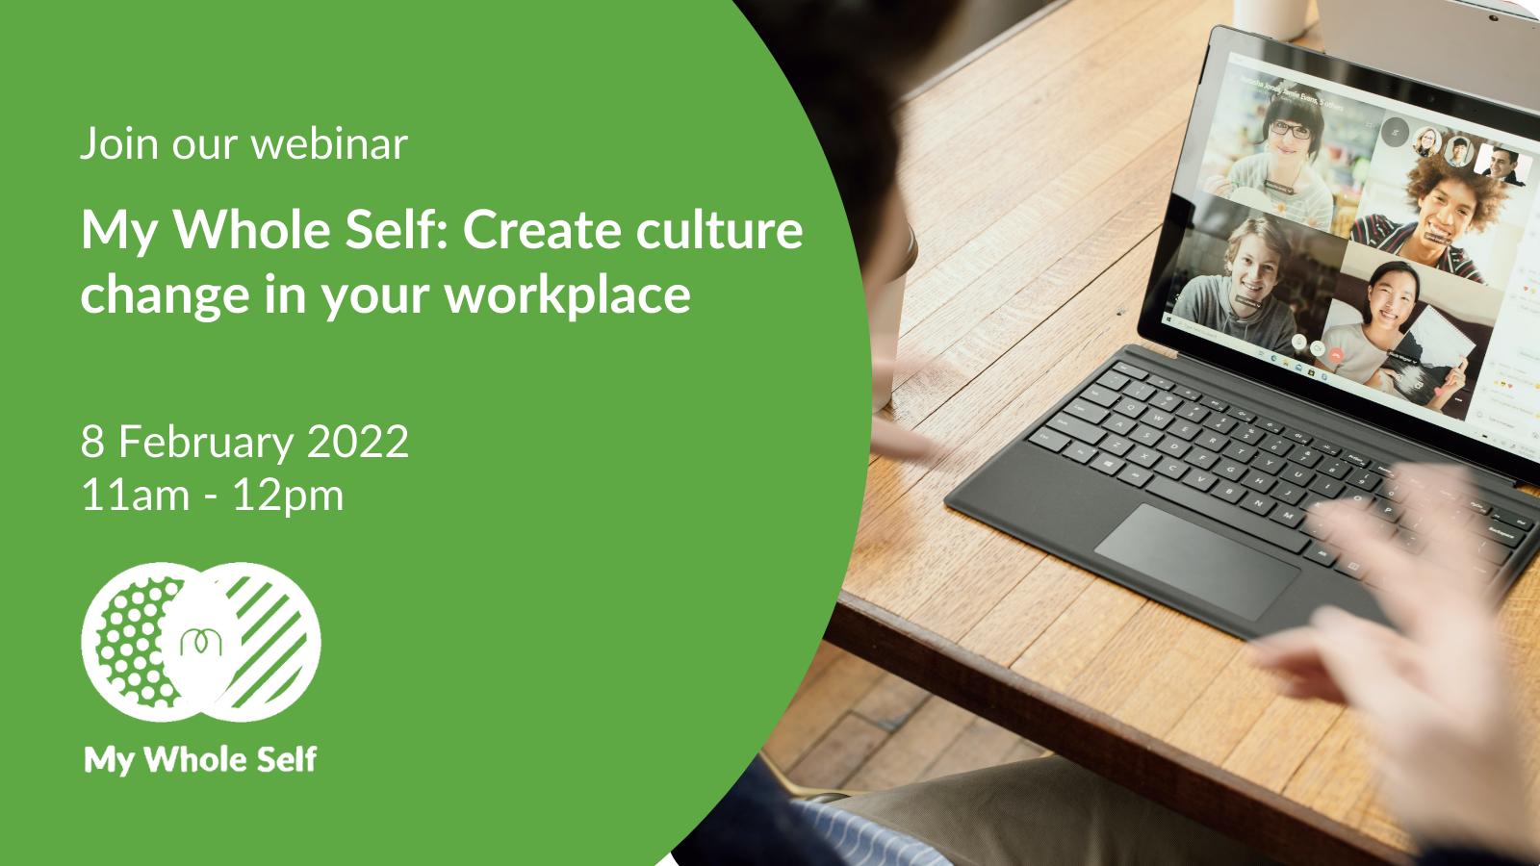
MHFA England Live
MHFA England will be hosting a live webinar on My Whole Self Day, 14 March. More information and registration details to follow.
If you want to watch last year’s webinars for some inspiration, you can take a look below:
My Whole Self: Create culture change in your workplace
My Whole Self: Creating a healthy and inclusive workplace
You can view all our webinars here.

Slide 8
Join the conversation and spread the word

Slide 9
Join the conversation online
We’ve drafted some suggested social media posts so you can share your support for the campaign with your network as we build up to My Whole Self Day on Tuesday 14 March.
Use a social card from the following slide to accompany your post.
Save the date - 14 March is #MyWholeSelf Day which encourages everyone to bring their whole self to work. Check out @MHFAEngland's free resources and get involved here: https://bit.ly/3x1QQsJ
We’re supporting #MyWholeSelf because everyone should be able to bring their whole self to work – it’s better for our wellbeing and for business. Get involved by downloading @MHFAEngland’s free resources here: https://bit.ly/3x1QQsJ
How will you celebrate #MyWholeSelf Day on 14 March? Get your free resources from @MHFAEngland's website now and start planning what your workplace can do to empower everyone to bring their whole selves to work https://bit.ly/3x1QQsJ
How can we create mentally healthy workplaces? It starts when we are able to bring our ‘whole self’ to work. On 14 March workplaces across the country will celebrate My Whole Self Day – download these free resources now to get involved: https://bit.ly/3x1QQsJ

Slide 10
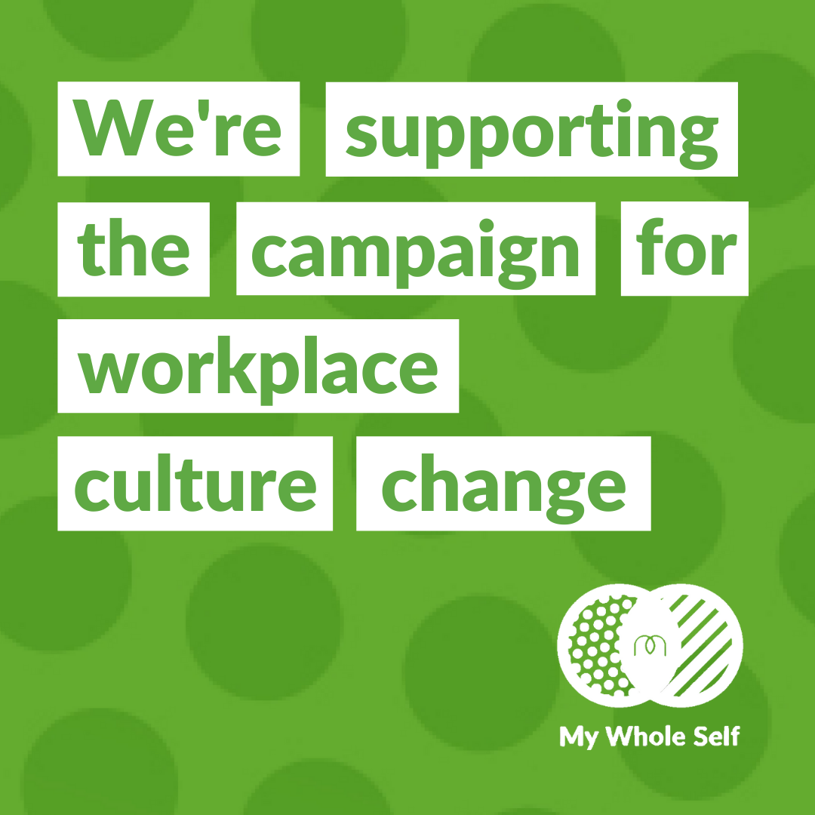
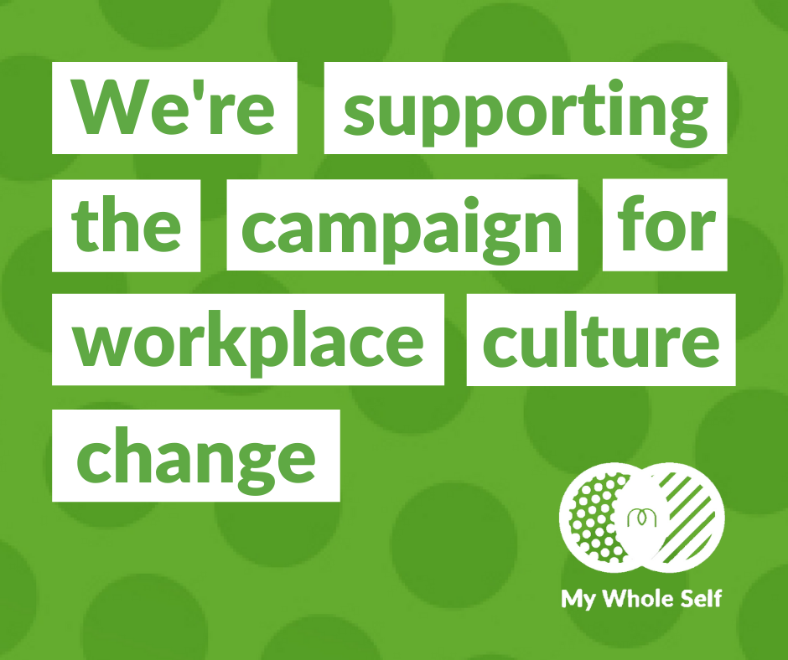
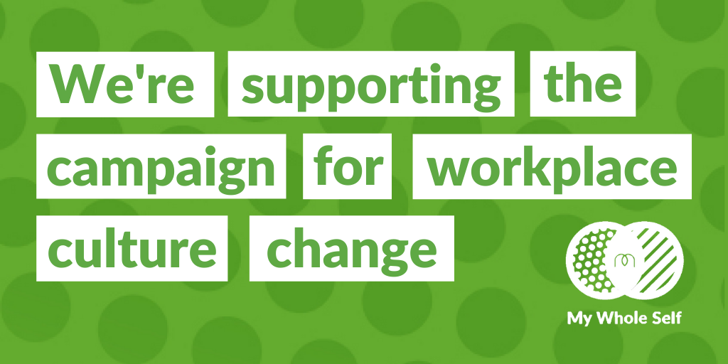
Use our social cards
Show your support for the My Whole Self campaign by using one of our social cards to use across your social channels. Download these by clicking on the links below.
Instagram
LinkedIn
Facebook
Twitter

Slide 11
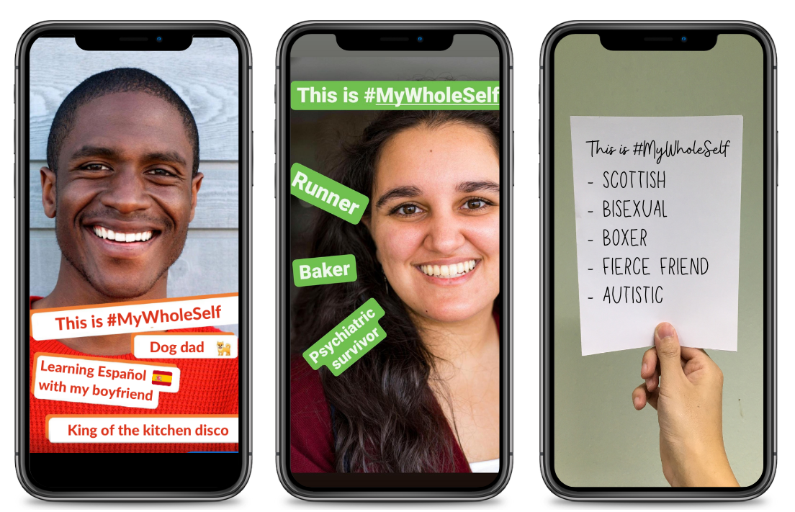
Share your My Whole Selfie and video story
Show your support for #MyWholeSelf on 14 March by sharing a photo of your authentic self. Here’s how to take part:
Take a selfie, and add ‘This is #MyWholeSelf’ and words to describe your whole self. You can write on a piece of paper and hold it in the selfie, or you can add the words using your phone’s photo app or in your social media app (e.g. Instagram Stories, Facebook Stories, or a LinkedIn post)
Share your picture on your social media - you can tag us @MHFAEngland
A self-shot video story is another powerful way to share you or your organisation’s support. Ask a leader or an employee to share their #MyWholeSelf story by answering the three questions below. Film this as a 60 second piece-to-camera on a smartphone and share on social media using #MyWholeSelf on 14 March – My Whole Self Day.
Why are you supporting the My Whole Self campaign?
In your experience, how has bringing your whole self to work helped you?
Why is it important that everyone feels they can bring their whole selves to work?

Slide 12
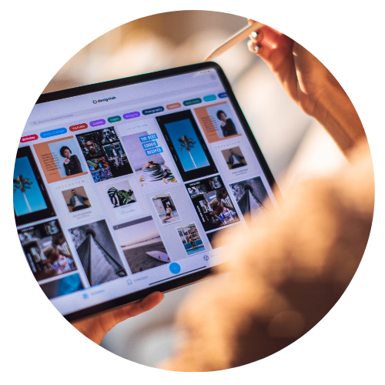
Web or newsletter copy
You can adapt this copy for your newsletter, blog, or website to highlight your support for the campaign and encourage others in your network to take part:
[organisation name] is proud to be supporting My Whole Self 2023, Mental Health First Aid (MHFA) England’s campaign for workplace culture change.
In 2023 we shouldn't feel like we have to leave parts of our identity behind - be that our cultural or ethnic background, gender identity, sexuality, disability, or health. The My Whole Self campaign calls on organisations to empower employees to bring their whole self to work, whether that be digitally or in person, and support their own and other’s wellbeing. This year we are proud to be a part of this movement.
To mark My Whole Self Day, we will be [insert activities that you will be doing as well as joining instructions]. If you would like to find out more about the campaign and download free resources to help you take part at, visit My Whole Self · MHFA England http://mhfaengland.org/mhfa-centre/campaigns/my-whole-self-2022/

Slide 13
My Whole Self Day 2023
This year MHFA England are focusing their attention on the role that managers play in helping people feel psychologically safe and bring their whole self to work. Feeling supported to bring your whole self to work is better for wellbeing and better for business. Managers help build working environments that allow people to be authentic and share their whole self.
Keep an eye on our digital channels on and around the 14 March when we will publish a FREE Managers' Toolkit.
To ensure you get a copy of your toolkit, visit My Whole Self · MHFA England and sign up to receive My Whole Self emails.

Slide 14
We really value your support. Let us know how you plan to get involved and spread the word about My Whole Self
To request additional resources or to discuss the campaign further contact: media@mhfaengland.org

