Slide 1
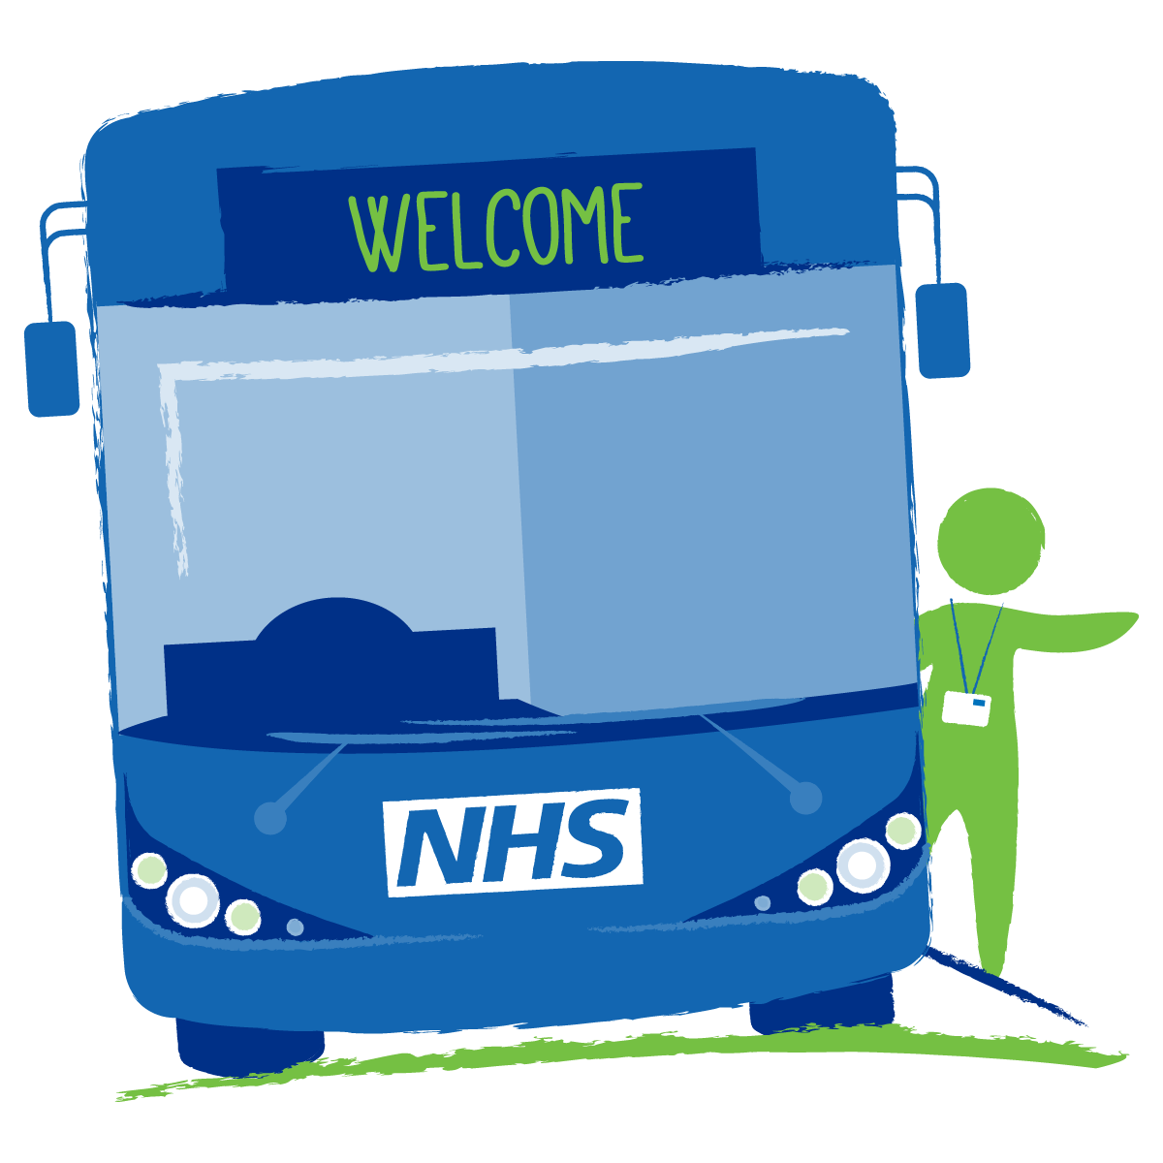

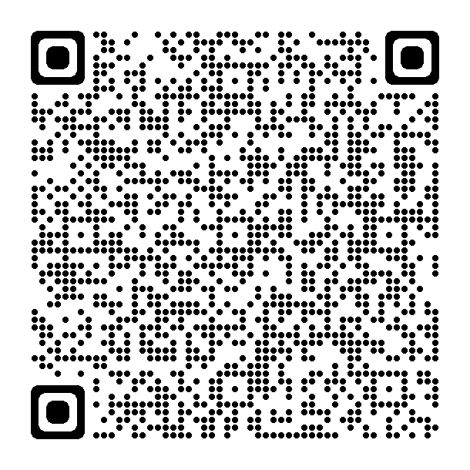
Early Language Workshops
On 22nd November, the Early Years Speech & Language Therapy Team will be visiting sites across Berkshire on the Health Bus. Our Speech & Language Therapists will be available for any questions between 1pm and 3pm and will also be delivering workshops live between 1:30pm and 2:30pm.
Please scan the QR code below for more information:
Waitrose
Rectory Rd,
Wokingham
RG40 1BB
22nd November, 1pm- 3pm

