Slide 1
Supporting smooth transitions into reception - practical examples from our latest guidance
Reception RISE Webinar
24 June 2026

Slide 2
Agenda
1
Opening and context of transition
Heather Scott –DfE (Chair) & Sue Robb- Best Start In Life Champion
2
Developing strong relationships with families and children & preparing children for starting Reception
Evelyn Street Primary Academy (including parent) & Goosehill Nursery
3
Building strong, collaborative partnerships between schools and settings
Thornton Dale CofE Primary School & Puddleducks Nursery
4
Inclusion by design: building understanding before children arrive
Ilsham CofE Primary
5
Reflections, call to action and closing remarks
Heather Scott –DfE (Chair) & Sue Robb- Best Start In Life Champion

Slide 3
Getting children ready for reception: How schools and early years settings can work together with families to support transition into Reception
Overview
Guidance for all educators involved in the transition to reception, built around three clear principles that keep children at the centre and focus on building a sense of belonging so that the needs of every child and family can be met.
Guidance: Getting children ready for reception: supporting effective transition - GOV.UK and Top tips: Supporting a smooth transition into reception - GOV.UK
Working closely with families
Strong partnerships with early years settings
Early identification of need
Build relationships early and make them meaningful​
Share clear expectations and practical information​
Understand and address parental anxieties​
Deep and sustained with shared responsibility
Plan purposeful sequence of transition activities
Request and share information
Start early: transition is a year-round process​
Visits to home and settings​
Prioritise inclusion from the start
Time to plan with partners

Slide 4
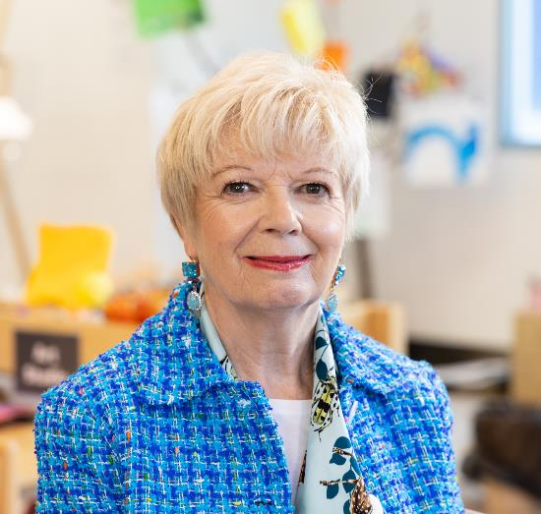
Context of transition
Sue Robb, DfE Best Start in Life Champion

Slide 5
Developing strong relationships with families and children
Louise Smith, CEO, Warrington Primary Academy Trust and Executive Headteacher, Evelyn Street
Kay Tobin, Assistant Headteacher and Early Years Lead, Evelyn Street Primary

Slide 6

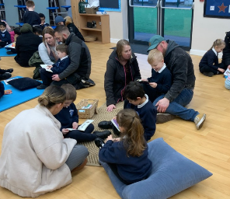
Building Culture Through Initial Relationships
Model relationship-based practice: “we are part of the family’s transition”
KEY MESSAGES
WHAT THIS LOOK LIKE IN PRACTICE
IMPACT
Transition begins long before a child's first day.
Positive relationships create a sense of belonging for children and families.
Consistent communication helps reduce anxiety and build trust.
A strong transition process reflects our school culture and values.
Every interaction with families contributes to a welcoming, inclusive community.
Nursery visits and transition meetings.
Stay-and-play sessions and classroom familiarisation.
Sharing information about children's interests, strengths and needs.
Consistent messages from all staff.
Celebrating diversity and ensuring every family feels seen and valued.
Children feel safe, confident and ready to learn.
Families develop trust in the school.
Strong foundations for attendance, engagement and achievement.

Slide 7
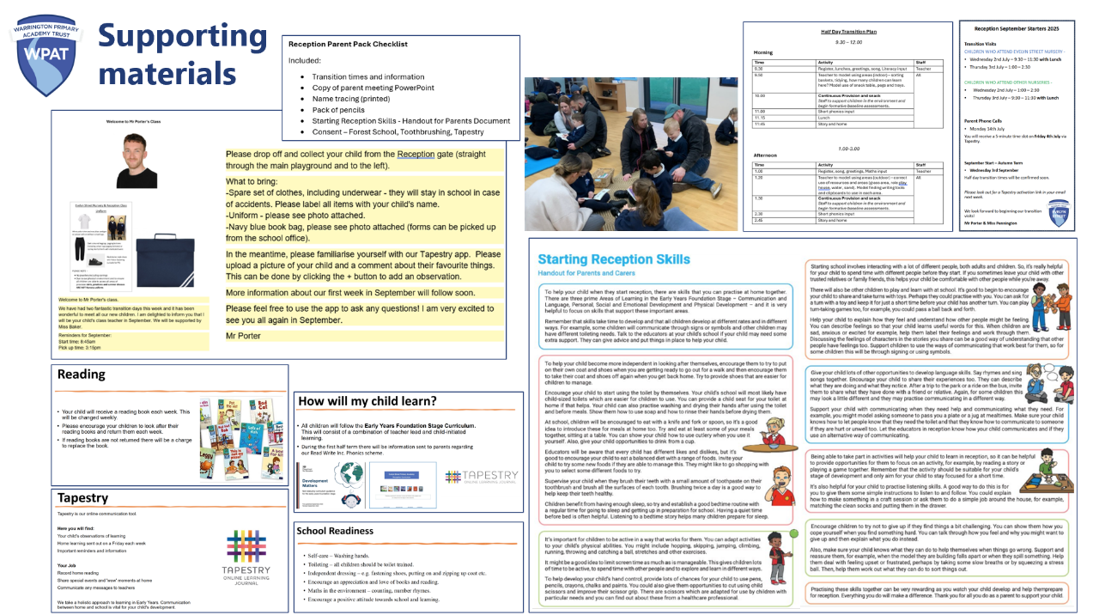

Slide 8
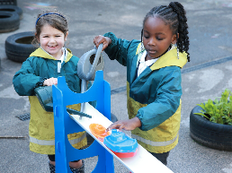
Working with Parents to Support Reception Readiness
KEY MESSAGES
SUPPORTING RECEPTION READINESS
BUILDING LONG-TERM RELATIONSHPS
Parents are a child's first and most important educators.
Reception readiness is about more than academic skills.
Partnership working creates consistency between home and school.
Strong parent relationships strengthen the wider school community.
Share clear expectations about routines and independence.
Offer practical guidance rather than judgement.
Encourage:
  Communication and language development.
  Independence (toileting, dressing, self-care).
  Social skills and emotional regulation.
  Listening, attention and turn-taking.
  A love of stories, play and exploration.
Regular communication and celebration of successes.
Opportunities for parent engagement.
Listening to family voice and responding to needs.
Creating a culture of partnership rather than compliance.
Impact
Smoother transition into Reception.
Increased parental confidence.
Stronger home-school relationships.
Better outcomes for children.

Slide 9
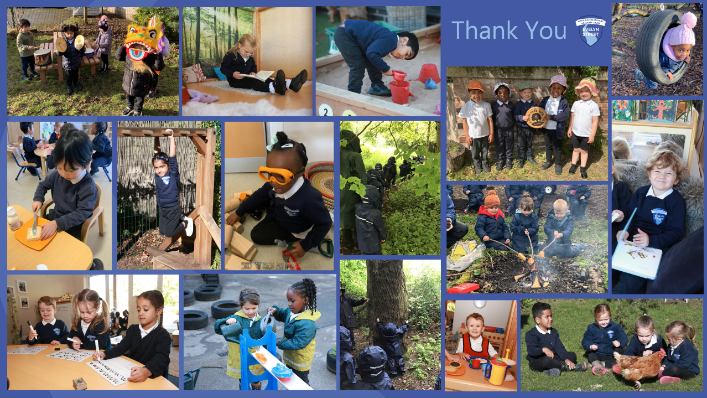

Slide 10
Preparing children for starting Reception
Amanda Willis, Nursery Manager
Goosehill Private Nursery & Goosehill Hepscott Park

Slide 11
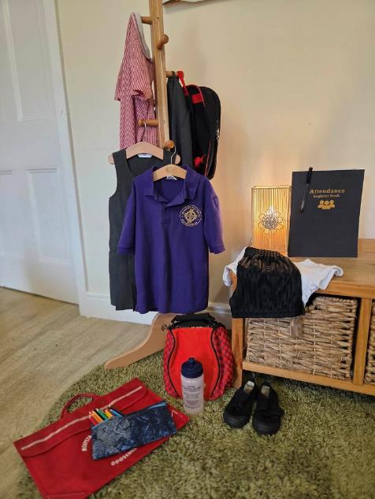

Before children arrive at school, they need to see themselves there.
Building familiarity, confidence and independence through meaningful play.

Slide 12
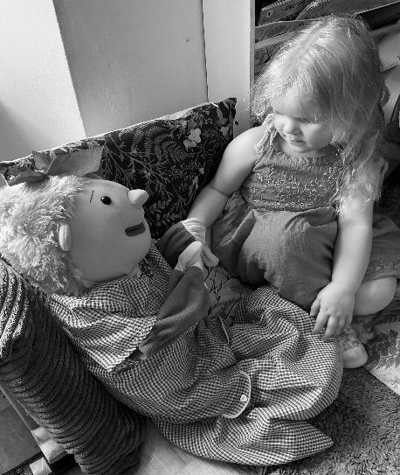
Georgia the Puppet Supporting Emotional Readiness
Helps children explore thoughts and feelings about school
Reduces the pressure of speaking directly to adults and encourages the children to voice uncertainties
Offers reassurance and emotional support
Provides repeated opportunities to revisit school-related thoughts and feelings
Trusted friend within nursery

Slide 13
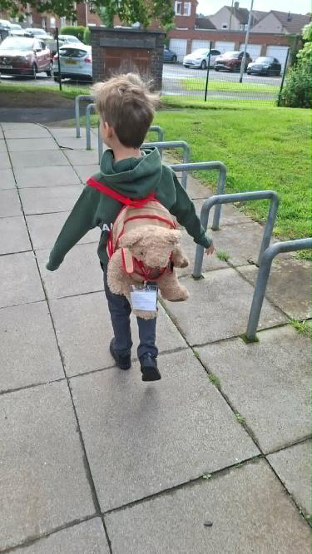
Bob the Bear
Building Connections with School
Accompanies children on school visits
Gives children a voice when they are unsure about speaking to teachers
Strengthens links between nursery, school and the children

Slide 14
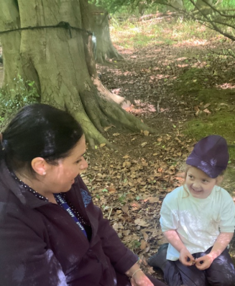
Building relationships
“The sessions where our Reception teacher was able to visit and play with the children in their nursery setting were so valuable. These visits really helped to build early relationships and gave the children confidence before starting school. We were particularly impressed by how carefully each visit was planned to suit individual children – for example, arranging to meet a quieter child during a forest school session, where they felt most comfortable and could really shine”
Mrs O’ Dell
Tritlington Church of England First School, Northumberland

Slide 15
Building strong, collaborative partnerships between schools and settings
Camarah Mosey, Headteacher, Thornton Dale CofE Primary
Lindsey Dring, Nursery Manager, Puddleducks, Pickering

Slide 16
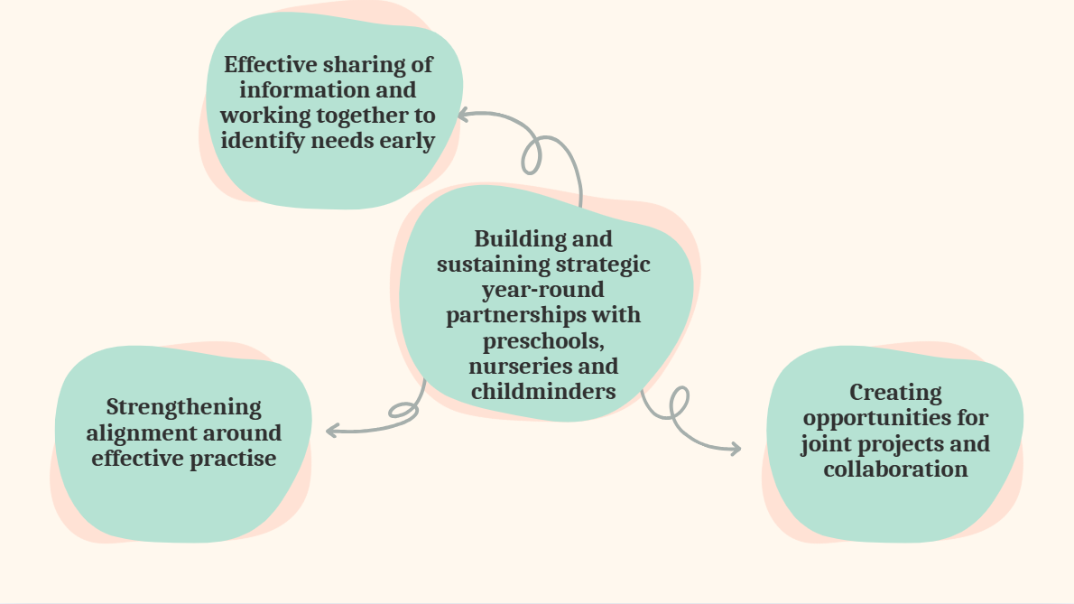
Partnership mapping

Slide 17

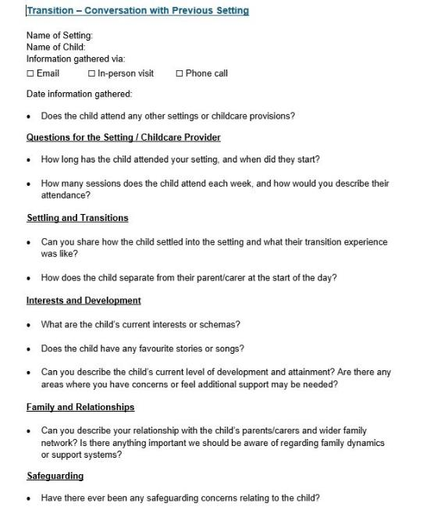
Effective sharing of information

Slide 18
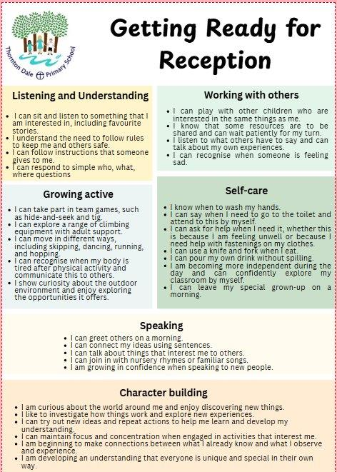

Strengthening alignment around effective practice

Slide 19
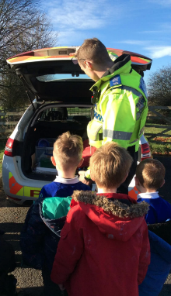

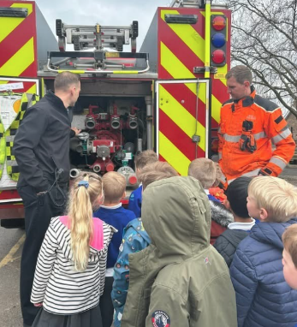
Creating opportunities for joint projects and collaboration

Slide 20
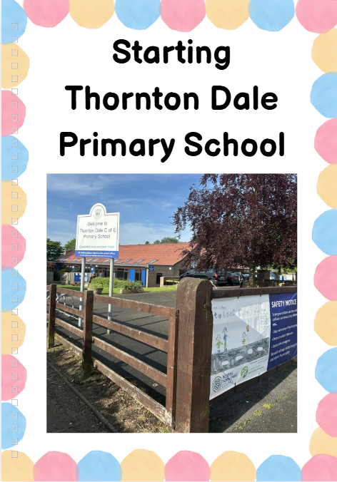
Transition packs for settings
School Jumper​
Social Story
Book Bag ​
Key Adults
Expectations document
Photos of environment

Slide 21

Lindsey Dring
Nursery Director,
Puddleducks Nursery, Pickering
A reflection of the transition process from a nursery setting

Slide 22
Inclusion by design: building understanding before children arrive
Jake Grinsill, Headteacher
Ilsham Church of England Academy

Slide 23
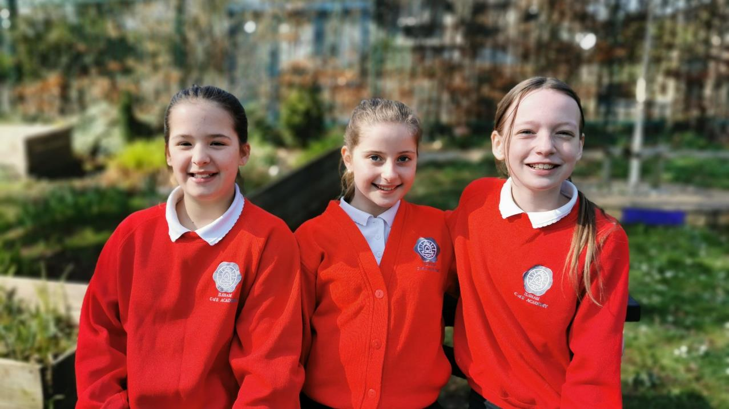
Reception Transition Case Study
Ilsham Church of England Academy

Slide 24

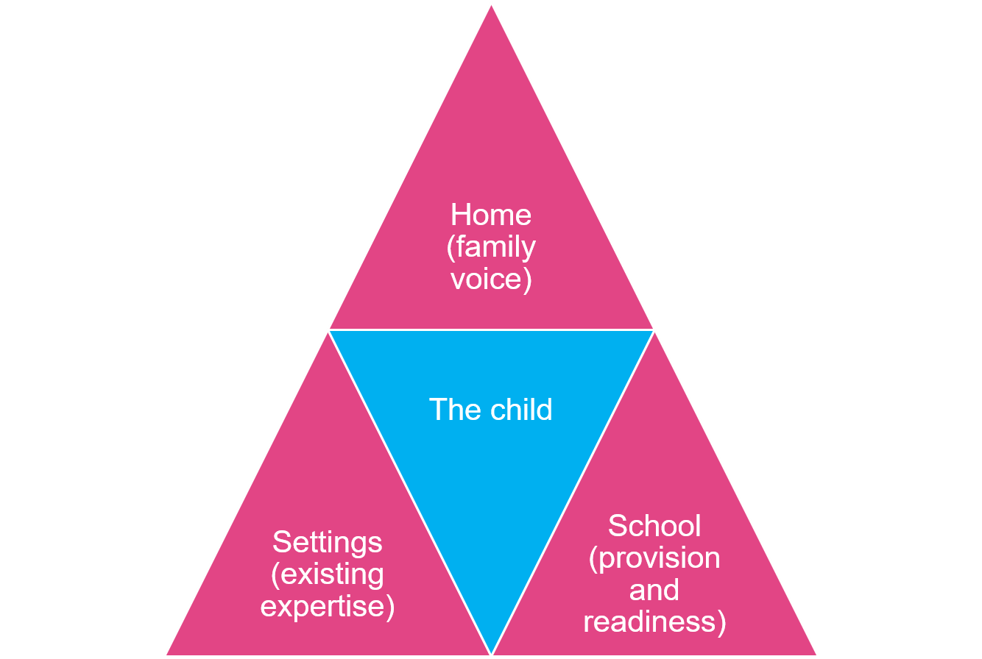
Three point transition model

Slide 25
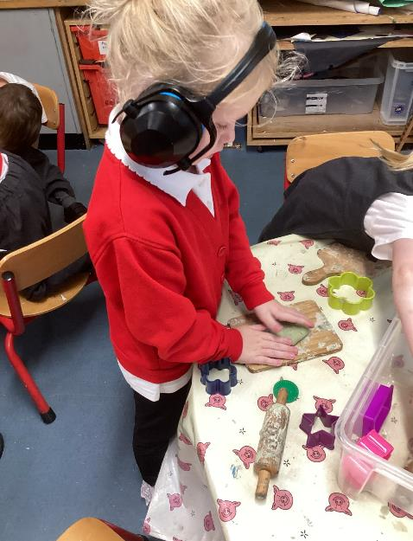
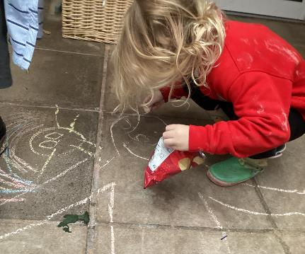
Case Study
Shared understanding
Adapting provision
Enhanced meetings
Multi agency approach
Early partnerships
Listening before September

Slide 26
Reflections
Sue Robb, DfE Best Start in Life Champion

Slide 27

Call to action: what will you do after today?
Support and resources
Reception transition guidance
What do you do well and where can you improve?
Working closely with families​
Strong partnerships with early years settings​​
Early identification of need​
What can you tweak for the September cohort?
Where does transition feature in the school improvement plan?
Where can you go for support?
Reception improvement offer
Reception Networks
We would welcome your post webinar feedback

