Slide 1




Support for SEND in Slough
A system that works for everyone
Draft for Consultation
February 2019

Slide 2
Contents
 | Slide
Introduction – our ambition for a system that works for everyone | 3
Making a difference – securing real change | 4
A system that works – for children and young people, parents and carers, practitioners | 5
How we will know we are successful – Outcomes and indicators | 9
How are we doing? – improvement pathway, outcomes, performance, pressures | 10
Priorities – where we need to improve | 23
Our approach – governance and accountability, work streams | 24
Impact and evaluation – local area data strategy, making effective use of data | 28

Slide 3
Introduction
Just because the journey of the SEND reforms has been difficult and challenging, don’t forget why we’re doing it. Our vision is of a society in which disabled children and young people’s rights are respected, their aspirations supported and life chances are assured
Dame Christine Lenehan (Chief Executive, Council for Disabled Children)
This strategy describes our collective ambition for children and young people with special educational needs and disabilities (SEND) aged 0-25. It sets out our shared commitment to work together to create a system of support and provision that truly works for everyone
We know that current arrangements still do not work well enough:
Children and young people with SEND still achieve much poorer outcomes than their peers
Too often families believe that they have to battle to get the support they need
There is too little trust and confidence across the system
The challenges are complex, deep-seated and involve many stakeholders. They challenge us to change how we work with each other and with children and young people with SEND and their families, to focus relentlessly on improving outcomes, offer more choice and control and, critically, earn their trust and confidence
Real change requires fundamental, system-wide organisation and cultural change, built around a common purpose that is:
Asset-based: focusing on strengths and resources within the child or young person and their family
Proactive and preventative: needs picked up early and support offered quickly
Enabling: families know what they can expect and have more control over decisions that affect them
Collective: professionals collaborate, share skills and knowledge and work seamlessly from assessment through to support

Slide 4
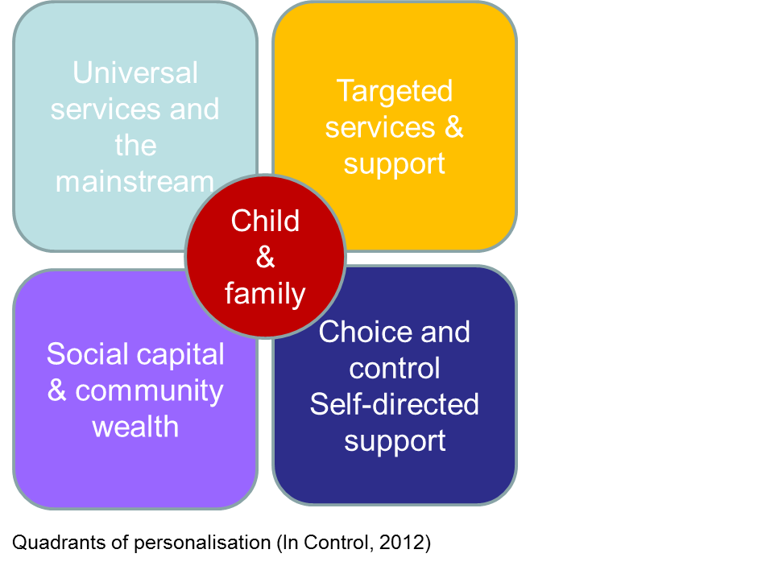
Making a difference
We are determined to ensure that the SEND Reforms make a real difference to the lives and life chances of children and young people with SEND and their families. We have placed the principle of enablement at the heart of our shared ambition and strategy for SEND. This means doing all that we can to:
Enable children, young people and families to participate fully in their own communities and lead connected lives
Prevent long-term dependence on services
Prevent unnecessary and convoluted journeys through services and assessments
Support families to be independent and exercise more choice and control over their lives
Our ambition is to secure real change. This is a complex, long-term undertaking and requires concerted and collective action by all of our partners across the local area, underpinned by a common purpose and shared values and principles. We have deliberately chosen not to set a specific time frame for our ambition and strategy. Rather, it is designed to provide a clear sense of direction against which we will plan our activity, continually monitor our progress and make adjustments where and when that is required.
We are ambitious for the well-being of children and young people with SEND and their families. Our Strategic Partnership Board takes overall responsibility for providing robust leadership and governance of our strategy. We are working with our partners to make sure that we have as clear and complete an understanding of our position as possible and that we use the data and intelligence that we have to focus our efforts to improve.

Slide 5

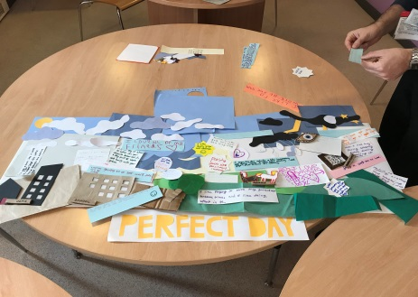

A system that works for children and young people with SEND
Children and young people with SEND tell us that they have the same or very similar dreams and aspirations for when they are older and finish school as their friends: having a family, buying a house, owning a business, getting a job, playing sport, moving abroad, travelling, writing a book
They also tell us that that the things that matters most to them – help to make a “perfect day”, include: interesting lessons, leisure activities, time with friends and family, what people say to them, being listened to, keeping busy and achieving things and even the weather
Day to day problems that children and young people with SEND say that they face - things they don’t like and what they think prevents them from achieving include: people being rude and mean, anxiety, lack of money for resources and activities, lack of the right support, problems with sleep, scary environments, lack of confidence, lack of opportunities

Slide 6
A system that works for parents and carers
Parents and carers tell us that in everything we do, we must keep in mind that it affects the lives of “real people”. They want to be able to trust what they are told and to have more choice and control over the support and provision that their child or young person receives.
I tell my story once
My child “belongs”
I feel in control of my life
A system that works for parents and carers
My child gets the support he/she needs
I don’t feel that I am on my own
I feel listened to and understood
I think that the system is fair
I know what I need to do or who I need to contact if I need help or advice
I am confident about the future
My child is happy and enjoys his/her life

Slide 7
A system that works for practitioners
Professionals and practitioners tell us that they want to work in a system that is fair and transparent, has the needs and interests of children and young people with SEND and their families at it heart and focuses relentlessly on improving their lives and life chances
Person-centred support
Workforce
Skilled, confident and resilient
Collective Responsibility
They are passionate and hardworking and want the best for children and young people with SEND. They believe that support and provision for SEND in Slough is beginning to improve and optimistic that it will continue to do so
Needs and interests of children with SEND
0-25
Belonging
Unconditionally inclusive
Respected
Joined-up
Coherent
Collaborative
Accessible
Smooth transitions
They suggest that for the system to genuinely work for everyone, further improvement is needed to strengthen:
Joint working and collaboration
Capacity across the workforce
A culture where children and young people with SEND and their families are included unconditionally and feel that they belong – in their community and in their education setting
Early Identification & intervention
(SEN Support & EHCP)

Slide 8
A system that works for practitioners: School leaders
School leaders and SENDCOs tell us that they sometimes struggle to meet the needs of their children with the most complex SEND. The cite as particular concerns:
Insufficient funding
A need for more resource base and special school provision
Delays in getting support from key specialist services, e.g. Child and Adolescent Mental Health and Speech and Language Therapy Services
Transitions between education phases and into adulthood
They identify as particular priorities for further professional development and training:
Social, emotional and mental health needs (SEMH)
Children and young people with needs on the autistic spectrum
School leaders’ and SENDCOs’ suggest as areas for further development:
Collaboration between schools
Affordable whole-school CPD in SEND
Dedicated training and networking for teaching assistants
Arrangements for placement planning – also to include pupil mobility and new arrivals

Slide 9
How will we know we are successful?
We want children and young people with SEND in Slough to be happy and successful in their early years, at school and at college, to achieve the best that they can, find employment and go on to live happy and fulfilled adult lives. We also want to give children and young people with SEND and their families more choice and control over their support and to instill trust and confidence across the system.
We will know we are successful when:
Children and young people with SEND and their families trust and have confidence in the support they receive, e.g.:
A lower proportion of children and young people have an EHCP in Slough than in similar areas
Children, young people and young adults with SEND are educated locally - Slough’s ‘local first’ approach is its commitment to providing for children and young people with SEND in the Borough. (Unless a parent or young person’s stated preference for an out of borough setting is suitable and an efficient use of resources or their needs are so severe, complex and exceptional that they cannot be met locally.
Very few families need to seek mediation, dispute resolution or recourse to the SEND Tribunal
More families of children and young people with an EHCP choose and make good use of a Personal Budget
Children and young people with SEND have great life chances, e.g.
Pupils with SEND make at least good progress by the end of Key Stage 2 and Key Stage 4
The achievement gap (SEN Support and EHCP) is well below the national average
All children and young people with SEND attend a school that is rated good or outstanding
A higher proportion of young people with SEND attain at least a Level 2 qualification at 18 than in similar areas
Children and young people with SEND are happy, healthy and enjoy their education and social life, e.g.
The proportion of children, young people with SEND that are Looked After is well below similar local areas
Overall attendance of pupils with SEND improves and persistent absence decreases year on year
The proportion of pupils with SEND receiving a permanent or fixed-term exclusion is well below similar areas
Children and young people with SEND enjoy good health and well-being
Young adults with SEND live happy and fulfilled lives
The proportion of young adults with SEND that are NEET at 16-19 decreases each year
The number of young adults with SEND in supported internships at ages 16-25 increases year on year
Number of young adults (ages 19-25) with SEND accommodated out of the Borough falls year on year

Slide 10
How are we doing?
The SEND Service transferred back to Slough Borough Council in October 2017. This helped to mitigate a number of historical issues and support for SEND is on a rapid path of improvement . We use the improvement model developed by the ISOS Partnership to help us understand where we are on that path and how we need to focus our efforts.
Three phases Defining characteristics
Poor-to-fair
Getting the basics right – driven by leadership
Building the ethos and culture/engaging the workforce
Fair-to-good
Capacity for robust self-assessment, vigilance
Locus of leadership shifts and becomes more broad
From “mission-critical” aspects to whole-service view
Good-to-great
Improvement no longer a discrete project – the norm
Disciplined innovation embedded within delivery
Openness to others – challenge & systems leadership
ISOS Partnership

Slide 11
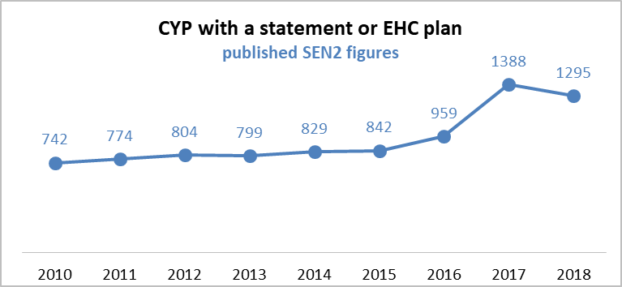
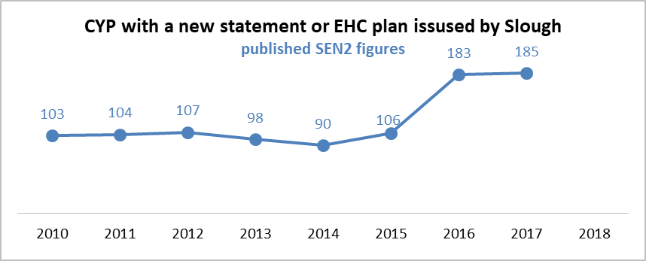
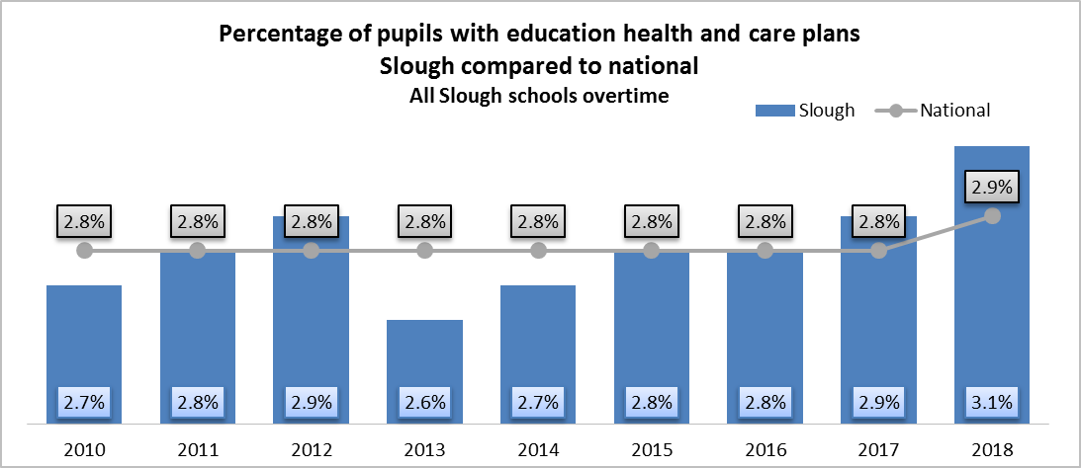
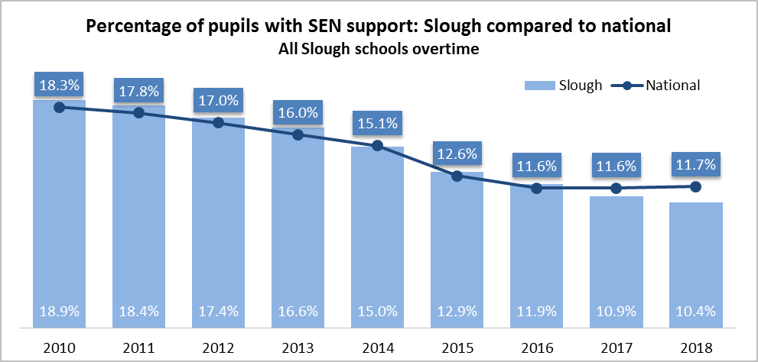
Outcomes
Children and young people with SEND and their families trust and have confidence in the support they receive
What the data says | What this might mean
There has been a significant growth in the number of children and young people in Slough with a statement or EHCP since the SEND Reforms were introduced in 2014. The number of children and young people with a statement/EHCP has grown by 56%. Over the same period the number of new plans has increased by 105%. There is now a higher proportion of children and young people with an EHCP in Slough schools than the average for other unitary authorities. At the same time, a lower proportion of pupils have SEN Support | Part of the increase in demand can be attributed to the fact that the SEND Reforms extended to 25 the age at which a young person might be entitled to an EHCP. However, it is possible that some parents and carers feel that their child or young person needs the “protection” of an EHCP to ensure that their needs are met. It likely that some education settings lack confidence that they have the resources and expertise to meet the needs of some of their children with SEND and, as a result, request an EHC assessment to secure additional funding from the High Needs Block

Slide 12
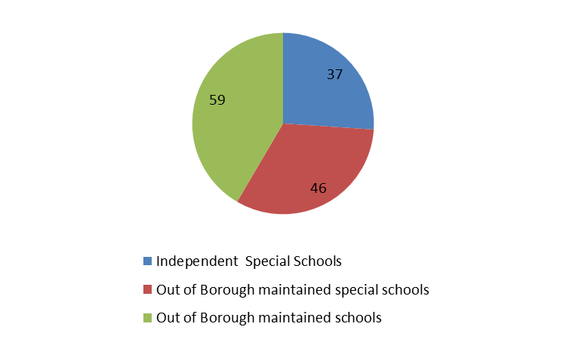
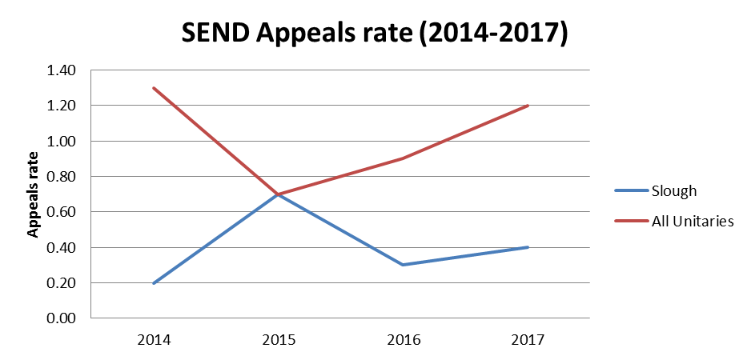
Outcomes
Children and young people with SEND and their families trust and have confidence in the support they receive
Children & young people with an EHCP educated away from Slough (2017-18)
What the data says | What this might mean
In 2017-18, a total of 145 (11%) children and young people with an EHCP attended provision outside Slough. Of these, 37 attended an independent special school, double the number in 2016-17 The rate of parental appeals to the SEND Tribunal has been consistently lower than in may other local areas | An increase in the number of out of borough placements may suggest that some parents lack confidence that their child’ needs can be met locally On occasion, recourse to the SEND Tribunal is necessary to resolve a disagreement between the LA and parent or carer about the support a child or young person needs. However, the consistently low rate of appeals suggests that such instances are relatively rare in Slough

Slide 13
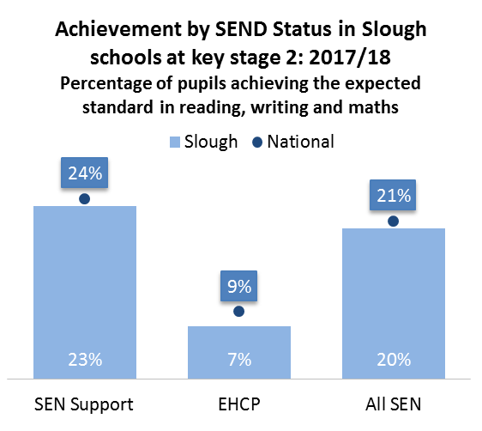
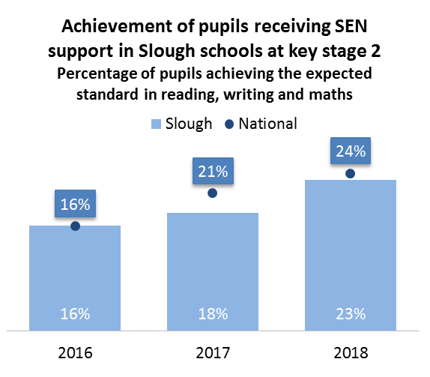
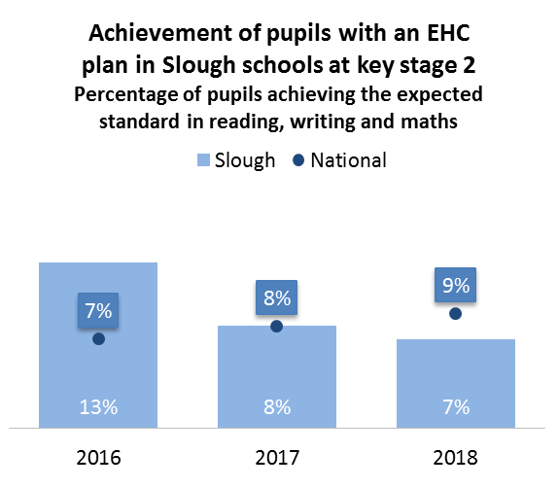
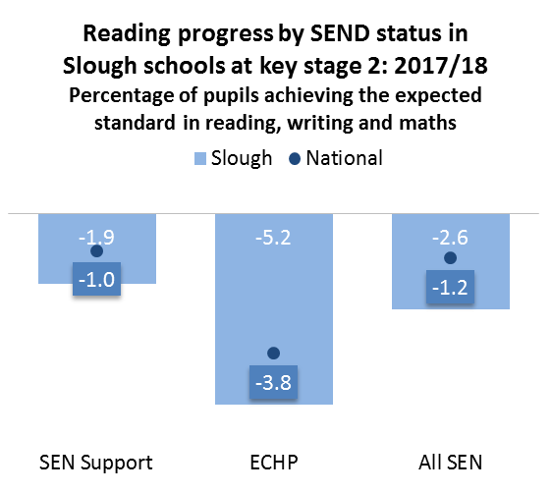
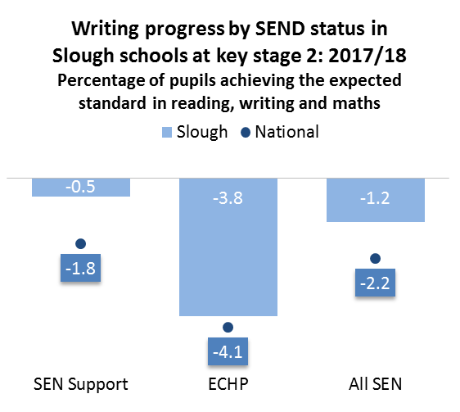
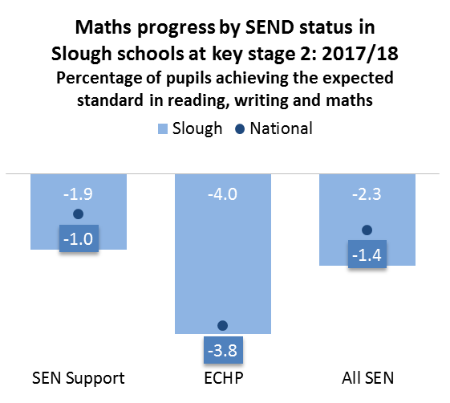
Outcomes
Children and young people with SEND have great life chances
Key Stage 2
What the data says | What this might mean
The proportion of pupils with SEND achieving the expected standard in reading, writing and maths in 2017/18 was broadly in line with the national average. However, this masks the relatively low proportion of those with an EHCP reaching the expected standard – which has fallen in each of the last 3 years. The progress made by pupils with SEND is below the national average in reading and mathematics, but above in writing | Further analysis is needed to understand: The disappointing achievement and progress of pupils with an EHCP by the end of Key Stage 2 The relatively poor progress made by all pupils with SEND in reading and writing

Slide 14
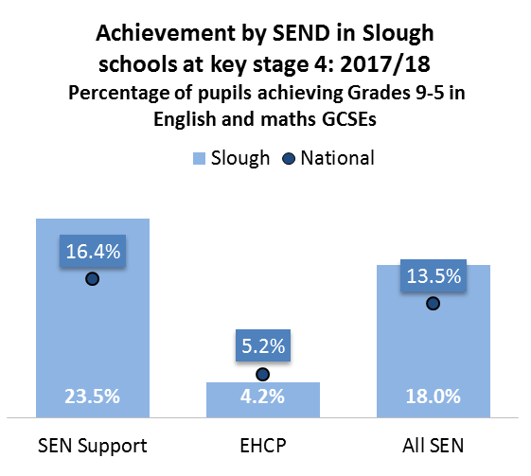
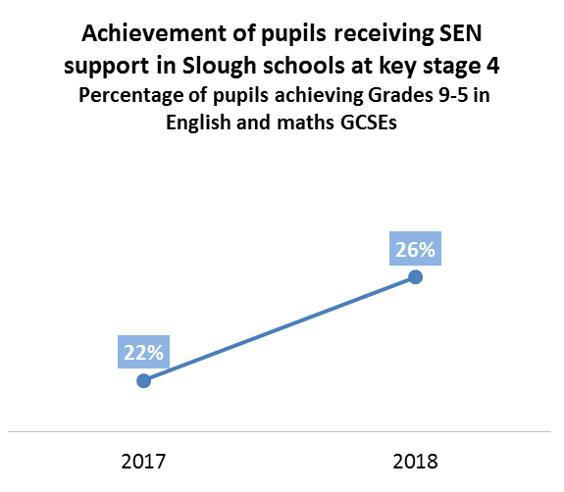
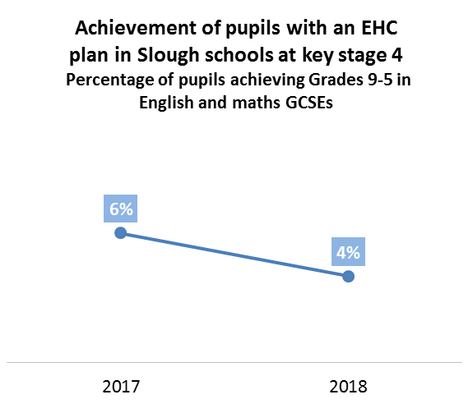
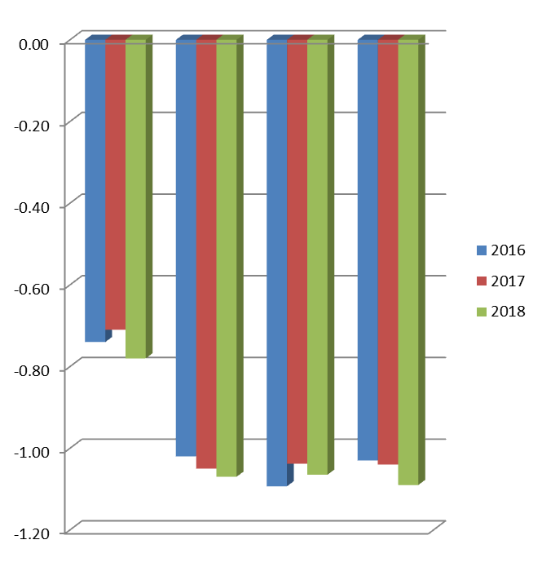
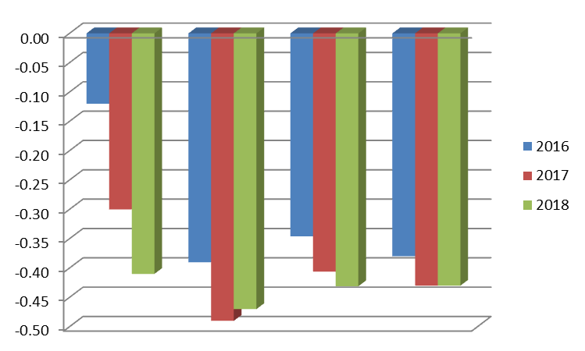
Outcomes
Children and young people with SEND have great life chances
Key Stage 4
What the data says | What this might mean
The proportion of pupils with SEND achieving grades 9-5 in English and maths GCSE in 2017/18 was above the national average. However, this masks the relatively low levels of achievement by pupils with an EHCP – which also fell in 2018 The progress made by pupils with SEND is below the national average | Further analysis is needed to understand: The disappointing achievement and progress of pupils with an EHCP by the end of Key Stage 4 The relatively poor progress made by all pupils with SEND
Average Progress 8 score per pupil at end KS4 (Statement/EHCP)
Average Progress 8 score per pupil at end KS4 (SEN Support)
Slough
South East
Stat. Neighbour
England
Slough
South East
Stat. Neighbour
England

Slide 15
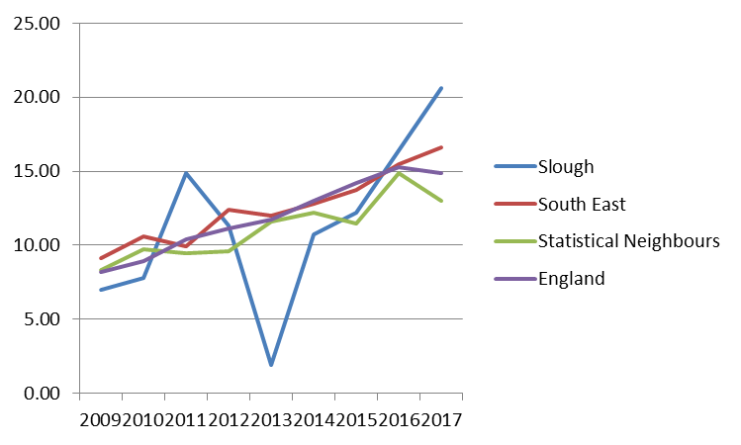
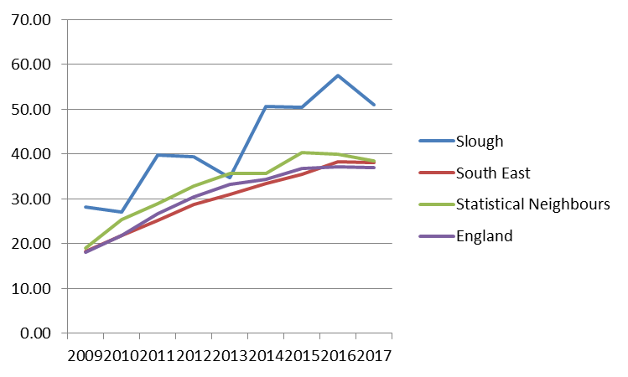
Outcomes
Children and young people with SEND have great life chances
Key Stage 5
% 19 years olds qualified to Level 2, incl. English and Maths (Statement/EHCP)
What the data says | What this might mean
The proportion 19 year olds with SEN that achieve a Level 2 qualification (incl. English and maths) in Slough is consistently above national, regional and statistical neighbour benchmarks. This is true for students with and without an EHCP | There is a good story to tell about and learning to be taken from the achievement of students with SEND by the time they reach the age of 19.
(% 19 years olds qualified to Level 2, inc. English and Maths SEN Support)

Slide 16
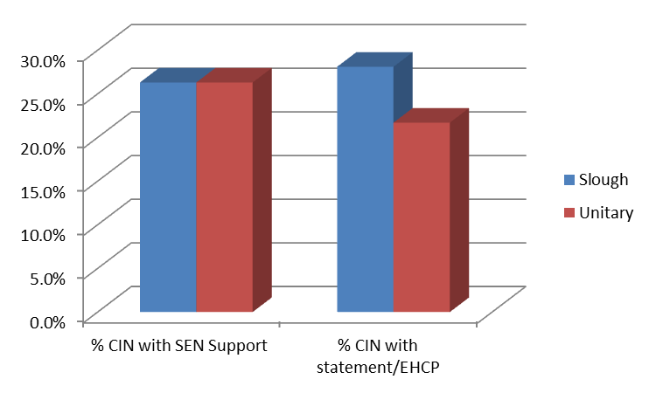
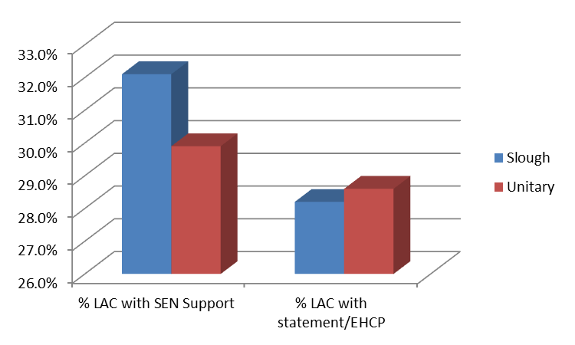
Outcomes
Children and young people with SEND are happy, healthy and enjoy their education and social life
Children in Need (CIN) and Looked After Children (LAC) – 2016-2017
% of CIN with SEN Support and with a statement/EHCP
What the data says | What this might mean
The proportion Children in Need with SEN Support in 2016/17 was in line with other unitary authorities. At the same time, a higher proportion of CIN in Slough had a statement of SEN or EHCP. A higher proportion of Looked After Children had SEN Support in Slough in 2016/17 than the average for other unitary authorities. Conversely a slightly lower proportion LAC had a statement of SEN or EHCP. | More detailed analysis is needed to understand why a higher proportion of CIN have a Statement of SEN or EHCP in Slough than the mean for other unitary authorities and any implications for further action. Subject to further analysis, our working hypothesis is that the Virtual School in Slough is working effectively with education settings and other services to ensure that LAC with SEND receive the support they need without recourse to an EHC assessment.
% of LAC with SEN Support and with a statement/EHCP

Slide 17
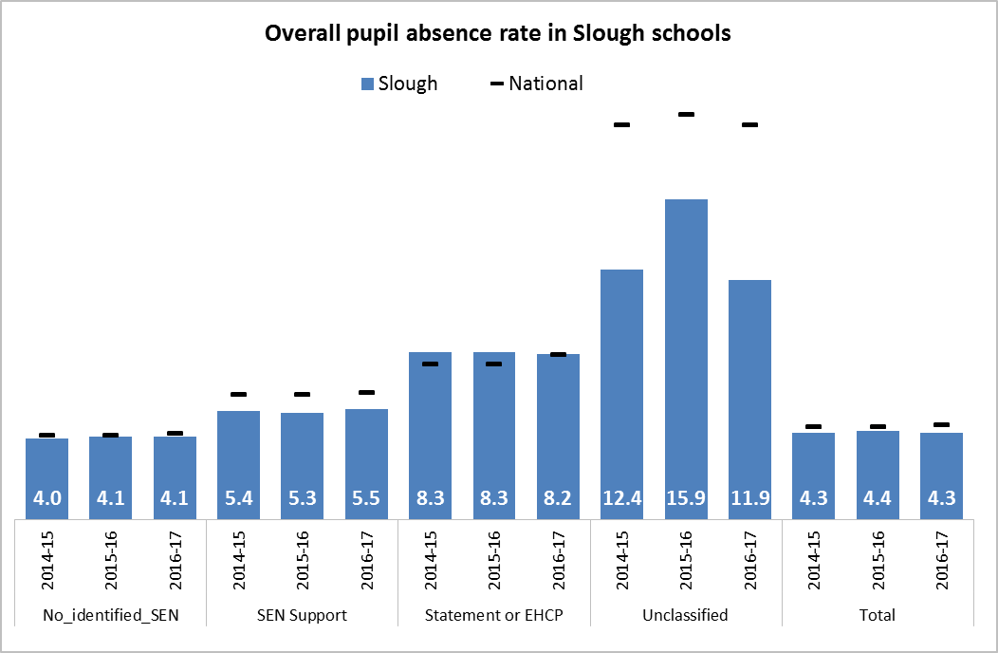
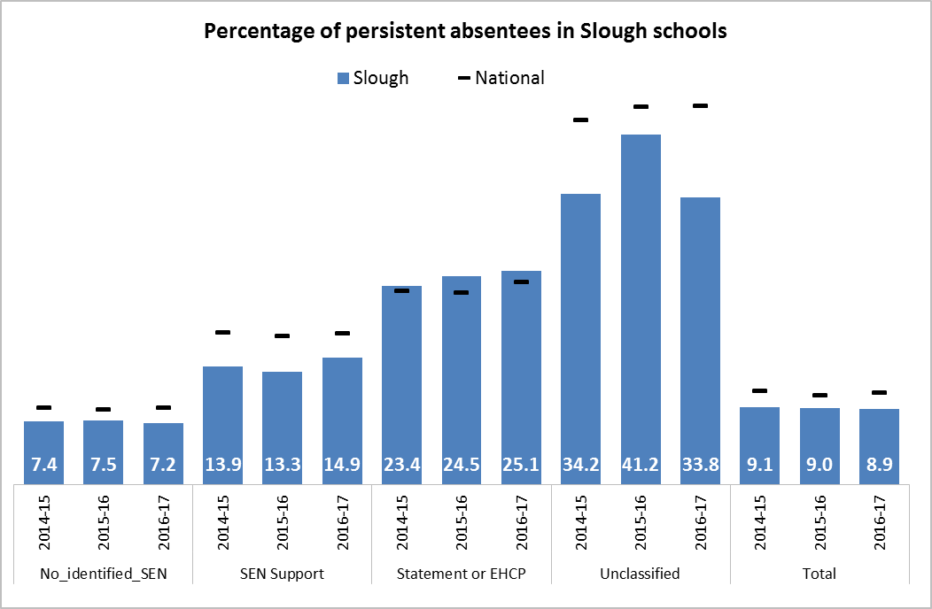
Outcomes
Children and young people with SEND are happy, healthy and enjoy their education and social life
School Attendance
What the data says | What this might mean
Overall absence (OA) in Slough schools has remained relatively stable between 2014/15 and 2016/17 at a level just below the national average. Pupils with SEND show a similar trend although OA for pupils with SEN Support is below national benchmarks and broadly in line for those with a Statement of SEN or EHCP Over the 3 years for which benchmarked data is currently available, the level of Persistent Absence (PA) in Slough has also remained relatively stable and below national comparisons. However, while PA for pupils with SEN Support is consistently lower than the national average, pupils with a Statement of SEN or EHCP show an upward trend to a level slightly above national benchmarks – particularly | Overall, school attendance for pupils with SEND is encouraging, particularly for those with SEN Support. While PA for pupils with SEND support compares favourably with other local areas nationally, further analysis will help to understand the significance of and possible factors behind the upward trend for those with a Statement of SEN or EHCP. Of particular interest will be the disproportionately high rate of PA in (mainstream and special schools) for pupils with: physical disability, severe and profound and multiple learning difficulties

Slide 18
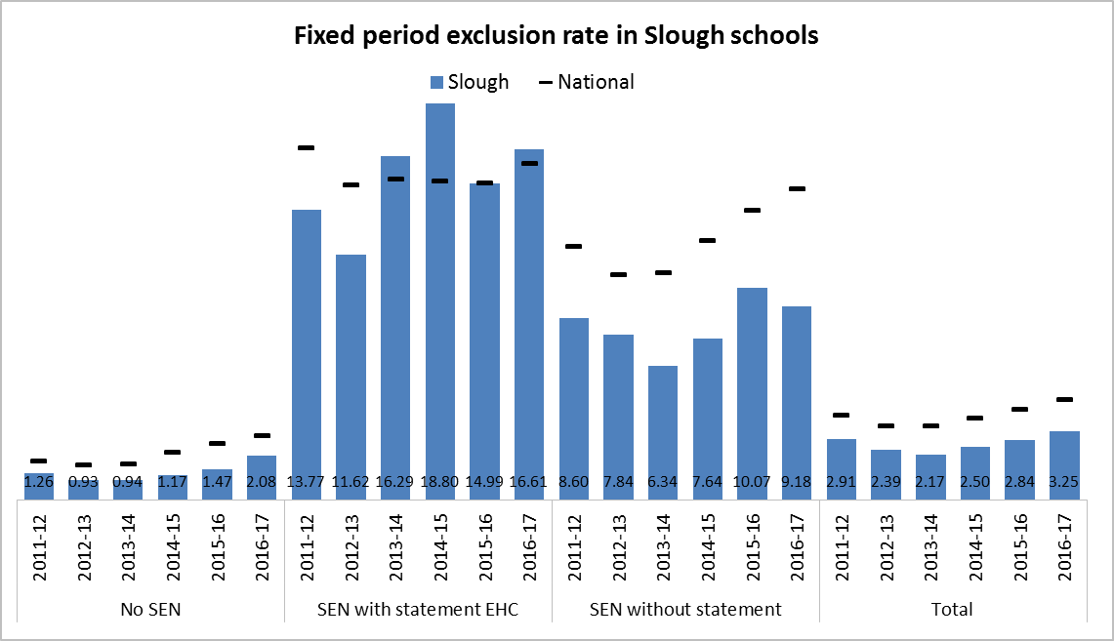
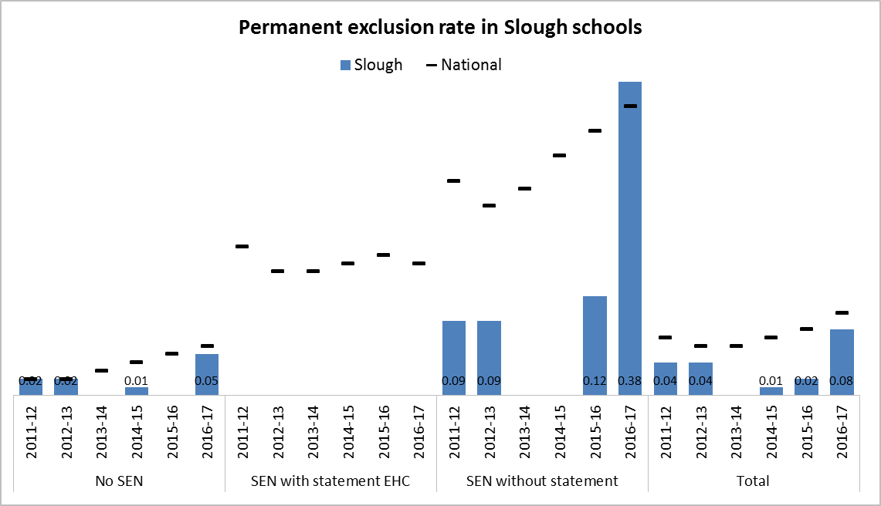
Outcomes
Children and young people with SEND are happy, healthy and enjoy their education and social life
Exclusion from school
What the data says | What this might mean
The rate of fixed term and permanent exclusion from school tends to follow the national trend – including a spike in permanent exclusions, albeit at a lower rate. While nationally, pupils with SEND are consistently over-represented in exclusion figures the position is quite complex in Slough: A high rate of fixed term exclusion for pupils with a Statement of SEN or EHCP is balanced by a very low incidence of permanent exclusion Conversely, a relatively low rate of fixed term exclusion for pupils with SEN Support contrasts with a significant spike in permanent exclusion in recent years to a level above the national average | While, overall, the position in Slough compares quite favourably with national trends, it is a concern that pupils with SEND remain disproportionately at risk of exclusion. Further work with partners is needed to understand the drivers behind recent increases in exclusion as the basis for concerted action to halt and reverse recent trends

Slide 19
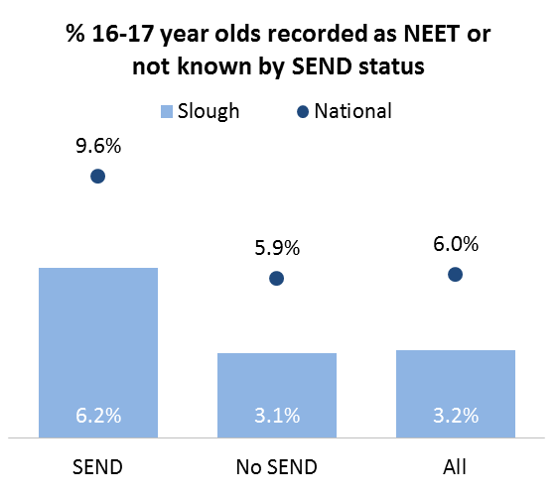
Outcomes
Young adults with SEND live happy and fulfilled lives
Education, employment and training
What the data says | What this might mean
The proportion of young people aged 16-17, including those with SEND, that are in not in education, employment or training (NEET) in Slough is well above the national average. However, young people with SEND are twice as likely to be NEET than their peers. | While, overall, the position in Slough compares favourably with national trends, it is a concern that pupils with SEND remain disproportionately at risk of becoming NEET. Further work with partners is needed within the wider Preparation for Adulthood (PfA) agenda to create more opportunities for young people with SEND to transition to a secure and independent adult life
Further work is underway with partners to establish a more robust evidence base linked to all 4 pillars of the PfA agenda, including:
Independent and supported living
Participation in the local community, e.g. volunteering
Supported internships and apprenticeships
Healthy life styles

Slide 20
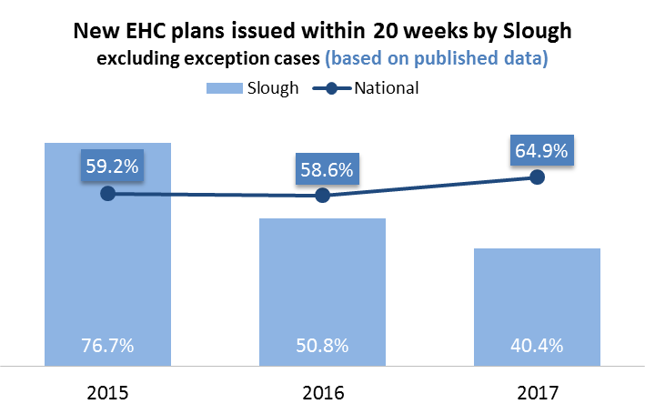
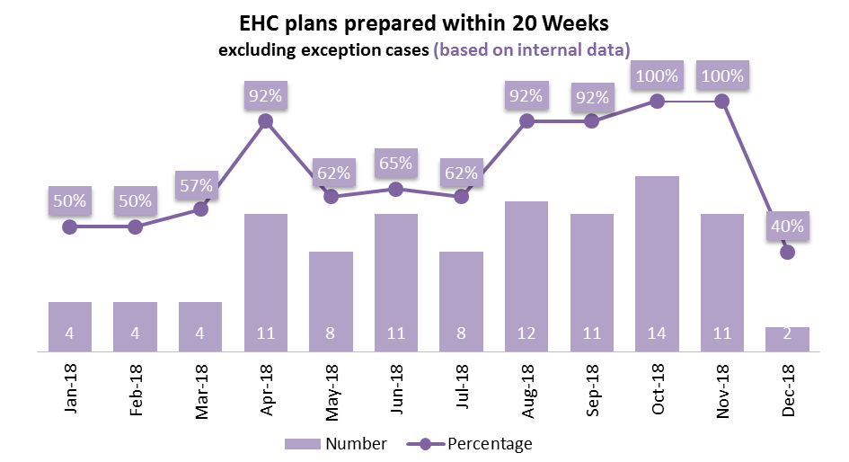

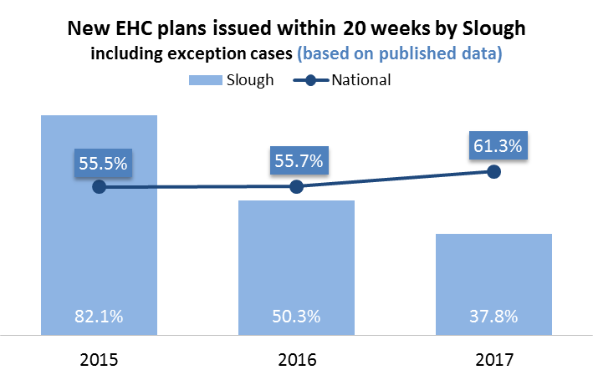
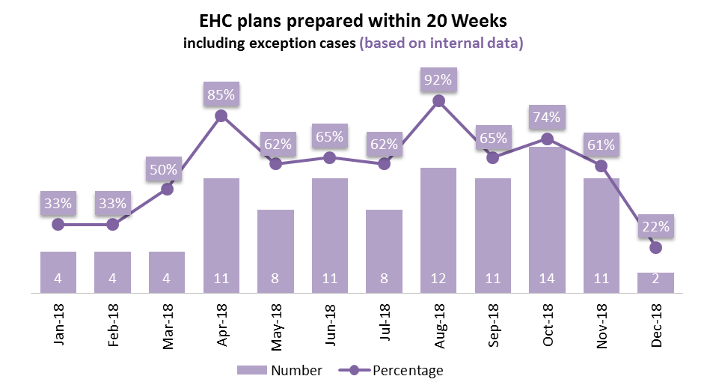

Performance
Issue of new EHC Plans within 20 weeks
No of Plans
What the data says | What this might mean
In 2017, just 40.4% of EHCPs, excluding exceptions, and 37.8%, including exceptions, were completed within 20 weeks. There has been a consistently improving trend in 2018 - in October and November the figure was 100% excluding exceptions. | Concerted action by the SEN Team and key partners has secured significant improvements in performance. The challenge is to make sure that these improvements are embedded within practice and sustained over time.
No of Plans

Slide 21
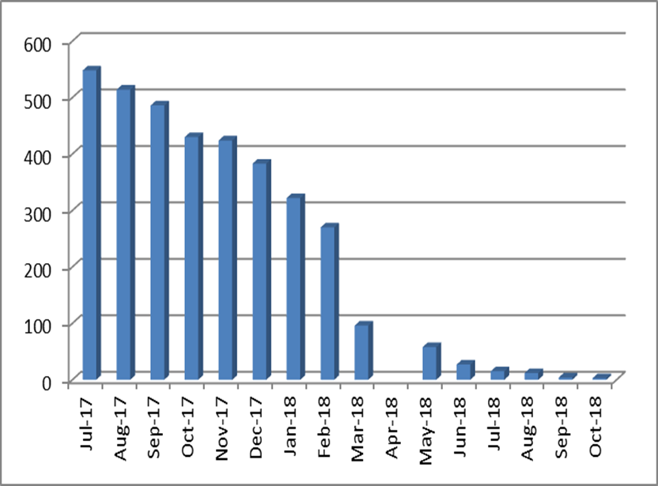
Performance
Conversion of Statements of SEN to EHCP
What the data says | What this might mean
In August 2017, 514 conversions remained to be completed. All remaining conversions were completed by December 2018 | The SEND Service has worked closely with colleagues from health and social care, education settings, parents/carers and children and young people to complete the outstanding conversions in a person-centred and multi-agency manner.

Slide 22
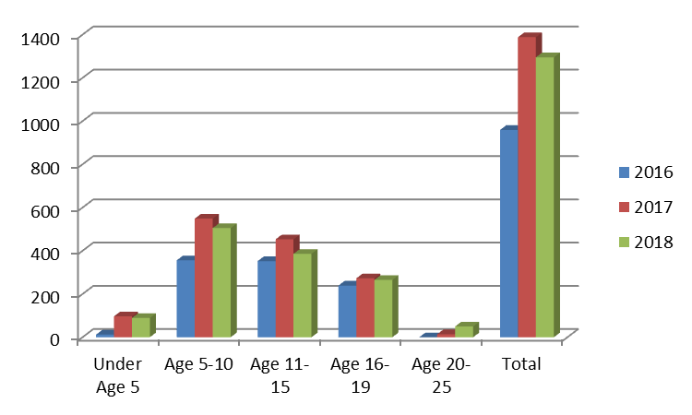
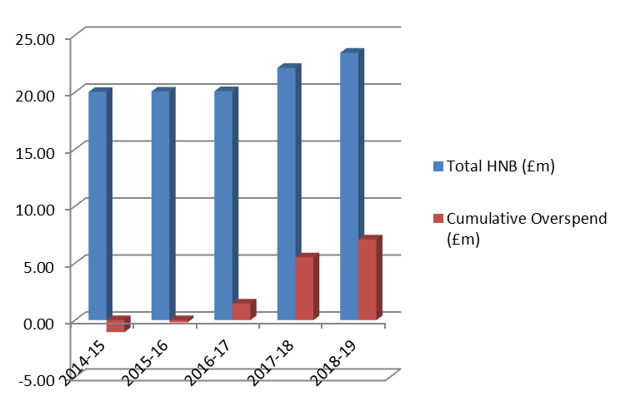
Pressures
Number of Statements of SEN/EHCPs
What the data says | What this might mean
The number of children and young people with a statement/EHCP has grown by 25% since 2016 and 56% since 2014. Although growth is evident across all age ranges, it is most significant for children under the age of 10 and young people over the age of 20. Since 2014, total funding within the HNB has grown by just less than 15%. Over the same period, an underspend of £1.05m in 2014 has turned into a cumulative overspend of £7.08m | Part of the increase in demand since 2014 can be attributed to the fact that the SEND Reforms extended the age at which a young person might be entitled to an EHCP to 25. However, more significant and long-term pressures are evident in higher demand in the Early Years and primary phases Growth in the HNB has failed to keep up with increased demand with the cumulative overspend in 2018-19 projected to be just over 30% of the total budget. Urgent action is required by all partners to: secure maximum efficiency and value for money Build an approach to demand management that proactive and preventative, person centred and focuses on strengths and resources within the family
High Needs Block (HNB)

Slide 23
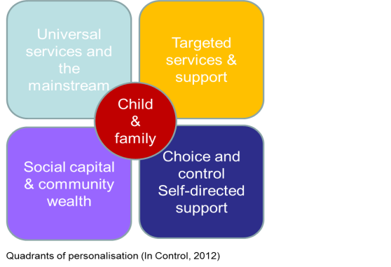
Priorities
We have used our analysis of key data and feedback from key stakeholders, including children and young people with SEND and their families, to identify our key strategic priorities:
Consolidate and improve arrangements for joint working and collaboration to:
  Secure fully joined-up support for children and young people with SEND 0-25
  Establish a comprehensive and integrated data set/dashboard for the local area
  Strengthen multi-agency decision making and Quality Assurance for high-cost residential or specialist placements, including multi-agency sign off and disagreement resolution around EHCPs
  Strengthen arrangements for joint commissioning, including the development of a multi-agency approach to Personal Budgets
  Build capacity across the system to support children and young people with SEND to:
  Understand and coordinate activity to meet the development needs across the children and young people’s workforce, in the 1st instance:
Social, emotional and mental health needs (SEMH)
Children and young people with needs on the autistic spectrum
Affordable whole-school CPD in SEND
Dedicated training and networking for teaching assistants
Promote and facilitate collaboration and networking between practitioners, agencies and education settings
  Strengthen arrangements to identify children and young people with SEND as early as possible in their lives and plan for their futures:
  Ensure alignment between Early Help and SEND to identify children and young people with SEND as early as possible in their lives and support children and young people SEND who may not need an EHCP
  Improve progress and achievement of children and young people with SEND by the end of Key Stage 2 and Key Stage 4 - particularly those with an EHCP
  Strengthen arrangements for co-production, particularly with children and young people
Support young people with SEND in any “moving on”/transition points to help them prepare for as independent, happy, healthy and successful adulthood as possible

Slide 24
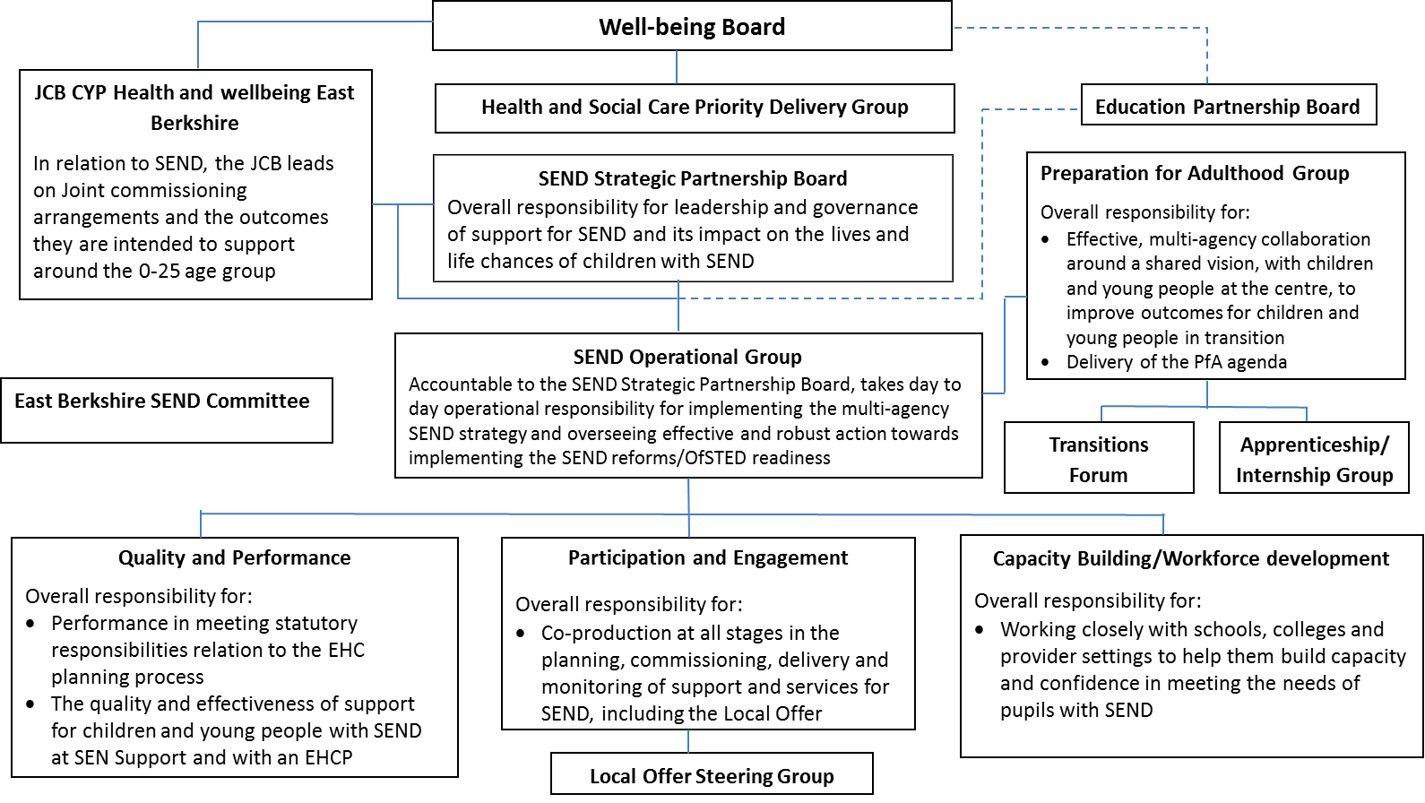
Our approach: governance and accountability
Challenges that are complex, deep-seated and involve many stakeholders, often with competing perspectives and priorities require whole system change. Since December 2017, the SEND Strategic Partnership Board has taken overall responsibility for leadership and governance for SEND across the local area

Slide 25
Our approach: governance and accountability
SEND Strategic Partnership Board
Overall responsibility for leadership and governance:
Multi-agency SEND strategy and implementation plan that defines partners’ strategic ambition and key indicators and measures to monitor quality and effectiveness
Alignment of work across all relevant national programmes
Ensuring that effective and robust assurance checks in place for progress towards implementation of the SEND reforms and, where necessary, holding partners to account for their contribution.
SEND Operational Group
Operational responsibility for implementation:
Coordinating and maintaining a robust multi-agency self-evaluation of the quality of support for SEND and its impact on outcomes
Oversight, alignment and quality assurance of designated work streams
JCB Children and Young People Health & Well-being East Berkshire
Responsible for joint commissioning arrangements 0-25:
An East Berkshire Children and Young People’s Joint Commissioning Framework/Plan to:-
  Put joint planning and commissioning at the heart of improving outcomes
  Develop robust forward planning, including preparing for adulthood, across children, young people and adult services
  Support the development of the local areas’ Joint Strategic Needs Assessment
  Have an overview of and integrate all relevant commissioning across health, education and social care.
A Co-production Charter and Co-production Network across health, education, social care.
Integrated commissioning groups for CAMHS, SEND, Children Looked After

Slide 26
Our approach: Work Streams
4 key work streams maintain an oversight of and drive improvement in work to deliver on our priorities
Quality and Performance
Overall responsibility for oversight of and driving improvement in:
Performance in meeting statutory responsibilities
The quality and effectiveness of support for children and young people with SEND
Outcomes achieved by children and young people with SEND
Parent and carers’ confidence and trust in how their child or young person is supported
Includes work to:
  Establish a comprehensive and integrated data set/dashboard for the local area
  Strengthen multi-agency decision making and Quality Assurance for high-cost residential or specialist placements, including multi-agency sign off and disagreement resolution around EHCPs
Ensure alignment between Early Help and SEND to identify children and young people with SEND as early as possible in their lives and support children and young people SEND who may not need an EHCP
Participation and Engagement
Overall responsibility for oversight of and driving improvement in:
Co-production, including the Local Offer
Communication strategy
Includes work to:
Strengthen arrangements for co-production with children and young people

Slide 27
Our approach: Work Streams
Capacity Building/workforce development
Overall responsibility for coordinating activity to build capacity and confidence across the system:
Engagement with leaders of local education settings
Adopting flexible and creative approaches and interventions
Making sure that the local authority and its partners are mindful of their equality duty in relation to disabled and non-disabled children and young people.
Includes work to:
Understand and coordinate activity to meet the development needs across the children and young people’s workforce
Promote and facilitate collaboration and networking between practitioners, agencies and education settings
Improve progress and achievement of children and young people with SEND by the end of Key Stage 2 and Key Stage 4 - particularly those with an EHCP
Preparation for Adulthood Group
Overall responsibility for:
Multi-agency collaboration for children and young people in transition
Delivery of the Preparing For Adulthood Agenda

Slide 28
Impact and Evaluation
Slough local area data strategy
Our local area data strategy has been developed by partners to help all partners understand their role and make an effective contribution to achieving our shared ambition for children and young people with SEND. It sets out to:
Focus action relentlessly on improving performance and outcomes for children and young people with SEN and on building the confidence and trust of their families
Provide a framework around which to coordinate the work of the wide range of partners and stakeholders
Enable partners to monitor performance, progress and impact and strengthen transparency and accountability.
The core elements of the data strategy are the local area’s:
Self-evaluation
SEND Dashboard
Outcomes Framework
Making effective use of data
The Outcomes Framework consists of:
4 high level outcomes set out on slide 9 chosen to represent our ambition for a System that works for everyone
For each outcome, a small number of primary indicators that:
Say something important about the well-being and future life chances of children and young people with SEND
Represent areas in which children and young people with SEN often achieve disproportionately poor outcomes
Can serve as a proxy for other indicators so that monitoring progress does not become unwieldy
A set of secondary indicators – the SEN Dashboard, that we can use to help to explain current performance and inform priorities for further action.
A data development agenda.
We will use the data to consider:
What do the primary indicators tell us about how we are doing – where do we need to improve?
What is the story behind the data – what are the causes and factors at work?
Who has a role to play in securing improvement?
What do we need to do to improve – what is our strategy?

