Slide 1
Executive Summary
87%
Schools good or better
EYFS/KS2/KS4
Above national
75%
Academies or
Free Schools
EYFS
LA 63rd
2nd quartile
KS2 RWM
LA 55th
2nd quartile
KS4 P8
LA 14th
Top quartile
KS5
A/L 50th
Applied 96th

Slide 2
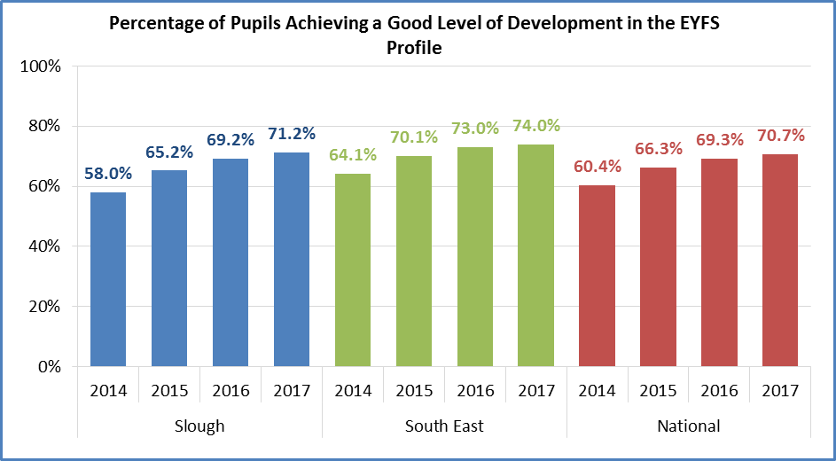
Standards - EYFS

Slide 3
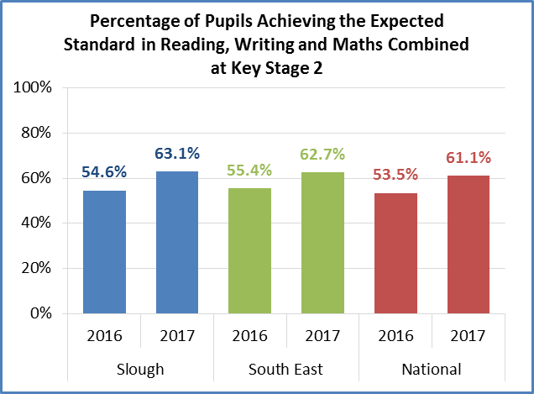
Standards – KS2

Slide 4
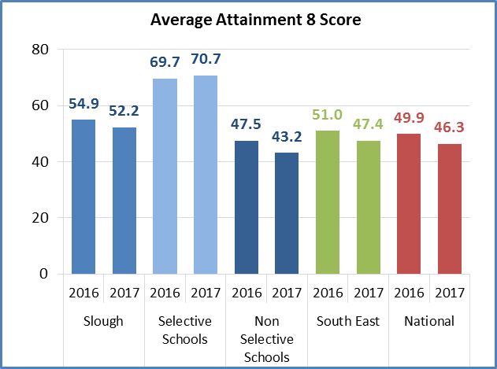
Standards – KS4

Slide 5
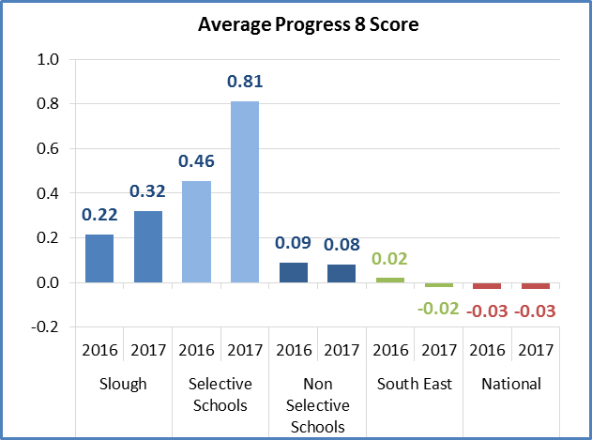
Standards – KS4

Slide 6
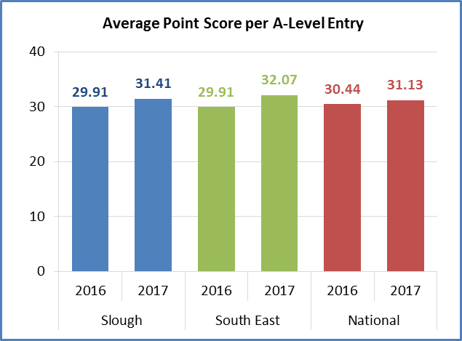
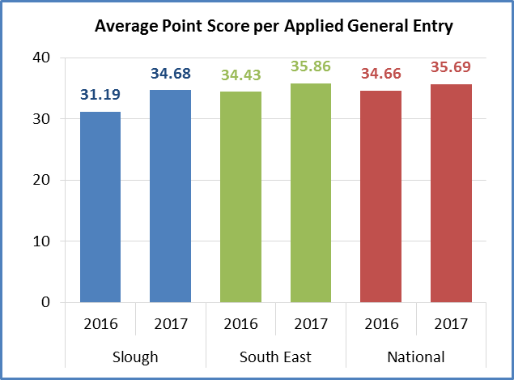
Standards – KS5

Slide 7
Gender - EYFS
Year | Gender Gap Slough GLD | Gender Gap National GLD
2014 | 16.0 | 16.3
2015 | 16.2 | 15.6
2016 | 15.9 | 14.7
2017 | 12.4 | 13.7

Slide 8
Gender – KS2
RWM
 | All Pupils | Gender
 |  | Boys | Girls | Gender Gap
National 2016 | 53% | 50% | 57% | 7%
Slough LA 2016 | 54.6% | 51.0% | 58.4% | 7.4%
National 2017 | 61.1% | 57.4% | 65.1% | 7.7%
Slough LA 2017 | 63.1% | 60.3% | 66.0% | 5.7%

Slide 9
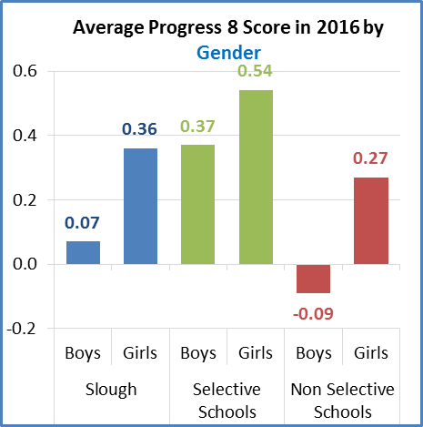
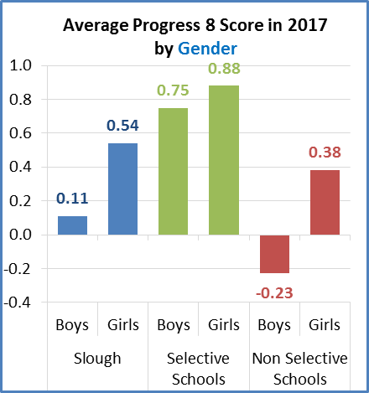
Gender - KS4

Slide 10
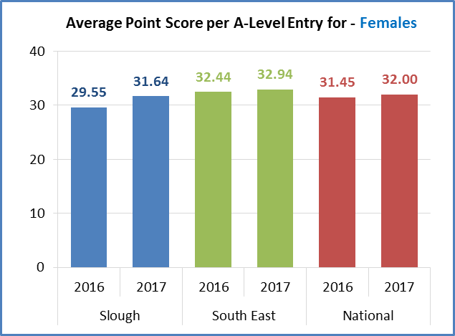
Gender – KS5

Slide 11
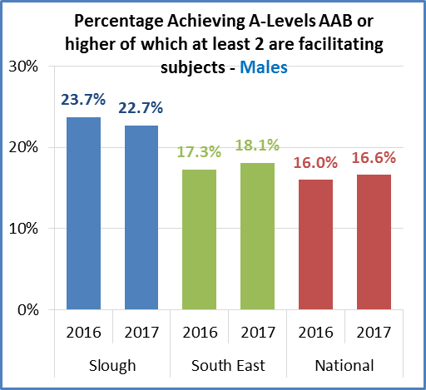
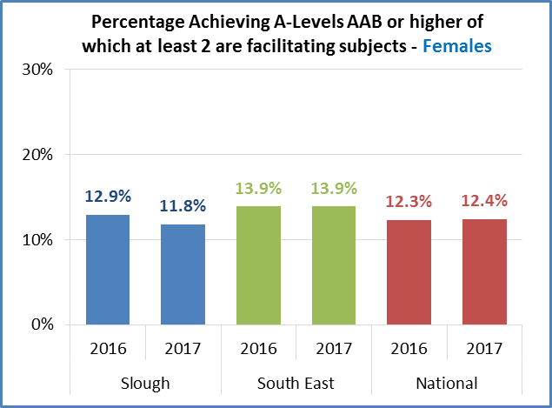
Gender – KS5

Slide 12
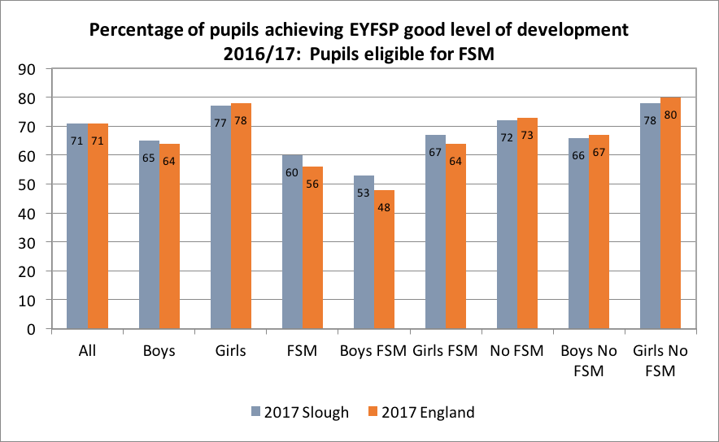
Disadvantaged (FSM) - EYFS

Slide 13
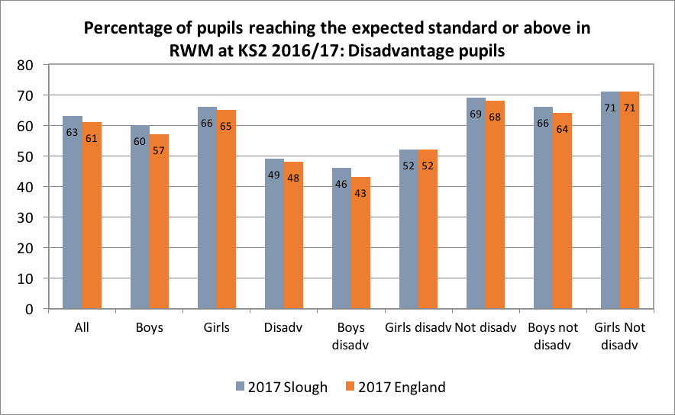
Disadvantaged – KS2

Slide 14
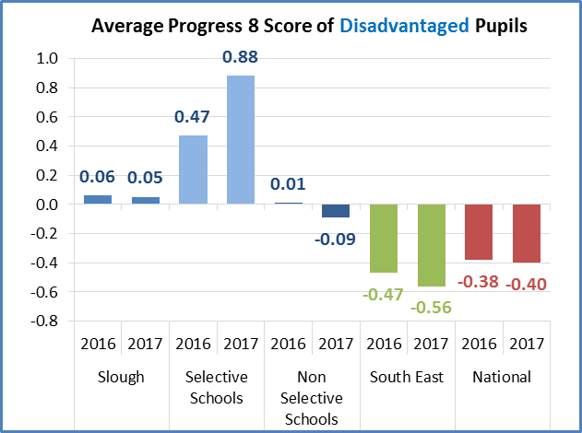
Disadvantaged – KS4

Slide 15
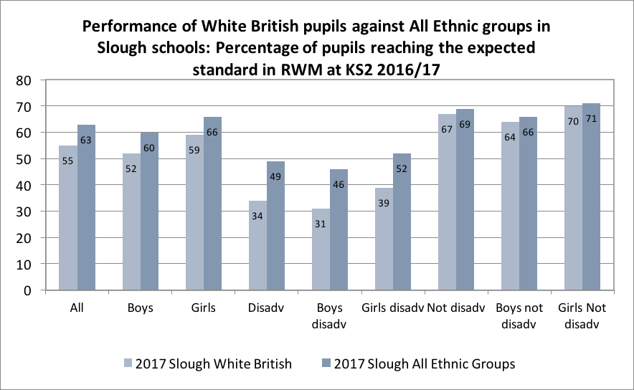
White British – KS2

Slide 16
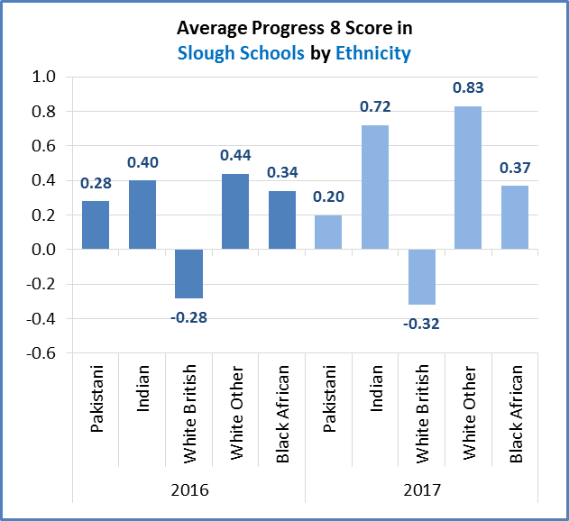
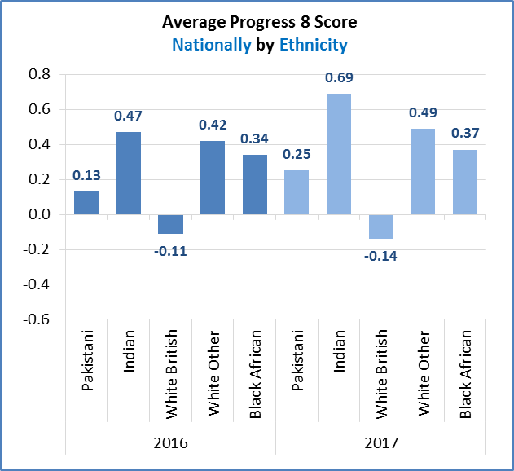
White British – KS4

Slide 17
Slough Residents KS4
Individual Secondary Schools

Slide 18
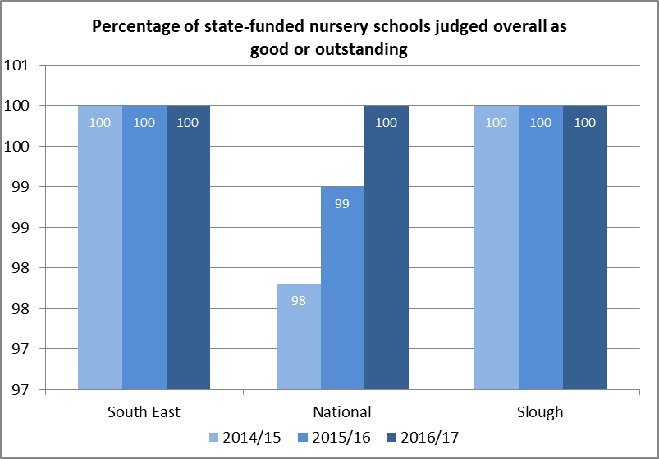
Ofsted Judgements by Phase

Slide 19
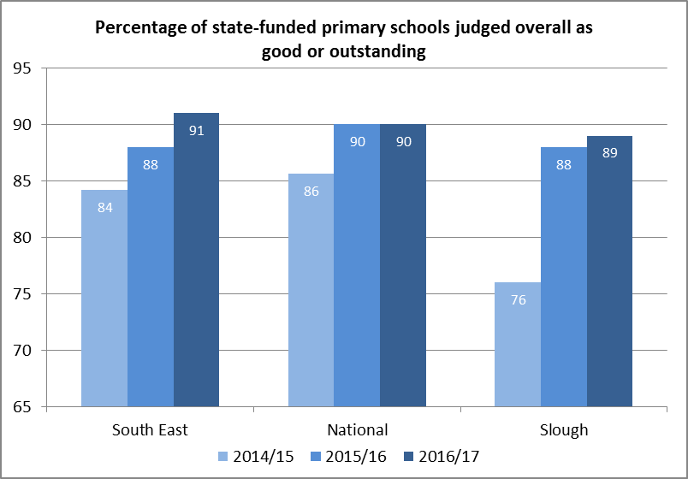
Ofsted Judgements by Phase

Slide 20
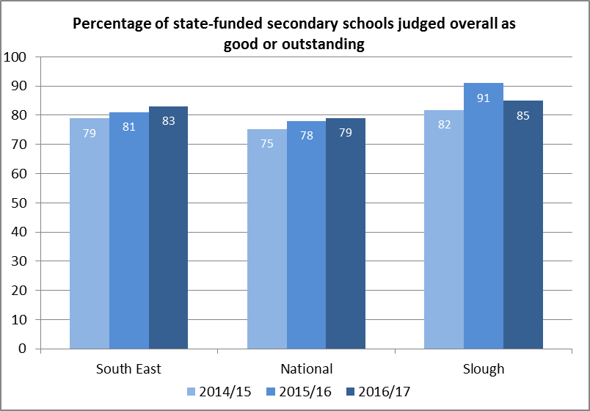
Ofsted Judgements by Phase

Slide 21
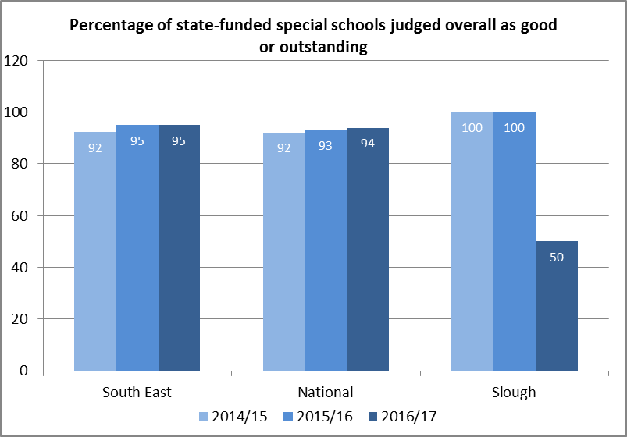
Ofsted Judgements by Phase

Slide 22
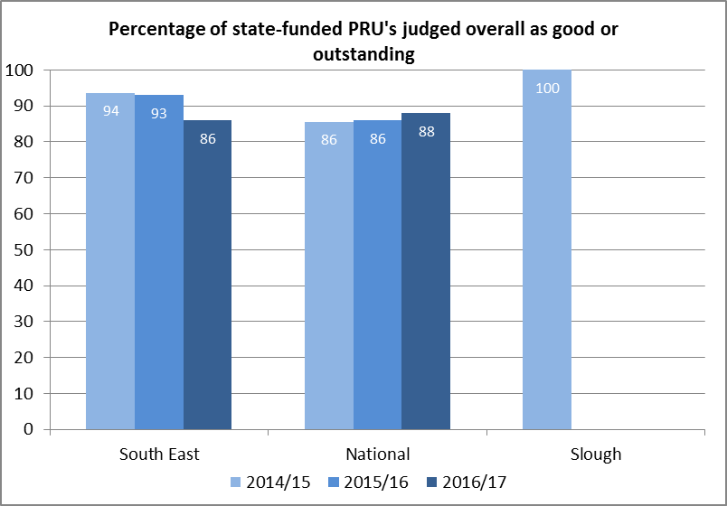
Ofsted Judgements by Phase

