Slide 1

OxWell Student Survey 2023
LodeSeeker session
For commissioners

Slide 2
Today’s session
OxWell 2023 overview of who took part and dissemination plan
Understanding access levels for LodeSeeker
Using LodeSeeker
National webinar
Stay in touch

Slide 3
7+

Slide 4
2023 data
Year 5 | 4786
Year 6 | 4703
Year 7 | 7160
Year 8 | 6502
Year 9 | 6226
Year 10 | 4878
Year 11 | 4668
6th form/FE | 4811
43,734 logins
  25,335 completed the
  final page
185 schools
  66 Secondary & FEC
  119 Primary

Slide 5
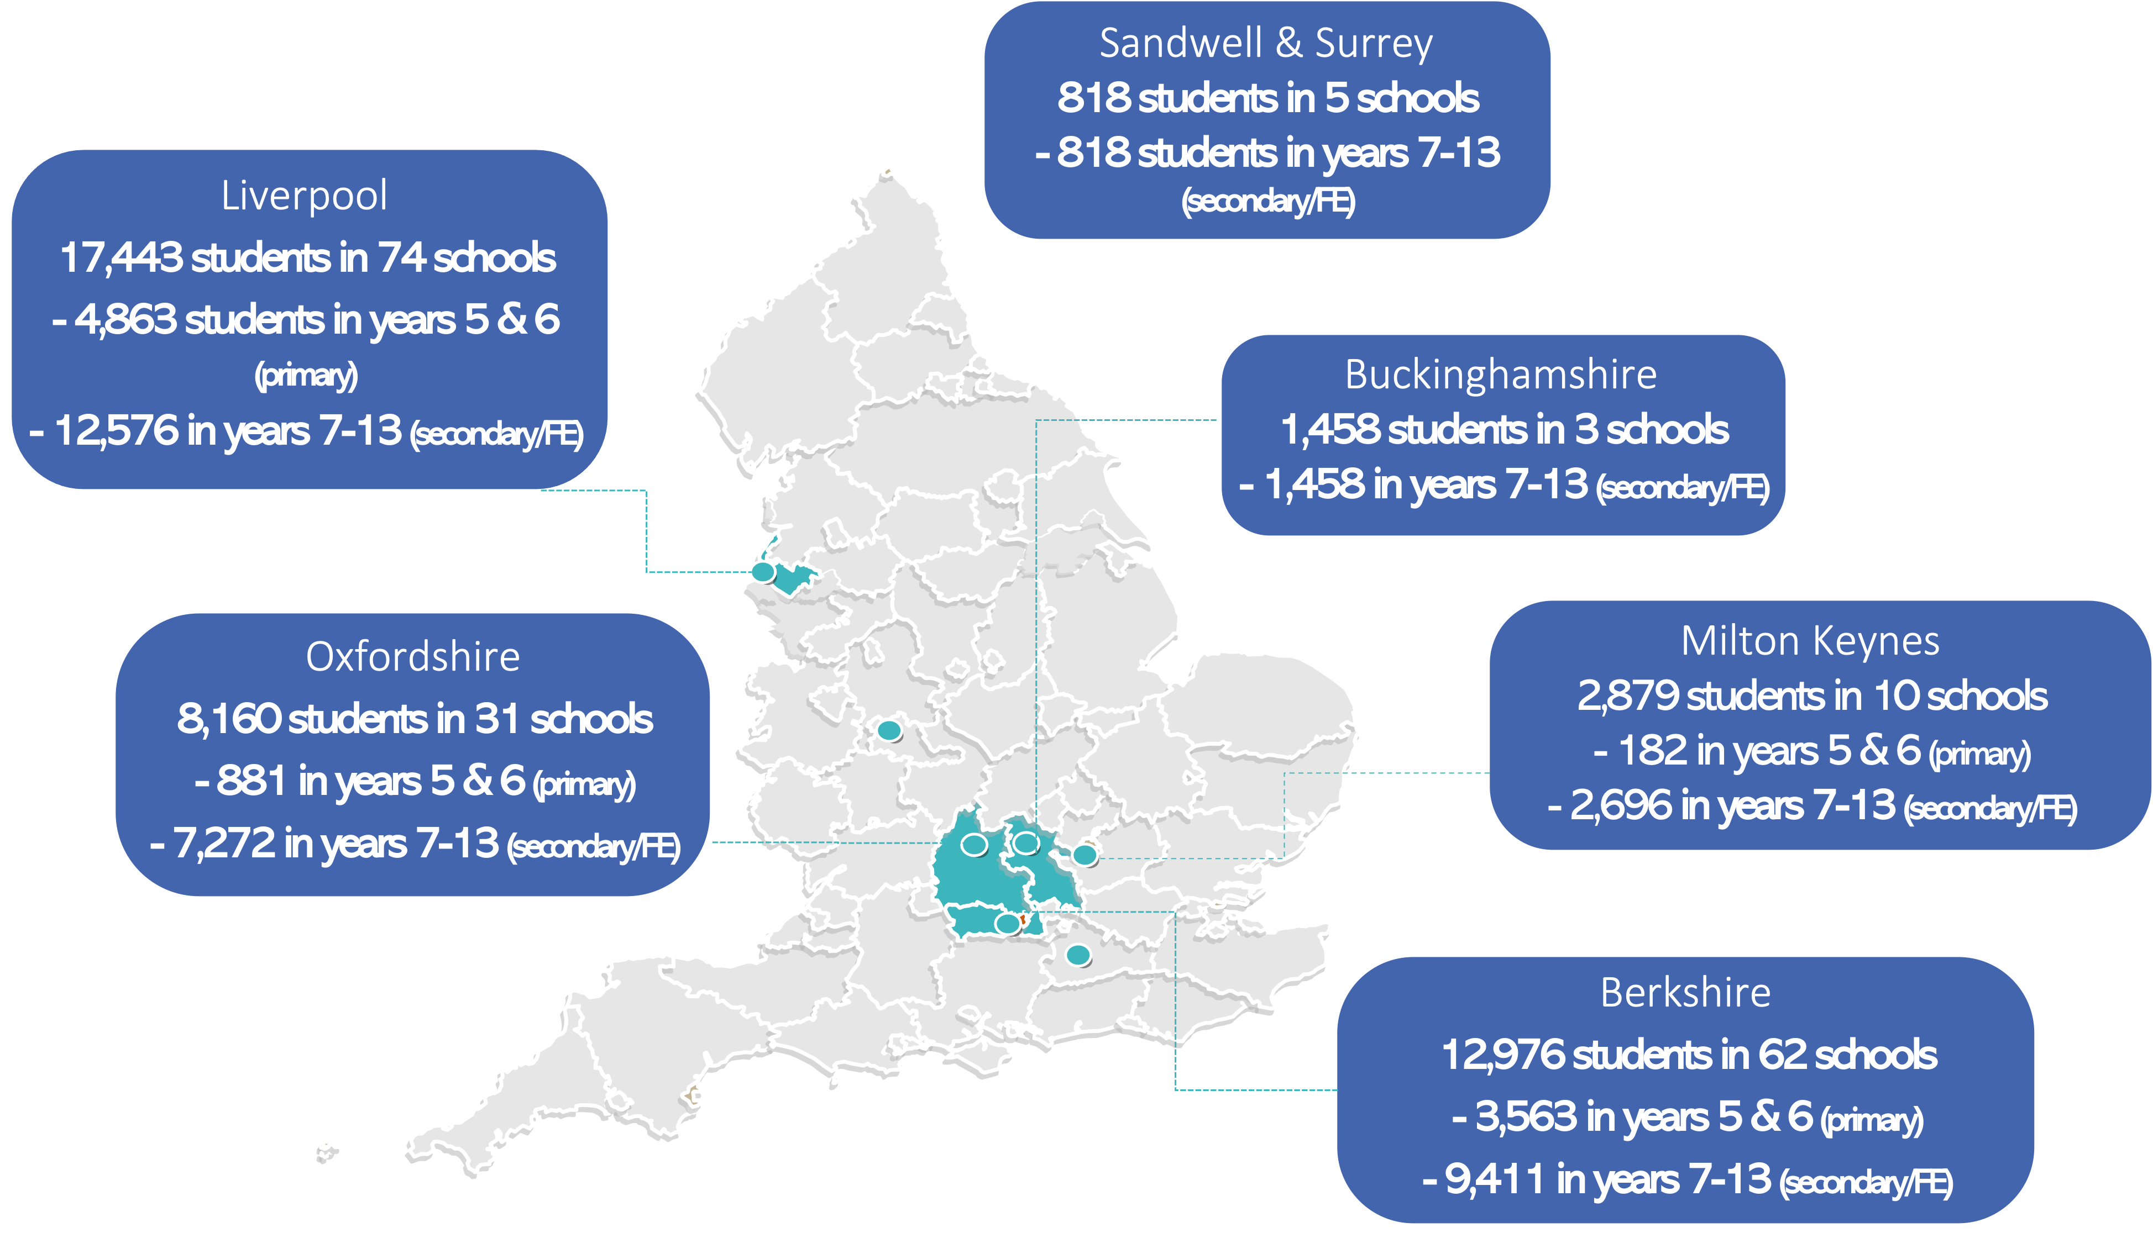

Slide 6
Mental health- aged 11-16
25.1% said they had had a mental health problem in the last 12 months

Slide 7
Age of first self harm

Slide 8


National
data
ICB level data
Place level data
School level data
Accessing the data
Interpreting (and understanding) the data
Responding to the data

Slide 9
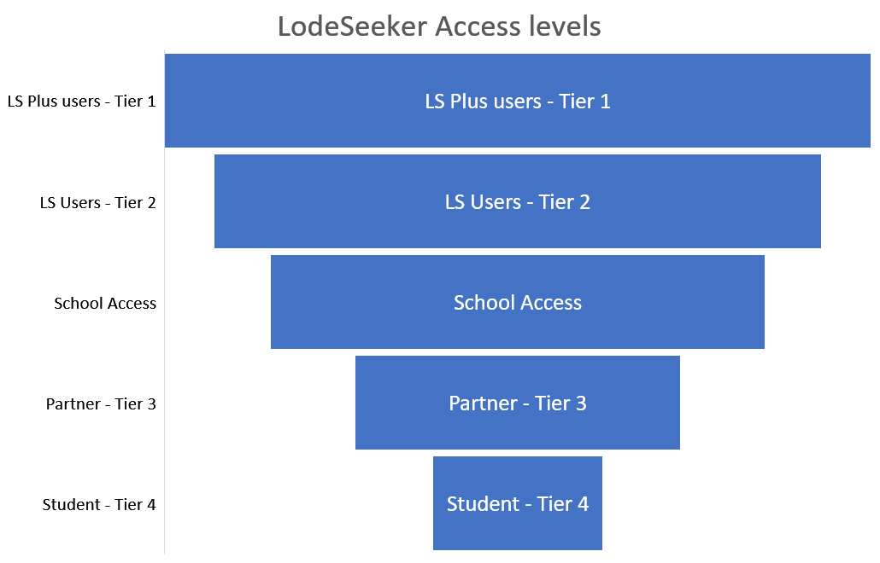
Can see & compare LA’s schools' data directly & run schools reports
No individual schools can see LA’s school types variable e.g. urban/rural etc
Can see own school’s data and compare to LA averages
No schools but can see LA averages
OxWell averages
Number of filters and
reports available

Slide 10
School level data
 | Who | When
Extended summary report | Senior Lead for MH | By end of May Sent
LodeSeeker webinar | Data Analysts | 13 June
LodeSeeker log in and guide | Data Analysts | w/c 19 June
Feedback questionnaire | Senior lead for MH | w/c 26 June
National Insights webinar | All | 6 July
Resource pack | Senior Lead for MH Partners | Sept

Slide 11
Area level data
 | Who | When
Full area report | Commissioners | 8/9 June
Lodseeker webinar | Commissioners | 8 June
Access level template to be completed | Commissioners | 16 June
Slide pack for reports | Commissioners | 16 June
One to one check ins (online) | Commissioners | 23 June
National insights session | Commissioners | 6 July

Slide 12
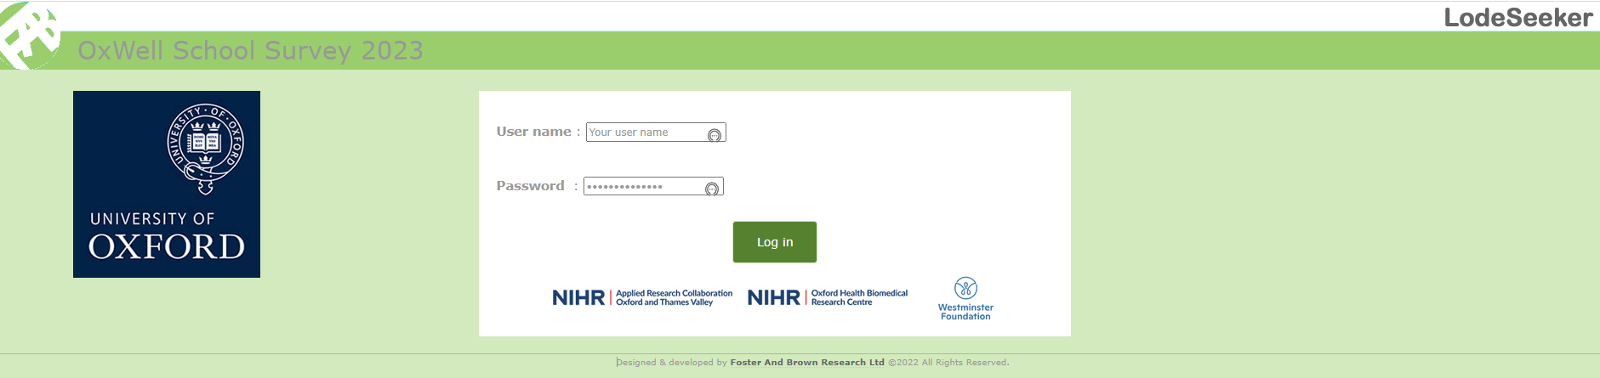
LodeSeeker – accessing and interrogating your data
https://oxwell2023ls.fabsurveys.co.uk

Slide 13
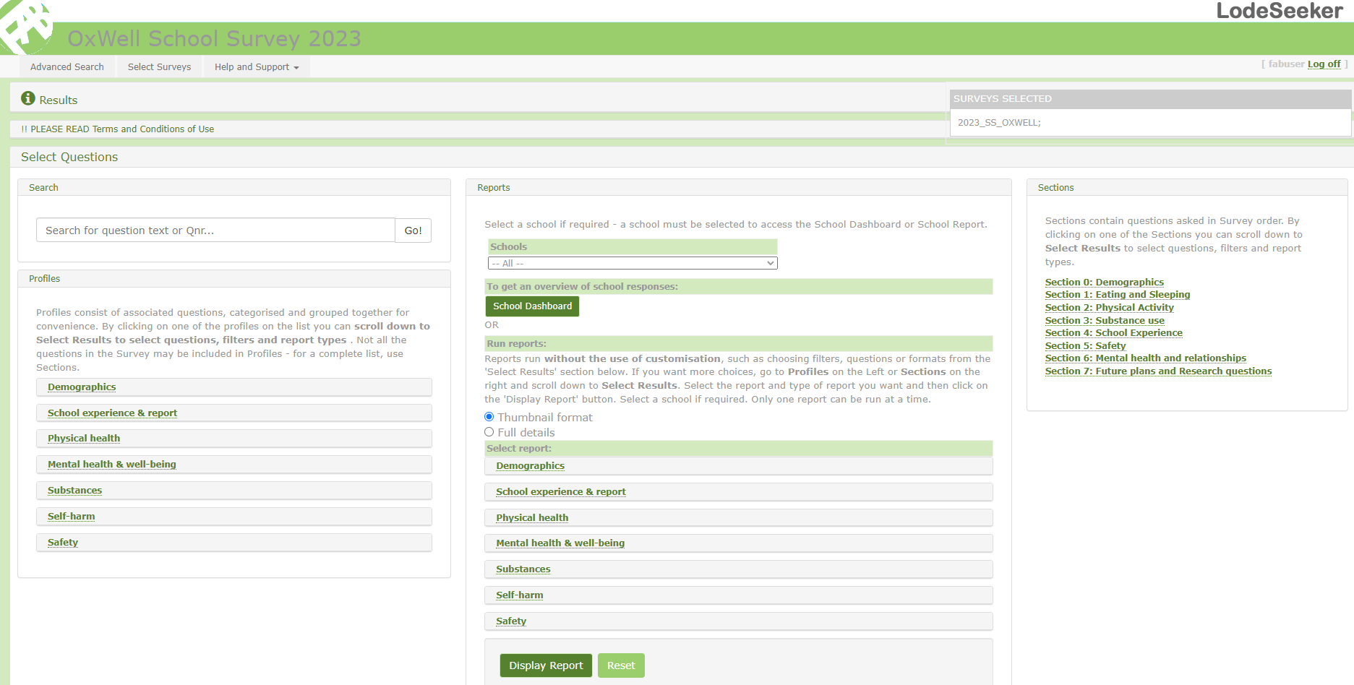
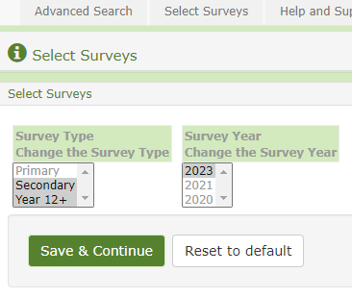

Slide 14


Selecting phases
Use mouse or Ctrl + click

Slide 15
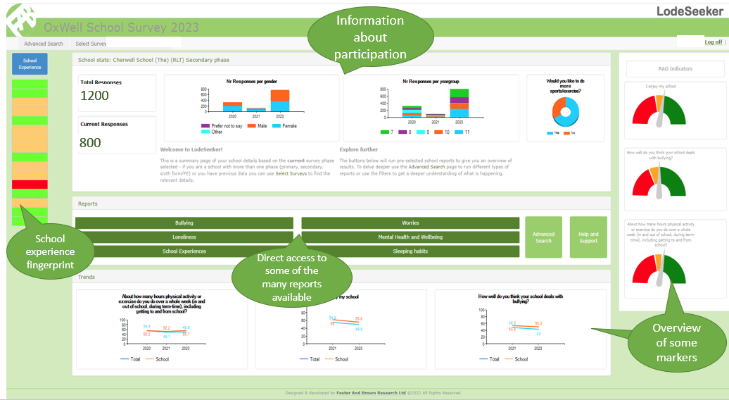
Schools landing page

Slide 16
Local Authority, Researchers and Partners Landing Page
Profiles Reports Sections

Slide 17
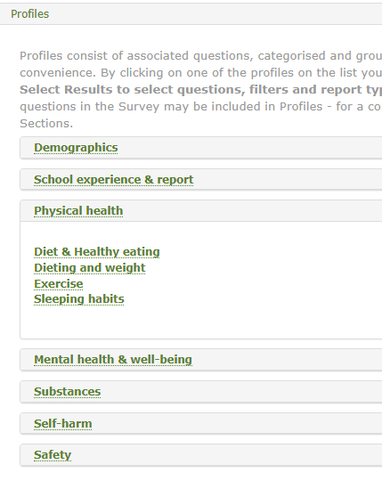
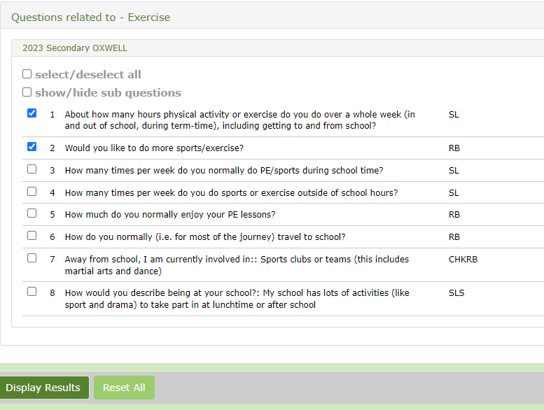
Example of running a question on LodeSeeker
1. Choose a section or a profile and click to see drop-down menu
2. The question list will appear – select which question(s)
3. Click on the green Display Results tile to run.

Slide 18

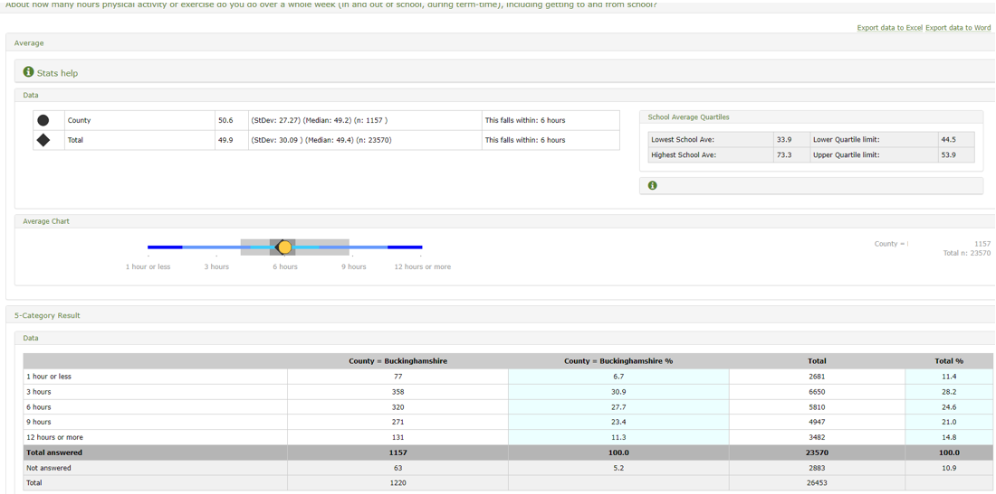


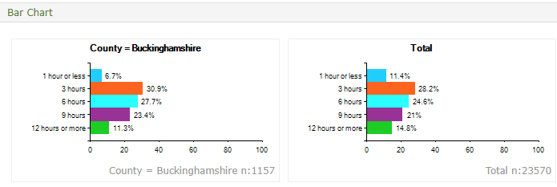
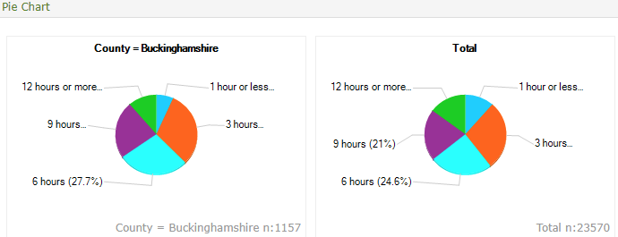
Results output

Slide 19
Running a school report
Reports

Slide 20
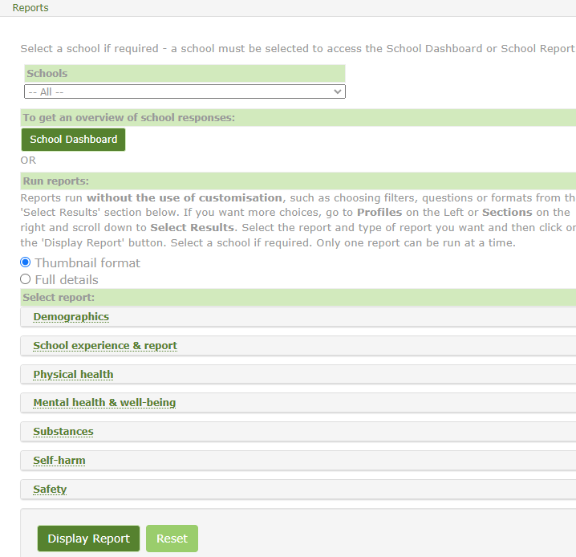
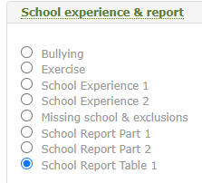
Running a School Report
1. Make sure the school’s name is selected from the pull-down menu in the box.
The other option is “ALL” this is the average of all the OxWell data in your phase.
2. Pick the default Thumbnail option to start with. This will give you a 2 or 3 page “at a glance” summary report very quickly. The full details report has at least 2 pages per question, can easily run to 40-50 pages and take much longer to run.
3. Click on the main heading or theme that you are interested in (e.g. School experience and Report)
Click in the blue circle of your chosen report in the sub-menu (note, you can only run one report at a time).
4. Click on the dark green Display Report button at the bottom

Slide 21
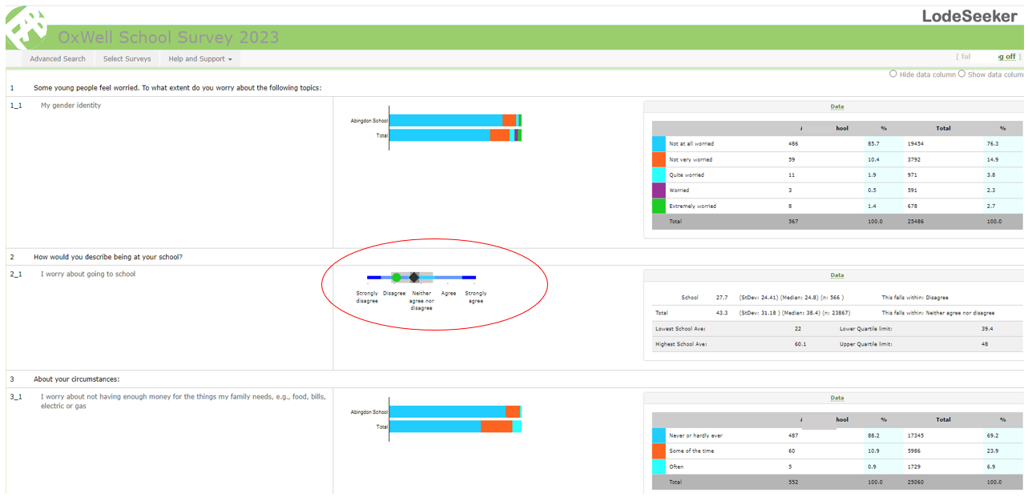
An example output from a Thumbnail report

Slide 22
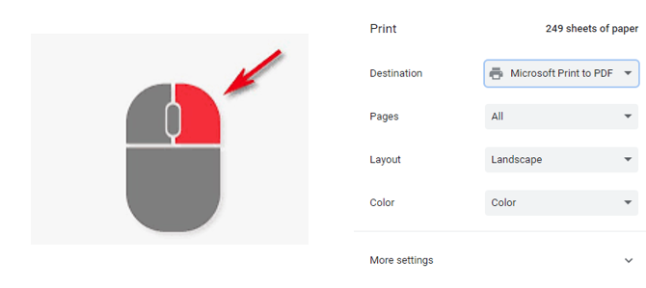
Saving and Printing Lodeseeker reports
Right click your mouse anywhere in the results section and you will see a drop-down menu with a Print option.
Click on this and choose Microsoft Print to pdf and save it to your desktop or you can send to your local printer

Slide 23
Filtering and cross tabbing the data - Going into more depth

Slide 24
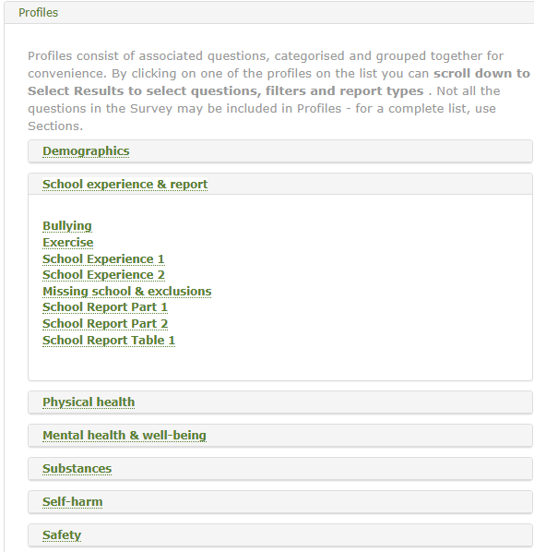
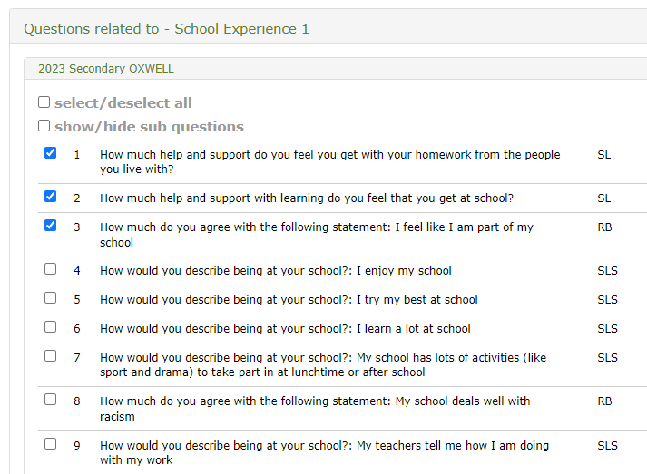
Exploring your data further – Profiles (this also applies to Sections)

Slide 25
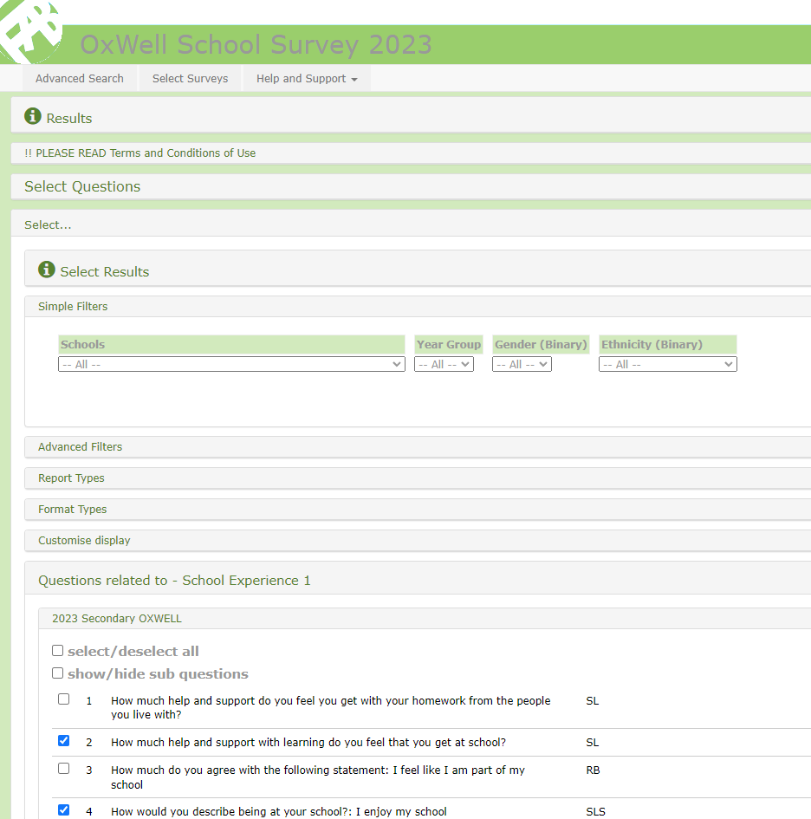
Filtering (cross-tabbing)
Once you have chosen your question(s), if you look above the question list there are five sub-menus:
Simple Filters – a quick filter for year group, biological sex & binary ethnicity
Advanced Filters – to filter (cross tab your data), not to be used in conjunction with simple filters
Report types – with quick compare buttons (compare all) and various school & RAG reports
Format types – format report – e.g. thumbnail, data only
Customise Display – to bespoke the content of the data shown in your reports.

Slide 26
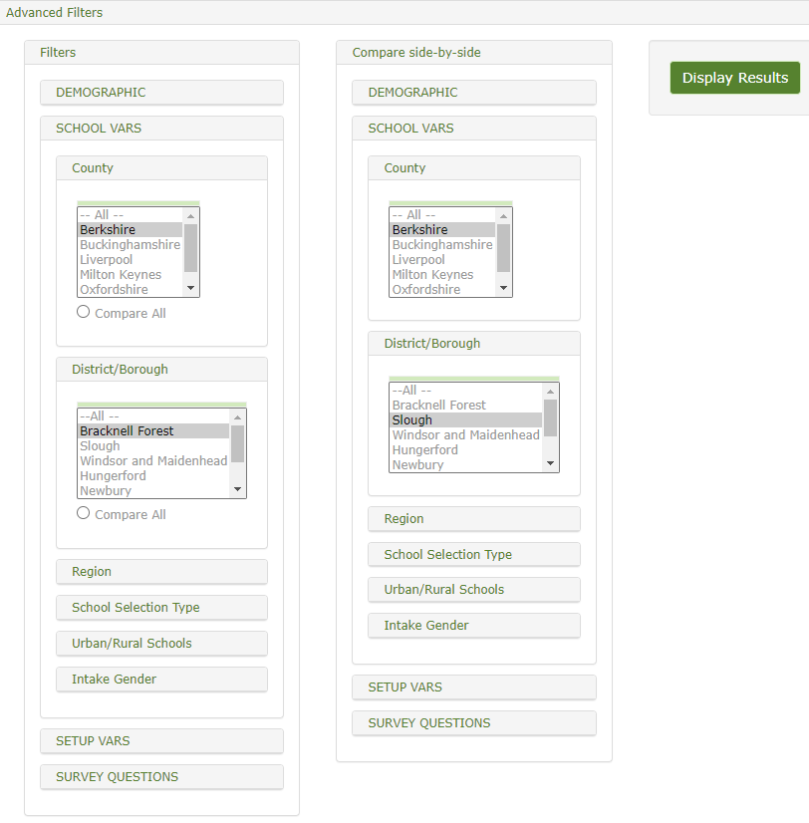
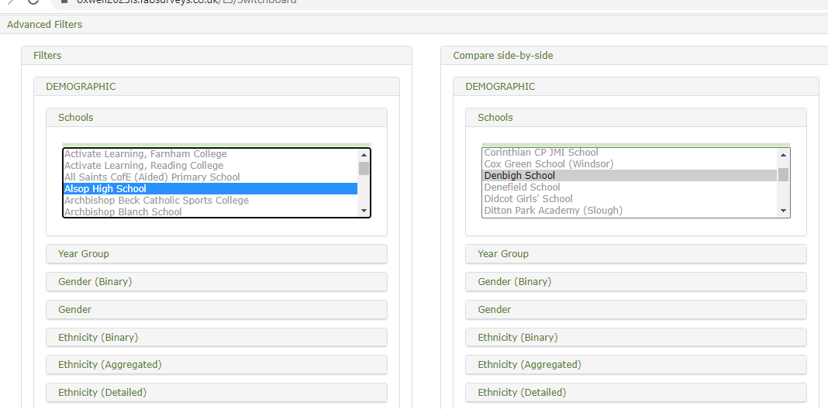
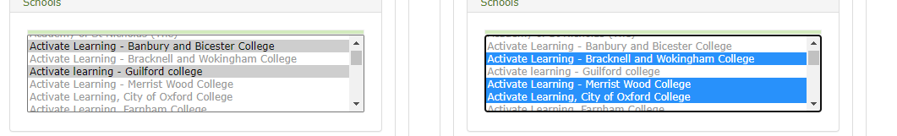
Advanced filters
Open your Advanced filters menu and you have a range of submenus as shown below. Point and click on any or all of these and you can filter your results.
If you want to compare groups (e.g. one area against another) you can use the compare column to the right.
Schools or groups of selected schools can be compared
Use Ctrl & click on each school to select groups of schools

Slide 27
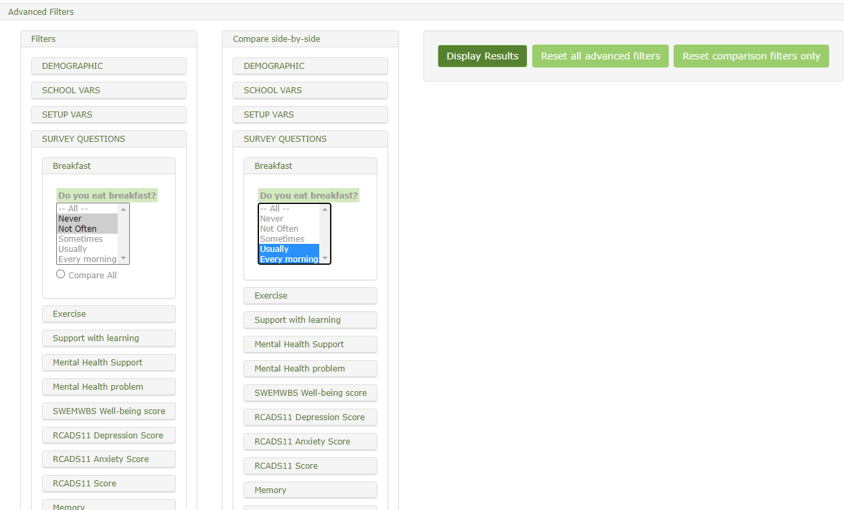

Advanced filters
As well as demographic filters there are useful ones such as Region where you can compare your school’s results with the
averages of those in your County, Region, School selection type (you can compare with non-selective or selective or independent schools for example).
There are also some behavioural questions to cross tab, for example, mental health filters, exercise, support with learning.
You can mix and match these filters but be aware this significantly reduces the data and data will be suppressed if fewer than five pupils are in a data set.
Tip: Once you have run your data remember to RESET your filters or they will stay there for your session while you are logged on in LodeSeeker.

Slide 28
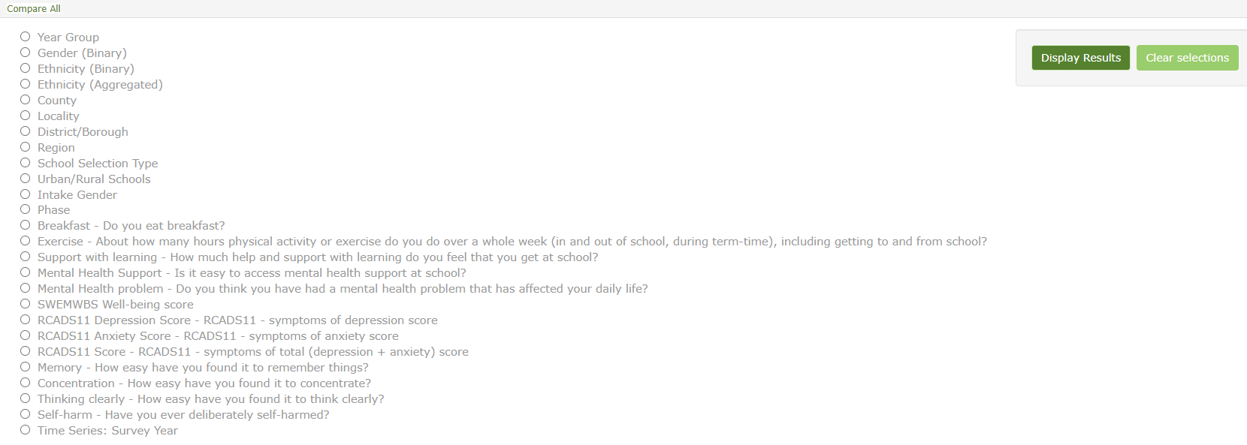
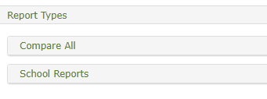
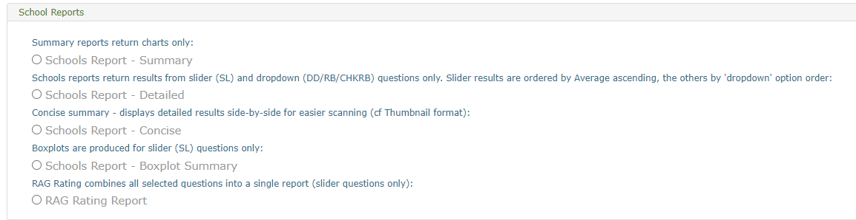
Reports types
There are two submenus here,
Compare All – a quick way to filter data
School Reports – access to useful RAG rating reports
There are up to 5 report types available

Slide 29
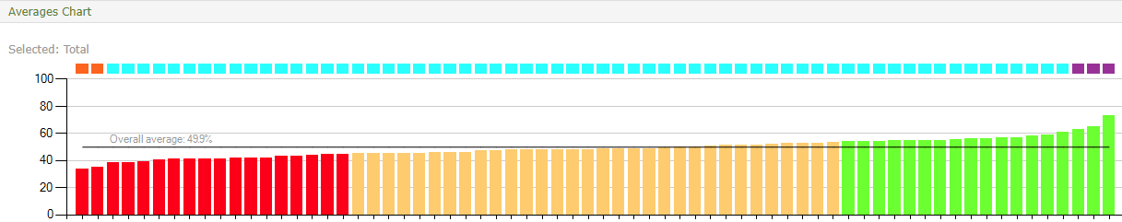
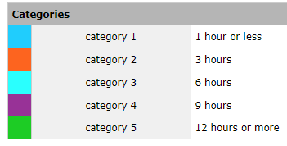
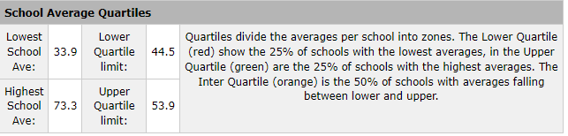
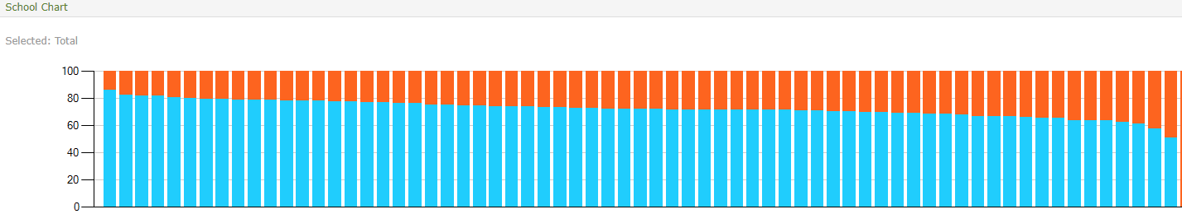
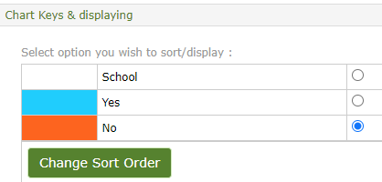
Schools Report - Summary
Visual comparison
Continuous (slider scale – SL, SLS) question
Schools
Categorical question (check boxed, radio buttons etc)
Schools

Slide 30
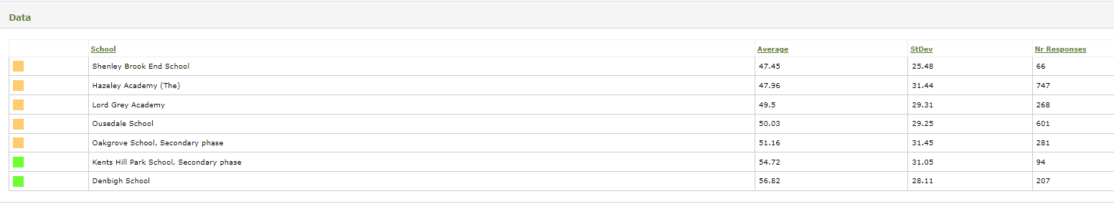
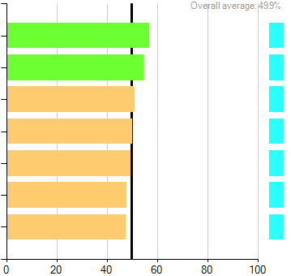
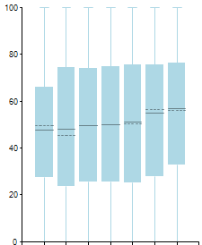
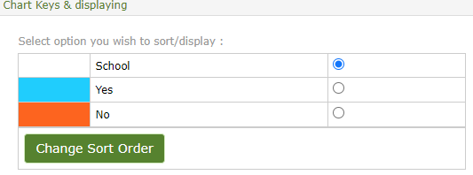
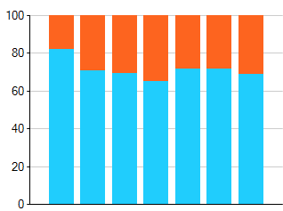
Schools Report - Detailed
 | Yes | No | Total | Not answered | Total selected
name 1 | 176 | 38 | 214 | 5 | 219
% | 82.2 | 17.8 |  | 2.3
name 2 | 556 | 229 | 785 | 40 | 825
% | 70.8 | 29.2 |  | 5.1
name 3 | 68 | 30 | 98 | 3 | 101
% | 69.4 | 30.6 |  | 3.1
name 4 | 184 | 98 | 282 | 22 | 304
% | 65.2 | 34.8 |  | 7.8
Schools

Slide 31
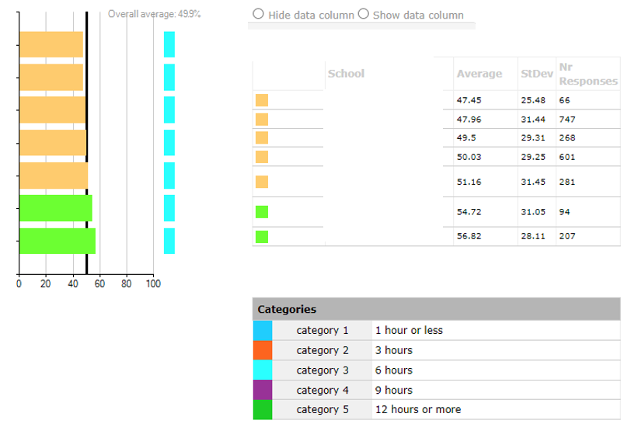
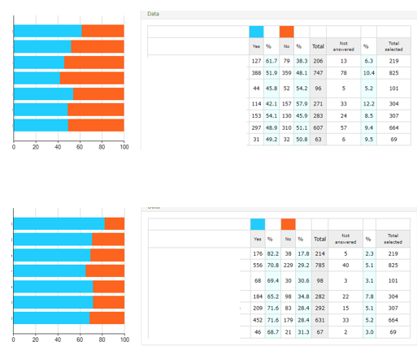

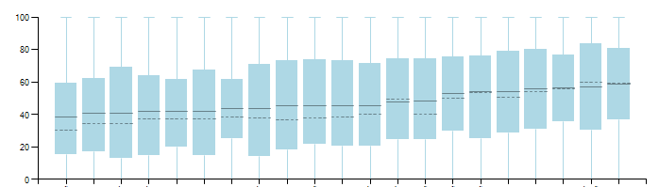
Schools Report - Concise

Slide 32
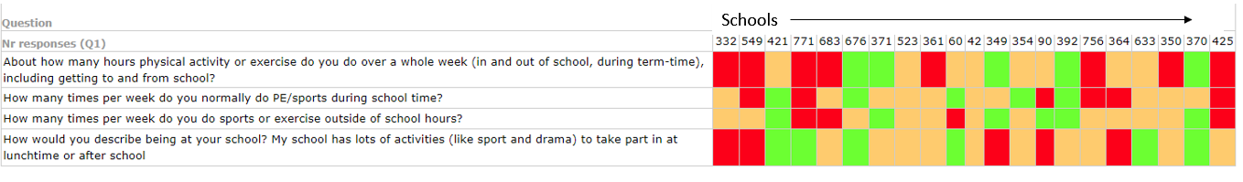
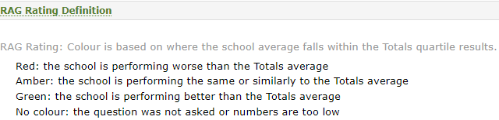

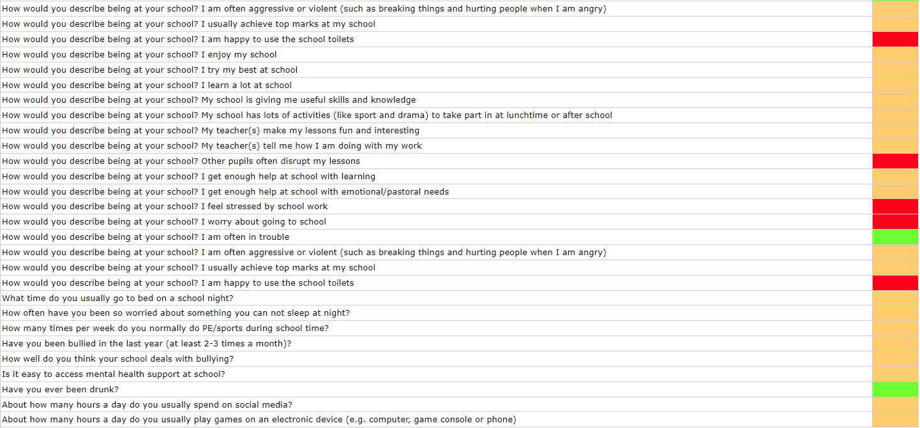
RAG – Rating Reports
If you choose to compare filters side-by-side, they will both be compared to the Totals average and listed separately (eg girls v. Totals, boys v. Totals) - they will not be compared to each other (e.g. girls v. boys)
Schools have access to the RAG rating where they can run a RAG
on a series of questions for their own school’s data.

Slide 33
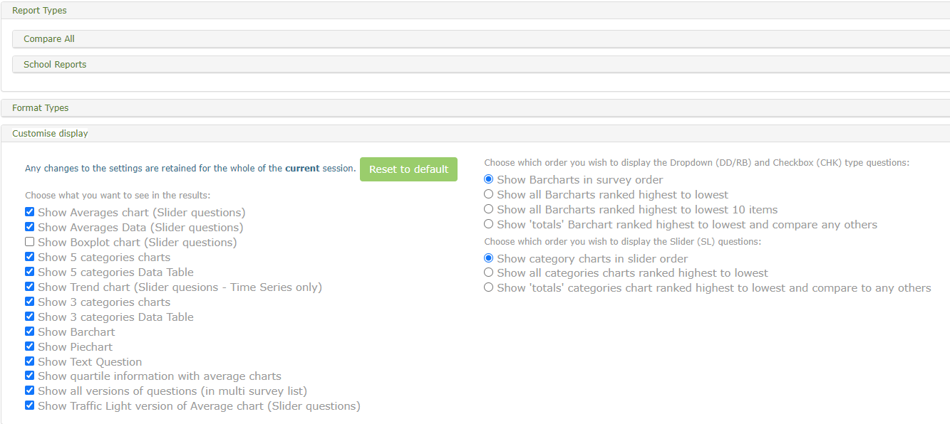
Customising your display and reports
Open the Customise Display menu to see your options. For example, you may not need pie charts or 5 category data tables so can turn them off or change the order of ranking.

Slide 34
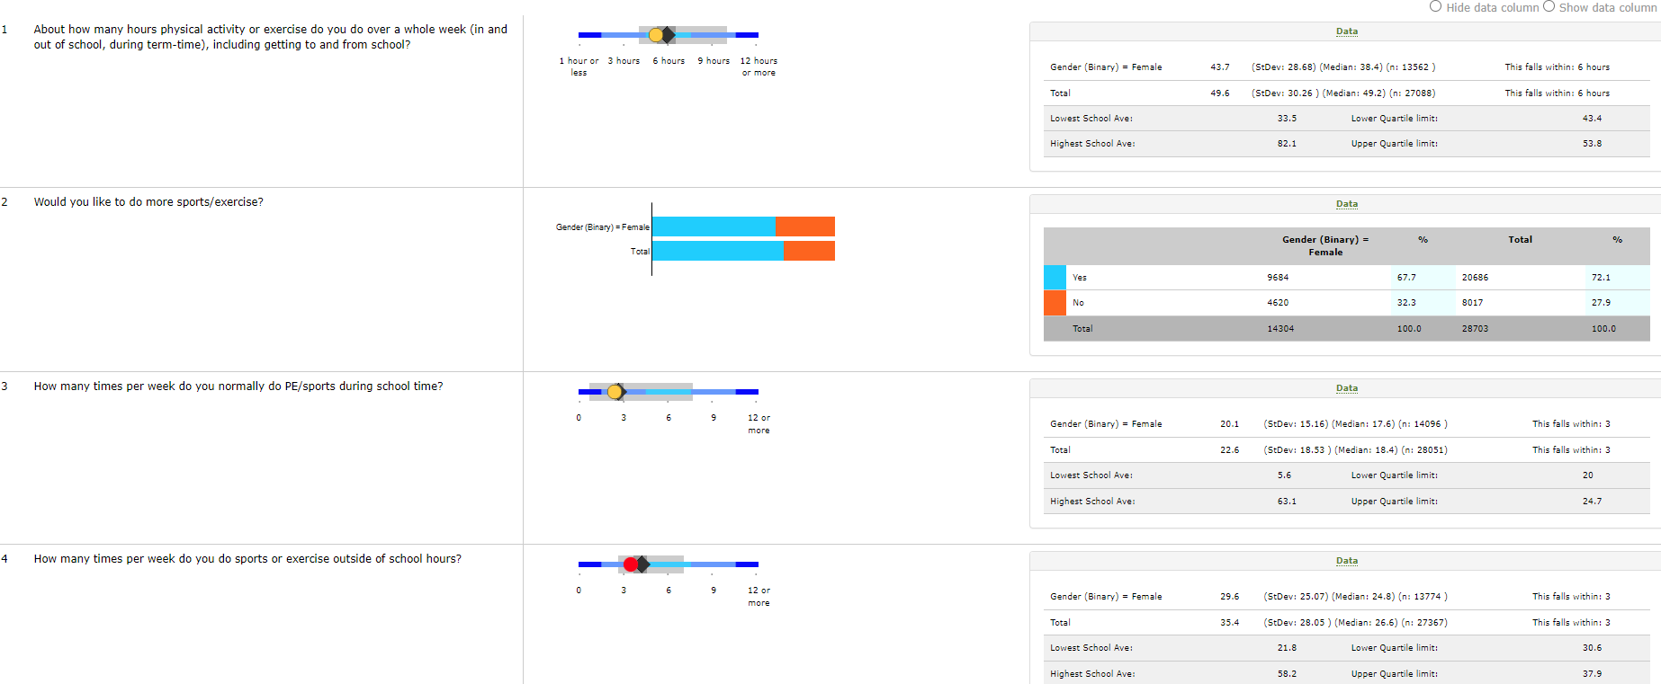
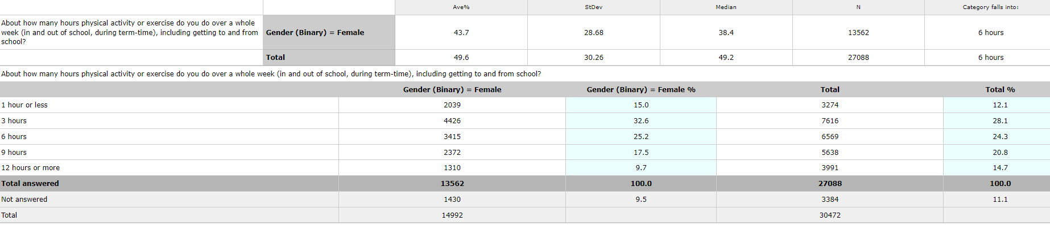
Format Types
You can now choose the formant you want the data to be in:
Thumbnail charts (like the reports section but you can generate them using the filters)
Data only that you can download into an excel sheet & a final option of this data in a vertical format

Slide 35
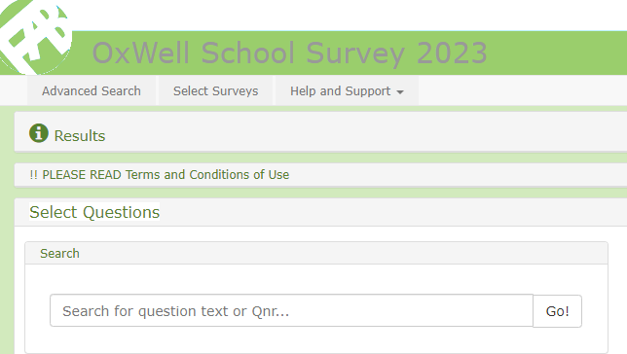

Search box
At the top, above the Profiles section is a Search box to retrieve question quickly.
Simply type in a key word or part of a word to retrieve questions containing that word – e.g. “bull” will retrieve all the questions with bully, bullied or bullying in them.
Further help and advice
Timed out
There are green i’s (i for information) throughout the website.
Click on these for more practical information and tips.
Please note that LodeSeeker has a time out set so you may find yourself logged out if you have not pressed anything for about 20 minutes. This is a security device as your data are sensitive. If this happens the login page will appear again and simply log back in.

Slide 36

National Insights Webinar
Thurs 6 July
4.00-5.00pm
Click here to book

Slide 37





Stay in touch
@oxwell_study
Click here
https://oxwell.org
Click here
oxwell@psych.ox.ac.uk

Slide 38
Thank you!
If you have any problems or questions please contact paule@fabresearch.com (for any technical queries or problems) or please contact the OxWell Research team at the University of Oxford oxwell@psych.ox.ac.uk for any data queries.

