Slide 1
Home Start Slough – Healthy weight family pilot
NEED SLOUGH BOROUGH COUNCIL PRESENTATION TEMPLATE
Fiona Harris – Deputy Director of Public Health

Slide 2
Slough NCMP 2021/22
RECEPTION (4 - 5yrs)
 | % Underweight | % Healthy weight | % Overweight | % Obesity | % Severe Obesity
Slough | 3% | 77% | 10% | 11% | 4%
South East | 1% | 79% | 12% | 9% | 2%
England | 1% | 77% | 13% | 10% | 3%
YEAR 6 (10-11yrs)
Slough | 3% | 53% | 15% | **29% | 8%
South East | 2% | 65% | 14% | 20% | 4%
England | 2% | 60% | 14% | 23% | 6%
*rounded up
** increase from 2019/20,
National Child Measurement Programme – taken in Reception and Year 6
Slough are currently above the national and local average for children starting school underweight.
Unfortunately, in Slough nearly triple the number of children identified as obese in Reception, remained obese in Year 6

Slide 3
Obesity rates in Slough
Of every 100 4-5 year olds in Slough, 11 are obese (10.8%)
Of every 100 10-11 year olds in Slough , 28 are obese (28.4%)

Slide 4
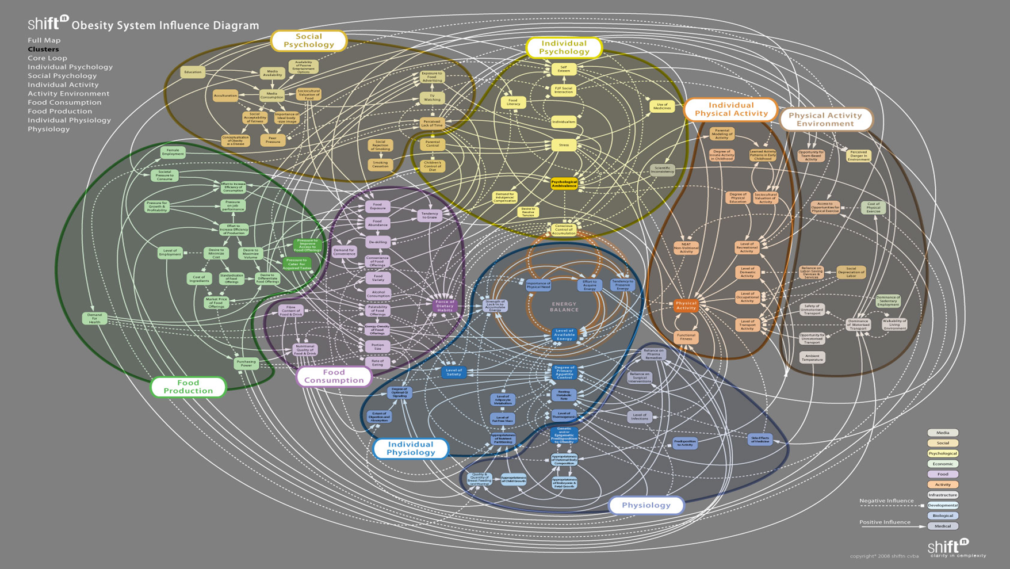
Childhood Obesity – A Complex System

Slide 5
Current child weight management service
Great engagement with children and young people (over 200 CYP each quarter), only a small percentage of these are identified as being overweight or obese
Over the last financial year – less than 4% of those engaging with the child weight management service identify as being overweight or obese.
Current child weight management service (5-16 year olds) in Slough. The current service provision is being reviewed to explore the impact, cost-effectiveness, and suitability for families in Slough.

Slide 6
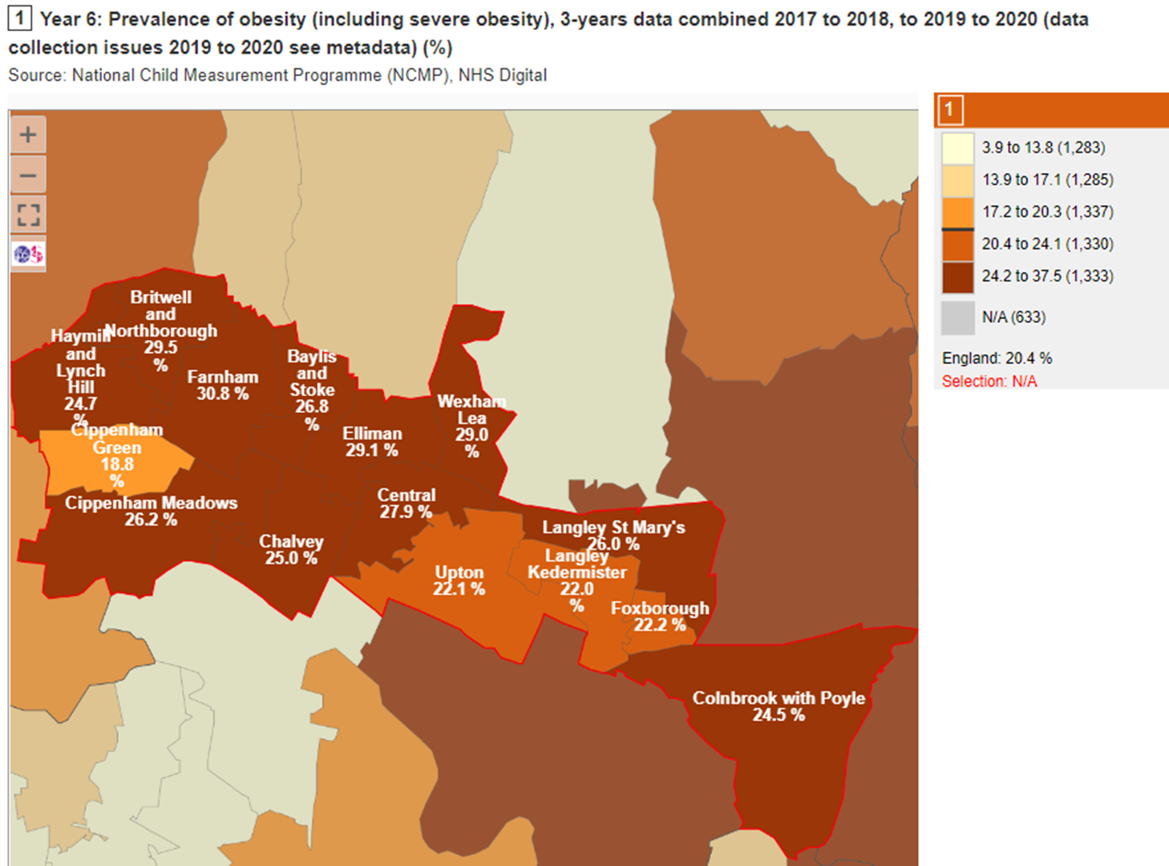
Service provisions for improving healthy weight in children should be aimed at : 1) Parents and children under 5 years old :- Britwell and Northborough (15.6%), Elliman (15.4%), and Foxborough (15.2%) 2) School aged children (under 11 years old) :- Farnham (30%), Britwell and Northborough (29%), Elliman (29.1%) and Wrexham (29%)

Slide 7
HomeStart - Healthy Family pilot
Aim
Provide a targeted strength-based approach 12-week home-visiting service to support healthy weight.
Model
A home-visiting service will be provided to families (with children under 5) in our most deprived wards, once a week for 12 weeks.
Trained volunteers will provide practical support in parenting skills, family lifestyle habits and emotional wellbeing.
Target 40 of our most vulnerable families – provide whole family approach.
Referral process
Families will be referred into service by Health Visiting, School Nursing, GP’s, Early Help etc.
On exit from the pilot, families will be referred to CWM programme (age dependant) and wider Active Slough offer.

Slide 8
Overview of Home Start Metrics and deliverables
Ward | Number of families supported from Britwell and Northborough |  | Outcomes | No. families reporting increased knowledge of healthy lifestyle
 | Number of families supported from Elliman |  |  | No. families reporting increased knowledge of wellbeing
 | Number of families supported from Foxborough |  |  | No. families reporting increased ability to manage child's physical health
 | Number of families supported (all) |  |  | No. families reporting increased ability to manage child's mental health
 |  |  |  | No. families reporting increased ability to manage parents physical health
Issues raised | Physical Activity |  |  | No. families reporting increased ability to manage parents mental health
 | Nutrition and healthy eating
 | Overcrowding |  | Referrals | Number of referrals to partners
 | Cooking skills |  |  | List referral partners
 | Financial / debt problems
 | Family/network support |  |  | Referrals received from partners
 | Mental health |  |  | List referral partners
 | Domestic abuse

