Slide 1
School Information Sharing Session March 2024
Children’s Services (Education)
Neil Hoskinson

Slide 2
Agenda 5th March 2024
Welcome from Cllr Bedi
Serious Violence Action Plan (Rebecca Curley)
School Intel Sharing Sessions (Donna Briggs)
Safeguarding Pressures in Schools (Simon Tattersall)
Slough Skills Plan (Sally-Anne Bone)
CME Update (Sabi Hothi)
SEND Update – March WSoA Monitoring Visit (Neil Hoskinson)
Inclusion Update (Sam Caley)
Other Updates
HAF Easter Programme
Virtual School CPD for DTs and DSLs
Metropolitan Police – Vapes Containing Illegal Drugs
Ofsted “Big Listen” Roadshows
Audits Actions in Schools
SACRE Agreed Syllabus Conference, Wednesday, 6th March, 2024, 5.30 pm
Young Traders Market

Slide 3
Welcome
Cllr Bedi

Slide 4
Serious Violence Action Plan
Rebecca Curley

Slide 5
Intel Sharing – Donna Briggs
Intel Sharing Sessions for Schools
It is clear that schools want something more specific about information sharing. Donna Briggs has followed up with those who attended and already has a secondary and a primary volunteer to meet to plan what is needed.
Therefore, we are planning intel sharing sessions and looking at how to remove the barriers that make this difficult. Donna is hoping to have an initial planning meeting before Easter.
SEPB / Partnership Working with Thames Valley Police re robberies and under reporting.
S.A.F.E Survey for Young People.
Safeguarding Practice Review.
New Intel sharing form from TVP.

Slide 6
Notes for SEPB Meeting – Simon Tattersall
School Safeguarding Pressures
Community Issues Breaching the School Gates – mobile phone use / community incidents
Case Load - spike in safeguarding cases / age profile lowering
Case Management - turnover of social workers / step-down V step-up
Parental Engagement – engagement with services / feuding families
Contextual Safeguarding - selling of ‘vapes’ to children / anti-social behaviour
Opportunities / Areas to Consider
Networking and Mapping – more opportunities to map key links / complex strategy meetings
Schools Safeguarding Curriculum - universal offer / ‘Slough Schools Safeguarding Charter’.
Outside of the School Gate - schools rightly at the centre of keeping children safe 8am – 4pm / how are we keeping students safe 4pm – 8am?
Final Thought - are the strategic plans delivering on an operational level that has impact on young people and families in Slough?

Slide 7
Safeguarding Lead

Slide 8
Slough Skills Plan - Sally-Anne Bone

Slide 9
CME Update
CME Update
Sabi Hothi

Slide 10
SEND Update
It’s 12 months since the meeting that led to a Statutory Direction being issued to SBC.
Partnership Board data dashboard now being used as a regional good practice.
EP assessment backlog removed and backlog for EHC plans beginning to reduce slowly.
Case tracking and panel processes improved / Work is ongoing to track Reception pupils with SEND.
Inclusion Conference / Ordinarily Available Provision document produced with SENDCos.
Reduction in waiting times for therapies maintained, dysphagia service established.
New Designated Clinical Officer and Designated Medical Officer for SEND in post now.
Therapy wait times remain less than 52 weeks, 6 week compliance rates are 81% across services.
East Berkshire Integrated Therapies Transformation progressing through procurement process.
Learning Disability / CAMHS Service launched. CYP Mental Health Primary Care Pilot underway.
Risk due to need to recruit new SEND Officers but opportunity to improve service overall.
Recognising that there are still too many complaints (particularly about communication) the SEND service is now receiving regular positive feedback from families and schools.
Important to acknowledge improvement, recognizing it is from a low base.

Slide 11
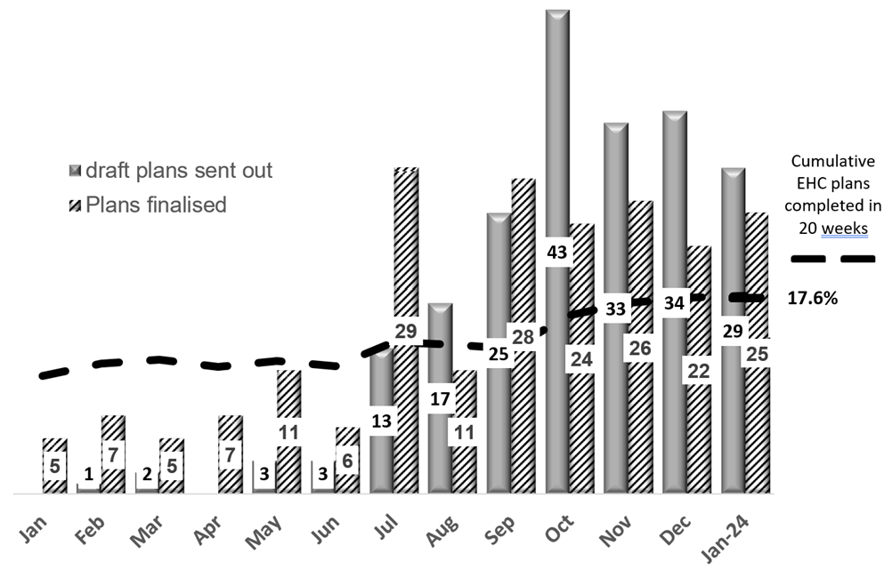
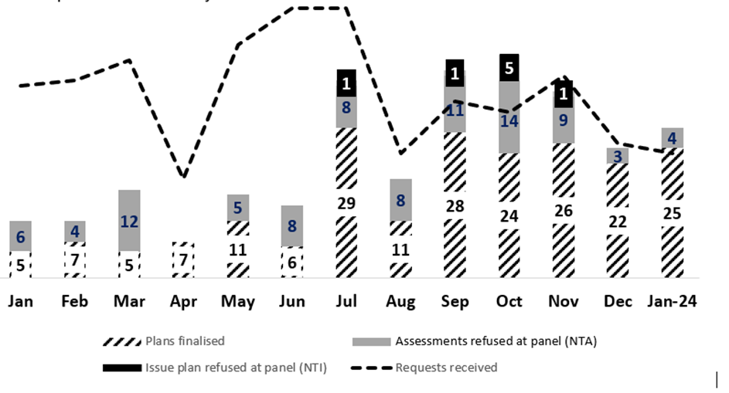
SEND Performance

Slide 12
Next Steps
Current staff turbulence presents an opportunity to build a stronger, hybrid team. Reasons for resignations include higher scrutiny via case tracking, uncertainty about a permanent structure and career opportunities elsewhere. Hybrid working requirements also play a role for some.
During the stabilisation period, the team has focused on two key objectives: the main 20-week ECHNA process and Transition reviews. This successful approach will be formalised into two work streams, Assessments and Annual Reviews, each led by a team manager with increased KPIs.
The 20-week process productivity now matches incoming requests but hasn't addressed the backlog, resulting in a lack of support for pupils, as well as potential complaints and tribunals. 20-week compliance between September 23 and January 24 was 24% (64% if backlog cases are excluded).
Multi-Agency Audits are being carried out in April 24 using support from the LGA including their toolkit. The SBC Quality Assurance Framework will then be launched.
Clarifying admin officers' roles in Capita input and maintenance within refreshed operating procedures will free case officers' time for casework and enhance stakeholder communication. A Communications Strategy will build on this work.

Slide 13
Inclusion – Key Achievements Sam Caley
January Conference and Capacity and Risk Evaluations evidence greater focus on inclusion in mainstream and the impact of the Inclusion Team. Schools developing new approaches to supporting SEND pupils.
“Very strong acknowledgement that LA processes have improved, this is caveated by ……. the low bar this is being judged against.”
Joint work between the Inclusion Team, SENDCos and Health / Early Years partners has supported the embedding of the Graduated Approach and co-producing an Ordinarily Available Provision [OAP] document which will further support mainstream inclusive practices.
Bespoke training including Autism Education Training [AET] delivered across the schools. Details of health courses and services now being circulated and work of Sensory Service shared with SENDCo Network.
Next Steps
SEND Code of Practice “Chapter by Chapter” for SENDCo’s to be co-produced.
Signing off Slough Transition offer and transition paperwork / Year 5 Transition Roadshow.
Training modules for Teaching Assistants and on identifying SEND with pupils who are EAL.
AET training to be delivered to travel passenger assistants.

Slide 14
Current SEND Team
Team Managers:
1. Natalie Hunt (interim)
2. Justin Brierley (interim)
SEND Officers:
Joanna Adams (Interim)
Pavan Ram (Permanent)
Abdirahman Osman (Permanent)
Indira Jayawardena (Permanent)
Nadia Masoodi (Permanent)
Sarah Telford (permanent)
Vacant (interim recruitment imminent)
Vacant (interim recruitment imminent)
Vacant (interim recruitment imminent)
Assistant SEND Officers:
Cathy Jones (permanent)
Sharmeen Shaikh (interim)
David Phillips (interim)
Satty Kenth (interim)
Business Support Officers:
Kaia Hunt (interim)
Holly Cullen (interim)
Pinda Bhuller (permanent)

Slide 15
HAF Funding Easter Holidays – Clare Thompson

Slide 16
Virtual School CPD for DTs and DSLs – Cherie Sears

Slide 17
Metropolitan Police – Vapes Containing Illegal Drugs
The Metropolitan Police reported that five young people aged 14-16 years were hospitalised with serious health harms having used vapes which toxicology results have confirmed to contain Spice. They also reported 2 young people experienced health harms having used vapes containing cannabis. We do not know how wide the issue of vapes containing illegal drugs is, and whether the young people involved planned to buy illegal drugs.
In the latest incident, the vape was a blue and purple coloured rechargeable metal vape device labelled ‘Vaporesso’, which held blue liquid residues within a clear plastic chamber of a silver and black cartridge.
If you have any reports of similar incidents in your area, please let SBC know
You may wish to share this information with partners to warn them about the risks of potential contaminated vapes and the related health harms and elicit from partners if they have any further information on similar incidents.
Free high quality information on Spice Vapes is available from Drug Science - https://www.drugscience.org.uk/teaching-children-about-vaping/ and
In addition to the free resources above, there is a free online parent, carer and teacher drug awareness session is online each Wednesday at 7:30pm – Please circulate the link to all parent, school and teacher networks. –

Slide 18
Other Key Information
“Slough BID and the Queensmere Observatory Shopping Centre are delighted to announce we will be holding a Young Trader Market in Slough town centre on 12th April 2024.
The event provides young entrepreneurs aged 16 – 30 with the opportunity to trade (free) from 10am to 5pm and take their businesses to the next step.
It is part of a national initiative run by the National Market Traders Federation and is in its 12th year. Each year the scheme attracts more and more young traders providing much needed opportunities for those who have set up businesses in arts & crafts, general retail, food and beverages and many more. Interested participants must be already trading, so not looking for a business opportunity but looking to grow their business, move from online to physical presence etc.

Slide 19
Headteacher and Senior Leader Roadshows
Series of free roadshows where Ofted will be speaking about and discussing the inspection process and facilitating a ‘Big Listen’ so that they can hear your views on Ofsted’s work.
14 March 10am to 1pm: Chichester High School, Kingsham Rd, Chichester PO19 8EB
14 March 9am to 12pm: Guildford County School, Farnham Rd, Guildford GU2 4LU
21 March 1pm to 4pm: St John the Baptist RC School, Elmbridge Lane, Woking, Surrey GU22 9AL
28 March 9am to 12pm: Uckfield College, Downsview Crescent, Uckfield, East Sussex TN22 3DJ
28 March 9am-12pm: Gosford Hill School, Oxford Road, Kidlington, Oxfordshire OX5 2NT
3 May 1:30pm to 4:30pm: The Kingsbrook School, Armstrongs Fields, Bierton, Aylesbury HP22 7BR
9 May 8:30am to 11:30am: St George’s CofE School, Meadow Rd, Northfleet, Gravesend DA11 7LS
10 May 9am to 12pm: Town Farm Primary, St Mary’s Cresent, Stanwell, Staines, Surrey TW19 7HU
6 June 8:30am to 11:30am: Cornerstone Primary, Bulebell Way, Whiteley, Fareham PO15 7QE
13 June 9am to 12pm: St Anselm’s Catholic School, Old Dover Road, Canterbury, Kent CT1 3EN
Please respond to CorrespondenceSouthEast@ofsted.gov.uk if you wish to reserve a place.

Slide 20
SACRE Agreed Syllabus Conference
Wednesday 6th March 5.30pm

Slide 21
Audit Compliance in Schools

